Slide 1

Minnesota
Health Care Financing Task Force
Seamless Coverage and Market Stability Workgroup
This presentation will be posted when accessibility standards are completed. In the meantime,
if you require a copy of the presentation, please contact SManasse@manatt.com
Options and considerations for the marketplace as a platform for the coverage continuum
October 16, 2015
Prepared by

Slide 2
Agenda
Introduction
Marketplace Options for Further Consideration
    Stay the Course
    Partially Privatized SBM
    Supported SBM
    Federally-facilitated Marketplace
Discussion
Next Steps

Slide 3
Introduction

Slide 4
Task Force Vision and Goals
Vision: Sustainable, quality health care for all Minnesotans
Guiding Principles
Realistic: The task force will make recommendations that can realistically be implemented.
High Value Impact: The task force will seek recommendations that have high value and are meaningful to Minnesota’s health care reform efforts.
Holistic Perspective: The task force understands that health care finance and our recommendations do not exist in a vacuum, and are components of the health care and population health systems.
Focus: The task force recognizes that health care financing and system reform is extremely complex and it will contribute to the broader policy debates by focusing its time and attention on the issues it is charged with addressing.
Innovation: The task force is encouraged to identify opportunities for innovation in Minnesota’s health care financing and delivery systems which show promise for lowering costs, improving population health and improving the patient experience.

Slide 5
Marketplace Problem Statement
Poor initial IT project governance, though improved with creation of executive steering committee
Initial eligibility determination functionality gaps for all insurance affordability programs, with gaps remaining for case management
MNsure IT projects have diverted resources from other State IT priorities, including DHS
Launch challenges (and low tax credits) led consumers to purchase outside of the Marketplace in 2014 open enrollment
Lack of automated transactions for carrier enrollment (834s)
Notes:
t

Slide 6
Minnesota Marketplace Goals
Provide quality consumer experience
Reduce cost and streamline administration
  Ensure that Marketplace IT projects do not divert resources from other state IT priorities going forward
  Ensure full E&E functionality, including automated transactions between the Marketplace and carriers
  Ensure Marketplace IT costs are sustainable in the long-run
Ensure State flexibility for policy innovation
  Accommodate Minnesota’s unique coverage continuum
  Enable State to align Marketplace, public programs and other payers to achieve delivery system reform

Slide 7
Follow-up to 10/9 Discussion:
Proposed Models for Consideration
State Based Marketplace (SBM)
(“Stay the Course”)
Supported SBM
Partially Privatized SBM
Federally Facilitated Marketplace (FFM)

Slide 8
Follow-up to 10/9 Discussion:
Marketplace and IT Governance
Alternative SBM Governance
Marketplace Governance: Secondary issue pending Marketplace Model recommendation
IT Governance: Secondary issue pending Marketplace Model recommendation
Proposed IT Governance recommendation: Depending on Marketplace model recommendation, codify the current IT executive steering committee structure

Slide 9
Key Differentiators in
Proposed Models for Consideration
Depending on model, selected E&E functions may be retained by state, contracted to vendor, or outsourced to federal government
ELIGIBILITY & ENROLLMENT
MEDICAID
Supported SBM, FFM and Partially Privatized SBM will require coordinating Minnesota’s IT system with federal or new vendor IT
FINANCE
Financing varies by model: state has wide flexibility in SBM model, private vendors may offer PMPM financing, SSBM relies on portion of FFM user fee and FFM on the entire fee

Slide 10
Key Similarities in
Proposed Models for Consideration
GOVERNANCE
In all but FFM model, state can keep its current governance or convert to another allowable model
PLAN MANAGEMENT
In all but FFM model, state is responsible for plan management
CONSUMER ASSISTANCE
In all but FFM model, the state is responsible for consumer assistance

Slide 11
Marketplace Options for Further Consideration

Slide 12
“Stay the Course”
ELIGIBILITY & ENROLLMENT
State retains its current integrated IT solution
MEDICAID
State retains its current integrated IT solution
FINANCE
State responsible for financing all operations

Slide 13
DHS Modernization
Eligibility & Enrollment
Vision: Technology enhancements to support a people-centered integrated human services delivery system in which policy, people, processes and technologies are aligned to serve the DHS mission.
Modernization Initiatives | Timeline
Mnsure IT System: Single Portal for health care coverage, first step in modernizing health care eligibility systems. | "IT Build" ongoing 2015-2016 to achieve desired core system functionality. Transition to maintenance and operations mode starting 2017.
Integrated Services Delivery System (ISDS): Establishes an integrated, people-centered service delivery system; encompasses several major business processes: eligibility, assessment, enrollment and case management. | Estimated 5- to 7-year effort, culminating 2022. Integrates key systems including public program health care eligibility determinations, child support, SNAP (food stamps), public program cash payments and more.
Minnesota Medicaid Information System (MMIS): Modernizes payment and provider management for health care. | Four phases concluding 2024. Phases address all elements of the program, from Provider data to Prior Authorization, Third Party Liability, Coordination of Benefits and more.
Direct Care & Treatment: Supports a twenty-first-century, people-centered care environment, including integrated electronic health records. | In development

Slide 14
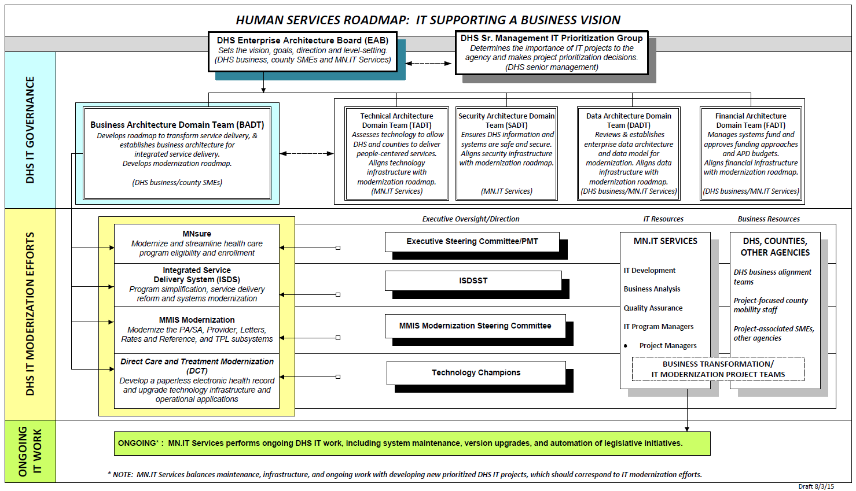
Plan for Eligibility & Enrollment Infrastructure

Slide 15
DHS Modernization Initiatives: Timelines
Vision: Technology enhancements to support a people-centered integrated human services delivery system in which policy, people, processes and technologies are aligned to serve the DHS mission.
  MNsure IT System
Timeline
2015:
  “IT Build” will continue to enhance system core functionality as defined by stakeholder input and business prioritization.
  Deliver a range of additional functionality improvements and defect fixes.
2016:
  Key deliverables already scheduled include:
    Periodic data matching (March 2016 legislative requirement)
    PRISM interface.
  Continue to enhance back-end IT systems to improve service delivery.
2017:
  Complete transition to maintenance and operations mode, staffed primarily by state employees.

Slide 16
DHS Modernization Initiatives: Timelines, continued
Vision: Technology enhancements to support a people-centered integrated human services delivery system in which policy, people, processes and technologies are aligned to serve the DHS mission.
  Integrated Services Delivery System (ISDS)
Timeline
2015-2017:
  Develop Business Architecture, Infrastructure, Environments, Interfaces. Deploy State Medical Records (SMRT); conduct pilot implementation Triage/Screening (Hennepin / Dakota Counties)
2017-2019:
  Deploy Child Support Enforcement, SNAP Eligibility (Food Stamps), Cash Eligibility
2018-2020:
  Deploy Child Welfare, Vulnerable Adult ISDS

Slide 17
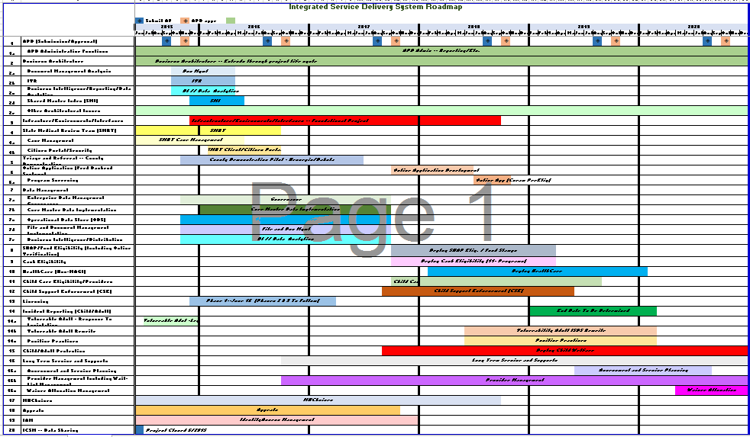
Integrated Services Delivery Roadmap

Slide 18
Eligibility & Enrollment Infrastructure
2015-2015
  PLAN FOR OPERATIONALIZING
  Significantly enhance and expand IT environments to enable improved and simultaneous code testing and deployments across multiple environments.
  Infrastructure will be shared – when appropriate – across all System Modernization efforts.
  Apply Project Management structure developed and used for MNsure IT (see next slide).
  Where appropriate, shift staff (who are not involved with MNsure) from Legacy systems to System Modernization.
  Embed specialty staff (Quality Assurance, Code development, Business Analysts) in projects
  Use stakeholder input and engage stakeholders in projects and overall program evolution

Slide 19
DHS Modernization:
Project Management

Slide 20
MNsure IT and State Resources
MODERNIZATION DRIVES RESOURCES, PRIORITIES
  A centralized IT Enterprise Architecture planning structure is in place to govern DHS Modernization efforts.
  All Modernization efforts are on parallel tracks; points of commonality and intersection are by intent.
  Separate state resource teams (independent of MNsure IT resources) are dedicated to the Modernization initiatives.
  There is a possibility of targeted diversion of resources in coordination with business partners to meet all priorities going forward.

Slide 21
“Stay the Course”: Pros and Cons
Pros:
Continues existing program and does not introduce new coordination challenges
Ability to fully customize to State-specific needs
Enables State to reach goal of integrating all public program eligibility
Supports MN goal for serving public assistance clients through counties, tribes, and contract agencies
Cons:
Requires State to fill all gaps in current system with State resources: IT and operational
May take longer to fill gaps (e.g. certain enrollment functionality may remain manual for longer period) than SSBM or private SBM models
May require more State resources long term to ensure system remains up-to-date

Slide 22
Partially Privatized SBM
Private vendor provides key Marketplace functions
State oversees vendor and retains core Marketplace functions
State could purchase “exchange in a box” or selected modules (e.g., enrollment, like Idaho)
Vendor may retain functions “in the cloud,” and vendor will update modules regularly

Slide 23
Partially Privatized SBM, continued
ELIGIBILITY & ENROLLMENT
State or vendor may provide eligibility function; QHP enrollment function provided by vendor with State retaining public program enrollment
MEDICAID
Private vendor’s solution must meet the “single door” requirement for an integrated Medicaid-Marketplace eligibility system
State responsible for financing; some vendors may have monthly user fees with no upfront payment (assuming minimum enrollment threshold is met)
FINANCE

Slide 24
Partially Privatized SBM:
What can Minnesota Outsource?
SBM Core Function | Retained by State | May Outsource to Vendor | “Off-the-Shelf” Outsource Solution
Governance & Oversight | ✓
Financial Management |  | ✓
IAP Eligibility Determination | ✓
QHP Shopping and Enrollment |  |  | ✓
MA/MinnesotaCare Enrollment | ✓
SHOP |  |  | ✓
QHP Customer Service |  |  | ✓
Plan Management |  | ✓
APTC/CSR Appeals Management |  | ✓
Broker Support |  |  | ✓
Navigator Program Management |  |  | ✓
Marketing & Outreach |  | ✓
Source: Kingsdale, J., Assessing a New Option: The Feasibility of Contracting With a Single Firm to Build and Operate a State’s Marketplace. State Health Reform Assistance Network Issue Brief. July, 2015.

Slide 25
Partially Privatized SBM: Idaho Case Study
YourHealthIdaho shares components of its Marketplace functions across the Medicaid agency – Idaho Department of Health and Welfare (DHW) – and a private vendor
Consumers who request financial assistance through YourHealthIdaho are transferred to DHW to complete an application and obtain an eligibility determination
DHW owns and manages the eligibility determination technology
Consumers who are eligible for Medicaid eligible stay with DHW for enrollment

Slide 26
Partially Privatized SBM: Idaho Case Study, continued
Consumers who are not Medicaid eligible are transferred to YourHealthIdaho to select a QHP through the vendor Marketplace solution; QHP renewals occur through the Marketplace
Consumers report changes impacting insurance affordability program eligiblity (including APTC/CSR) through DHW
Consumers who visit YourHealthIdaho and do not request financial assistance are verified through a back-end process with DHW and continue directly to the vendor Marketplace

Slide 27
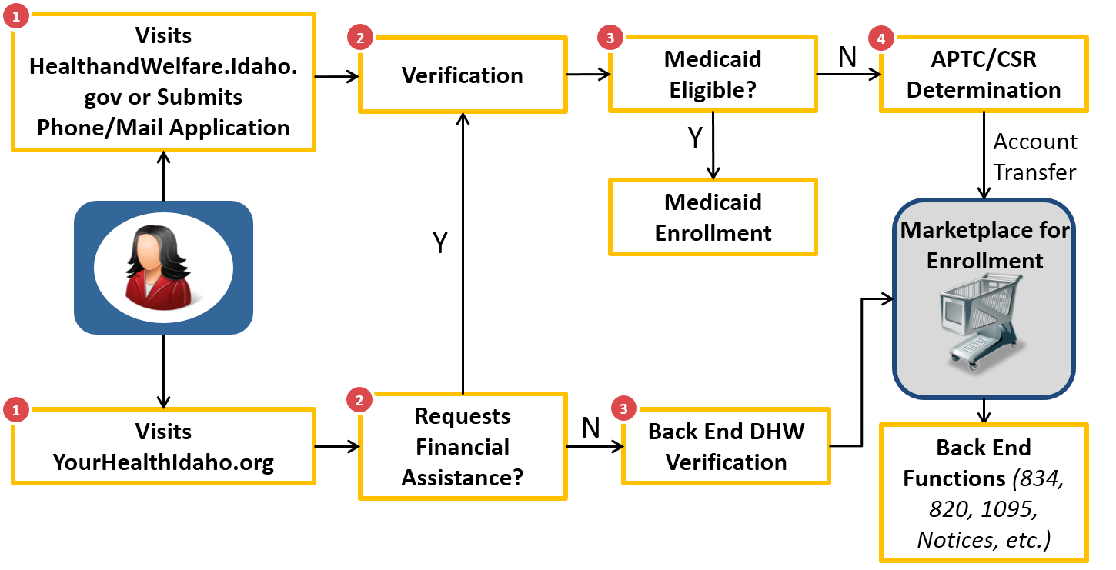
Partially Privatized SBM:
Idaho Consumer Example
Source: YourHealthIdaho Business Model Walkthrough

Slide 28
Partially Privatized SBM: Open Questions
Technical challenges and staff resources required to procure and integrate vendor systems
Cost of implementation
Degree of customization depending on functions being outsourced (greatest risk if State seeks to outsource eligibility functions as relates to Medical Assistance and MinnesotaCare)

Slide 29
Partially Privatized SBM: Pros and Cons
Pros
Enhanced functionality where needed
Gives State flexibility to purchase “off-the-shelf” products, customized solutions, or both
Potentially faster implementation than staying the course
Allows maximum customization
Enables State to reach goal of integrating all public program eligibility
Cons
Requires due diligence in procurement and ongoing state oversight
Requires integration with current IT
Too late for 2016 Open Enrollment Period
More risky given inexperience of vendors

Slide 30
Supported SBM
Healthcare.gov provides application and eligibility determination functionality for public programs and APTC/CSRs
  Individuals eligible for public programs are transferred to DHS for final eligibility determination and enrollment (in an assessment model)
Healthcare.gov provides QHP enrollment functionality; State retains public program enrollment responsibility
State must maintain an ACA compliant application and eligibility determination process for Minnesotans to apply for insurance affordability programs (online application, hub verifications, etc.)
  Individuals who are not eligible for State programs are transferred to Healthcare.gov for APTC/CSR determination

Slide 31
Supported SBM, continued
ELIGIBILITY & ENROLLMENT
Federal service with minimal Medicaid integration
All or nothing model; Healthcare.gov does not currently support BHP (unclear if it can in the near future)
MEDICAID
Healthcare.gov transfers Medicaid eligibles to State
State transfers non-Medicaid eligibles to Healthcare.gov
State can choose determination model or assessment model (where State makes final determination)
FINANCE
State responsible for financing federal services (beginning in 2017), as well as state services (plan management, consumer assistance, any other state activities)

Slide 32
Supported SBM: Open Questions
CMS’s cost to states for eligibility and enrollment functions
Ability of HealthCare.gov to support MinnesotaCare eligibility or other state customization
Cost and timeline of building interface with federal systems
Impact on State’s ability to maintain ACA compliant MAGI and non-MAGI eligibility functionality for Medical Assistance and MinnesotaCare
Additional Supported SBM programmatic requirements on states imposed by CMS

Slide 33
Supported SBM: Pros and Cons
Pros:
Proven eligibility and enrollment solution for consumer
Reduced risk for Minnesota, since Healthcare.gov is stable and tested E&E system
Cons:
Cannot implement until 2017 Open Enrollment Period
Constrained flexibility for MinnesotaCare and other State specific initiatives
New build for account transfer between Medicaid and HealthCare.gov required
Not Minnesota-branded solution; current accounts would need to be shifted and may cause consumer confusion

Slide 34
Federally-facilitated Marketplace
Similar to SSBM, Healthcare.gov provides eligibility determination functionality for Medical Assistance, MinnesotaCare, and APTC/CSRs and provides QHP enrollment functionality
Similar to SSBM, state must maintain application process for insurance affordability programs including account transfer
Major differences from SSBM is Minnesota will no longer retain plan management and consumer assistance functions and FFM 3.5% user fee funds all Marketplace functions
  FFM states can play an active advisory role in plan management

Slide 35
Federally-facilitated Marketplace:
Pros and Cons
Pros:
Same as SSMB plus
Reduces state resources dedicated to the Marketplace
Cons:
Same as SSBM plus
Diminishes state role in non-IT functions (including plan management and consumer assistance functions)
Constrains State flexibility
Not the “Minnesota Way”

Slide 36
Discussion

Slide 37
Framework for Considering Options
Consideration | Stay the Course (SBM) | Partially Privatized Model | Supported SBM | FFM
Ensure State Flexibility | High | Medium | Low | Low
Reduce Cost and Streamline Administration | Low | Medium | Medium | Medium
Provide Quality Consumer Experience | Medium | High | Medium | Medium

Slide 38
Next Steps

Slide 39
Thank you!
Joel Ario
jario@manatt.com
518.431.6719
Patti Boozang
pboozang@manatt.com
212.790.4523
Alice Lam
ALam@manatt.com
212.790.4583
Anne Karl
AKarl@manatt.com
212.790.4578

