Slide 1
Minnesota Health Care Financing Task Force
Seamless Coverage and market stability
9/18/2015
Minnesota Department of Human Services
Ela, Room 2370

Slide 2
Overview/Agenda
Lynn Blewett, SHADAC, School of Public Health, Univ. of Minn.
Distribution of Coverage update with new federal ACS data
Workgroup Charge
Coverage Continuum Goals
Public Program Review

Slide 3
MN Distribution of Coverage - 2014
Source: SHADAC, American Community Survey, 2014
Notes:
American Community Survey estimates. Smith, J.C., & Medalia C. September 16, 2015. "Health Insurance Coverage in the United States: 2014." Current Population Reports. Washington, DC: U.S. Census Bureau. Available at http://www.census.gov/- content/dam/Census/library/publications/2015/demo/p60-253.pdf

Slide 4
Change in MN Rate of Uninsurance
Source: SHADAC, American Community Survey, 2014

Slide 5
Workgroup charge: Seamless Coverage
The workgroup will examine opportunities for providing and financing a seamless, affordable and financially stable coverage continuum in Minnesota.
As provided under Minn. Session Laws 2015, Chap. 71, Art. 11, Section 62, options may include, but are not limited to, the following:
Alignment of eligibility and enrollment requirements;
Smoothing consumer cost-sharing across programs;
Alignment and alternatives to benefit sets;
Alternatives to the individual mandate;
Alternatives to the employer mandate and penalties;
Alternatives to advanced premium tax credits; and
Alternatives to qualified health plans.

Slide 6
Workgroup charge: Market Stability
The workgroup will assess options for aligning the financing and governance of operational and resource components for insurance affordability programs, including:
Medical Assistance
MinnesotaCare
Advanced premium tax credits used to buy an ACA-compliant commercial insurance product.
The workgroup will also consider the impact of recommendations on the ability of families to maintain adequate and affordable coverage as they move up the income ladder.
Recommendations should take into consideration the transparency and accountability of programs.

Slide 7
Seamless Coverage Continuum: Consumer Perspective
For the Consumer:
As individuals’ incomes or circumstances change, to prevent or mitigate:
Significant financial impact on out-of-pocket spending (i.e. cliffs) and;
Gaps in care or benefits due to changes in covered benefits, health plan, or provider.

Slide 8
Seamless Coverage Continuum: State Perspective
For the State:
Administrative efficiency when meeting enrollees care needs as income/circumstances change
Workable solutions must contribute to:
Sustainability of current HC programs;
Efficient and targeted use of public resources; and
Maximize federal funding.

Slide 9
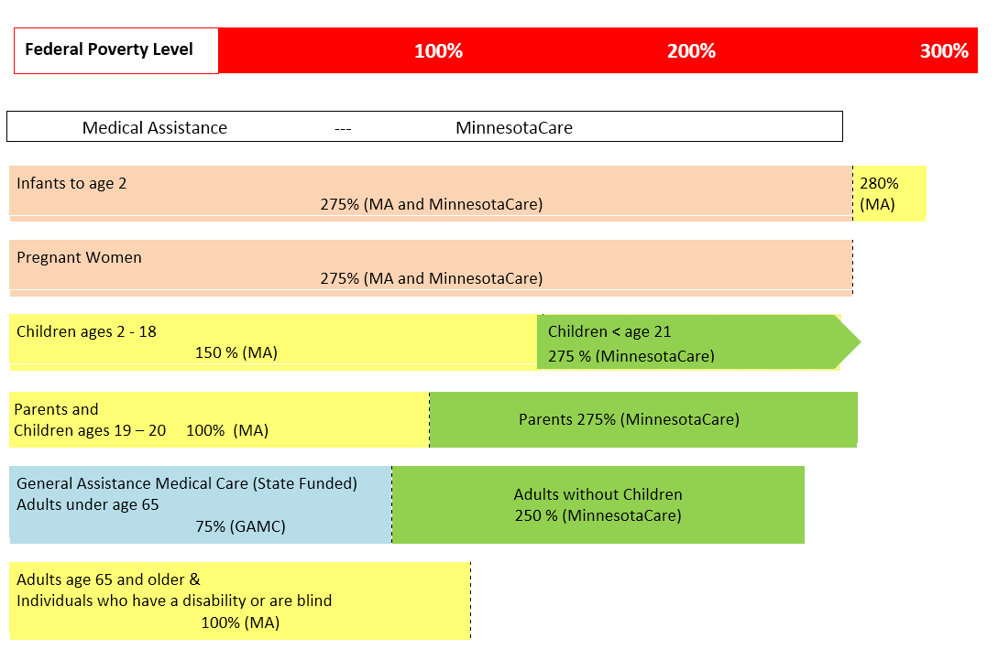
MN Coverage Continuum: Pre-ACA
Source: 2010, Minnesota Department of Human Services.
Notes:
This represents MHCP in January 2010.
GAMC – State funded program for adults without children. In the years prior to Medicaid funding for this population legislature grappled with how best to cover them..
GHO – Hospital only coverage, Transitional MinnesotaCare (sought to move people from GAMC to MCRE), in 2012,Healthy MN Contribution Program for adults w/o children >200% FPG to subsidize private coverage. GAMC expired in March 2011 with implementation of the early expansion, MA for adults without children.
First three population buckets: Infants, pregnant women and children had maintenance of effort requirements under the law so Minnesota was limited in its ability to reduce eligibility levels for these populations. These populations were moved over into Medical Assistance in an effort to meet these requirements. (MOE for Medicaid and CHIP populations goes until 2019)
Medical Assistance Changes:
Parents, children ages 19-20, and adults under age 65 without children experienced an increase in income eligibility for MA with the Medicaid expansion.
Medicaid coverage for seniors and disabled and/or blind remained virtually unchanged under the ACA.
MinnesotaCare Changes:
Moved to basic health plan model capped at 200%FPL
Reduced income eligibility for parents from 275%FPL to 200%FPL
Removed the health contribution program for adults without children
Removed the buy-in option for children in MinnesotaCare (Most children under 200%FPL are in MA with a few exceptions of children who are in MinnesotaCare)
New Public Program:
Addition of a federal subsidy program for ACA-compliant plans purchased through MNsure

Slide 10
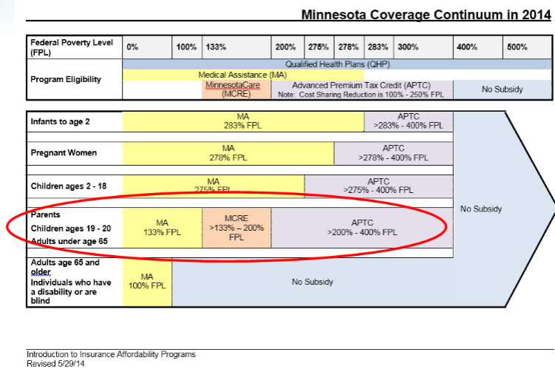
MN’s Current Coverage Continuum
Source: 2014, Minnesota Department of Human Services.
Notes:
Most of the discussion for streamlining our coverage continuum for this workgroup centers around this group of parents, children, and adults without children, including a discussion of how parents in MNCare or those parents from 201-275%FPL who have APTCs can have more seamless coverage options with their children who are separately covered under MA. Once we determine what issues we want to address, the waiver presentation in two weeks by our facilitator will help us decide which tools are most appropriate to addressing these issues within the coverage continuum.

Slide 11
Medical Assistance (MA): Minnesota’s Medicaid Program
Karen Giusto, MN Dept. of Human Services
Eligibility Requirements
Financial Eligibility
Cost Structure for Enrollees
MA Population Groups
MA Service Delivery
MA Governance & Administration
Financing of Medical Assistance

Slide 12
MA Eligibility Requirements
Social Security Number
State Resident
Citizen or qualifying noncitizen
Income
Not incarcerated
Basis of Eligibility
Parent, child, pregnant woman, adult without children, person age 65 or older, person who is blind or who has a disability
Special populations
Notes:
Citizen or qualifying noncitizen – immigration status eligibility very complex, separates noncitizens into those who qualify for Medicaid, those who do not, and those who qualify after they have been in country for 5 years.
Income – People must meet certain income limits to qualify for MA. Can also qualify for MA with a spend down (like a deductible)
Basis of eligibility: People are categorized into different groups or basis. Basis of eligibility Basis determines which income limit applies to you and how your financial eligibility is determined. Special populations: children in foster care or adoption assistance, MA-BC,

Slide 13
Financial Eligibility: Families with Children and Adults
Income limit: 133% to 283% FPL
Household Composition
Modified Adjusted Gross Income (MAGI) based
Sources of income that make up Adjusted Gross Income + Foreign Income + Tax Exempt Interest + Non-taxable Social Security Benefits
Lump sums, educational scholarships & American Indian/Alaska Native Exceptions
5% Disregard
No asset test
Notes:
MAGI – defined in section 36B(d)(2)(B) of the IR Code. Medicaid regs set out exceptions for Medicaid.

Slide 14
Financial Eligibility: elderly, or blind or who have disabilities
Income limit: 100%FPG
Non-MAGI (commonly referred to as)
Based on the rules for the Supplemental Security Income (SSI) program
Excluded and counted gross income sources
Net income test with disregards and deductions
Asset limits
Notes:
Deduct disregards and deductions, if applicable, in the listed order to arrive at net income:
Unearned Income.
a. Disabled Widow/Widower Disregard.
b. Widow/Widower Disregard.
c. Pickle Disregard.
d. Disabled Adult Child Disregard.
e. RSDI COLA Disregard.
f. PASS Deduction.
n Earned Income.
a. PASS Deduction.
b. Blind Disabled Student Child Disregard.
c. $65 Earned Income Disregard.
d. Work Expense for disabled basis of eligibility (Impairment-Related Work Expense Deduction).
e. One-half of remaining earned Income.
f. Work Expense for blind basis of eligibility (Blind Work Expense Deduction).

Slide 15
Cost Structure for Enrollees
No premiums
Limited cost sharing
$2.85 monthly family deductible
Non-preventive office visit $3.00
Non-emergency ER visit $3.50
Prescriptions $1.00 generic/$3.00 brand ($12 limit)
Eyeglasses $25
Cost sharing limited to 5% of family income
No cost sharing for pregnant women, children, American Indians, other exceptions apply
Notes:
Generally MA requires no premiums (MA-EPD)
Other cost sharing exceptions:
- MA-BC
- people receiving hospice care
- family planning
- emergency services
- people expected to reside in hospital, NF or ICF-DD for 30 days or more
Etc…

Slide 16
MA Population Groups

Slide 17
MA Service Delivery
Well over half of MA enrollees receive services through a managed care organization. Managed care is –
A way of purchasing and delivering health care
DHS contracts with and pays a monthly capitation to deliver all medically necessary covered services
Covered services are provided through the MCO’s network
Most individuals are mandated into the managed care delivery system; a small portion are voluntarily enrolled.
Services may also be delivered on a fee-for-service basis, giving the enrollee the choice of MA provider. People who receive services on this basis include -
Individuals with disabilities
Medically needy (income spenddown)
Notes:
Managed care:
Other specialized groups not mandated into managed care include: people with cost-effective insurance; adoption assistance children; American Indians living on a reservation.
Some excluded populations may voluntarily enroll in managed care.

Slide 18
MA Governance & Administration
Medicaid requires that a single state agency administer or supervise the Medicaid program:
DHS is the supervising single state agency
County human service agencies administer
DHS & MNsure have a shared eligibility system for public health care programs and the insurance marketplace. MAGI-based MA eligibility is determined through the new system. Applicants can apply using a paper application or online through MNsure website.
County workers enter paper applications and provide case maintenance including:
Process changes in circumstances and renewals
Customer service
DHS Health Care Operations assists counties when needed, and represents the agency in MA appeals for cases in the new eligibility system.

Slide 19
MA Groups & Eligibility Systems
MA groups in new system are those with MAGI-based eligibility:
Parents & Caretakers
Children
Pregnant women
Adults without children
Former foster care children
MA groups with a non-MAGI based eligibility, currently apply at the county with eligibility supported by legacy system (MAXIS) include:
Age 65 and older, persons who are blind or have disabilities
MA for Employed Persons with Disabilities (MA-EPD)
Medicare savings programs (QMB, SLMB, QI)
Requests for Home and community based services (HCBS)
Medically needy
Children in foster care or receiving adoption assistance
MAGI = IRS Definition of Modified Adjusted Gross Income

Slide 20
Financing of Medical Assistance
Medical Assistance is jointly funded by the state and the federal government. The federal government pays states for a specified percentage of program expenditures, called the Federal Medical Assistance Percentage (FMAP).
FMAP varies by state based on criteria such as per capita income. The average FMAP rate for states is 57%. Minnesota’s regular FMAP rate is 50%.
The Affordable Care Act allowed states to receive an enhanced FMAP rate for certain expansion groups previously not eligible for Medicaid. Minnesota is receiving 100 percent FMAP for childless adults with incomes between 0-133%FPG from 2014 through 2016.
This enhanced FMAP rate falls to 95 percent in 2017, 94 percent in 2018, 93 percent in 2019, and then 90 percent in 2020 and beyond.
Notes:
Minnesota also qualifies for an enhanced match for individuals in the adult expansion group that are not considered ‘newly eligible.’ This enhanced match begins at 75% match in 2015, increases to 80% in 2015, 86% in 2017, 90% in 2019, 93% in 2019 before leveling off at 90% in 2020.

Slide 21
MA Funding Sources
The current projected cost of the Medical Assistance program in FY2017 is about $12.5 billion
About 41 percent of FY2017 program costs are funded by the state, 58 percent by the federal government, and 1 percent from counties

Slide 22
MA Spending by Eligibility Group FY2017

Slide 23
MinnesotaCare
Karen Giusto, MN Dept. of Human Services
MinnesotaCare History
The BHP
Eligibility Requirements
Financial Eligibility
Cost Structure for Enrollees
Population Groups
Service Delivery
Benefits: MinnesotaCare v. MA
Governance and Administration
Financing & Funding Formula

Slide 24
MinnesotaCare History
Longstanding Section 1115 waiver program
50% state/federal share (FMAP) for most populations
Coverage for lower income individuals and families with income above MA limits, and no access to affordable employer-sponsored coverage
Waiver permitted different eligibility rules than MA
Notes:
Children’s Health Plan enacted in 1987 to provide coverage for children under 6 and pregnant women ineligible for MA with income up to 185% FPG.
October 1, 1992 - The HealthRight Act (now known as the MinnesotaCare Act) which was drafted by a bipartisan group of seven legislators was passed by the Legislature and signed by Governor Carlson,.
Section 115 waiver has been in place for 20 years, primarily as the federal authority for the MinnesotaCare program, federal funding for MinnesotaCare evolved over time to result in 50% FMAP for most populations.
Different eligibility rules than MA:
- Household composition – family rather than individual determination
- Income calculation gross annual income
- insurance barriers, 4 month rule, ESI barrier

Slide 25
MinnesotaCare as the Basic Health Plan (BHP)
ACA provides state flexibility to establish basic health plans for low-income individuals not eligible for Medicaid.
BHP regulations finalized March 12, 2014
BHP Blueprint
State legislation passed in 2013 made Minnesota the first state to create a BHP.
New York recently became the second state with a BHP.
Notes:
Blue print : document that illustrates the design choices of the state and ensures CMS has the full understanding of the operations and management of the program and compliance with the fed rules. In the event the state wishes to make a change to alter program operations described in the blue print, the state must submit a revised blue print for review & certification.
MN blue print was approved on December 2014

Slide 26
MinnesotaCare Eligibility Requirements
State Resident
Citizen or lawfully present noncitizen
Ineligible for Medicaid
Income >133 <200 % FPG
Income 0-133 % FPG for noncitizens who are ineligible for MA due to immigration status
minimum essential coverage, no access to affordable employer-sponsored coverage
Not incarcerated
Notes:
Residency – Follows Medicaid. Individuals must live in MN and intend to reside here. Provisions for people who are looking for a job in MN, temporary absence. Cannot be visiting MN to get medical care or for other reasons.
Ineligible for Medicaid with minimum essential benefits (people who qualify for MA w/spenddown, not MEC)
Income limits – Also includes noncitizens who are ineligible for Medicaid due to immigration status (5 yr bar) with incomes less than 133% FPG.
MEC – Cannot have or be eligible to enroll in MEC. Medicare. Employer-sponsored coverage is affordable if employee premium is within 9.5% of household income.

Slide 27
Financial Eligibility
One income limit for all (200%FPL)
Household Composition
MAGI methodology
Projected Annual Income
Notes:
HH Comp – based on IR code (tax filers, spouses, tax dependents), nontax fling households generally follow MA rules.
MAGI not MAGI “based” methodology
PAI – income for the coverage year as an annual figure

Slide 28
MinnesotaCare Cost Structure for Enrollees
Most MinnesotaCare enrollees pay premiums.
Sliding scale $0 - $80 (0-200%FPL)
No premiums for children, American Indians, former military
Cost sharing
$2.85 monthly family deductible
Non-preventive office visit $3.00
Non-emergency ER visit $3.50
Prescriptions $3.00 all
Eyeglasses $25
Notes:
Cost sharing exclusions: children, American Indians
No 5% or OOP max for prescriptions

Slide 29
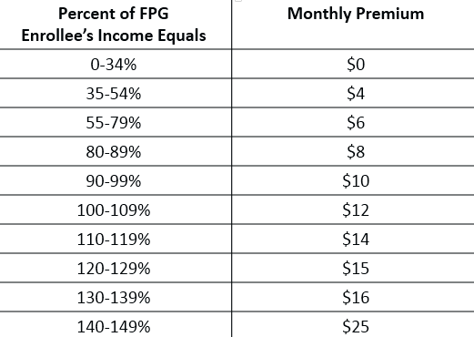
MinnesotaCare Premium Scale (0-149%FPG)

Slide 30
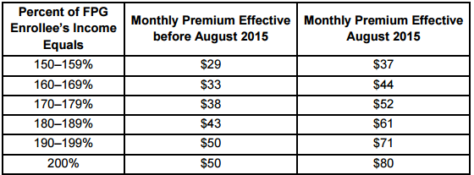
MinnesotaCare Premium Scale (150-200%FPG)
Notes:
The legislature increased premiums for a portion of the MNCare population between 150-200%FPL. This chart reflects those increases which were effective last month.

Slide 31
Cost Sharing and Actuarial Values
Legislation in 2015 increased the cost sharing for MinnesotaCare enrollees.
Once implemented the actuarial value (AV) will decrease from 98% AV to 94% AV.
DHS Commissioner has the authority to determine how these AV changes will look in terms of added costs and limited benefits for enrollees.
Notes:
In general terms, a 94% AV means the consumer is stuck with 6% of their annual health care costs and the health plan has to pay the rest (94%).
Federal law limits the state’s ability to lower the actuarial values below what individuals from 133%-200% FPG would have received if they had purchased coverage with cost-sharing subsidies through the exchange.
Meaning:
Coverage for MNCare enrollee from 133-150% FPG cannot have an AV lower than 94% AV.
Coverage for MNCare enrollee from 150-200% FPG cannot have an AV lower than 87% AV.

Slide 32
MinnesotaCare Population Groups
Notes:
The 19-20 year olds are included in the adults with children category; they are considered children in MinnesotaCare.

Slide 33
MinnesotaCare Service Delivery
BHP regulations require:
Managed-care like entities to deliver services;
A competitive contracting process that results in at least 2 plans being available in each county.

Slide 34
Benefits: MinnesotaCare v. MA
Children (ages 19-20) are covered for all of the MA benefits.
Adult enrollees, who are not pregnant, are covered for most, but not all, MA benefits.
Some of the MA benefits not included for adults in MinnesotaCare are:
Transportation (NEMT)
Nursing facility care
Personal care attendants
Private duty nursing services
Both MA and MinnesotaCare benefit sets offer more comprehensive coverage than the essential health benefit set required under federal law for private health plans offered through the exchanges.

Slide 35
Governance and Administration
DHS administers MinnesotaCare
MinnesotaCare eligibility is determined only through the new shared eligibility system. Applicants can apply using a paper application or online through MNsure website. County workers enter paper applications in new system.
DHS health care operations workers provide case maintenance including:
processing changes in circumstances and renewals
customer assistance
the premium billing process
agency representation on MinnesotaCare appeals
Notes:
DHS is piloting a phone in application pilot is underway at this process.

Slide 36
Financing of MinnesotaCare
MinnesotaCare is financed through a combination of enrollee premiums, state funds, and federal funds
In FY 2017, MinnesotaCare program expenditures are expected to reach $782 million
About 50 percent of program costs are funded by the state, 44 percent by the federal government, and 6 percent from enrollee premiums

Slide 37
Federal Share of MinnesotaCare
In January 2015, MinnesotaCare changed from a Medicaid waiver program to a Basic Health Plan (BHP)
Federal BHP funding is equal to 95% of the value of the advanced premium tax credits and cost-sharing subsidies that would have been available to this population if they had purchased the second lowest cost silver level plan through MNsure.
Advanced premium tax credits through MNsure vary by age, rating region, income, and other factors which directly affect Minnesota’s federal BHP funding.

Slide 38
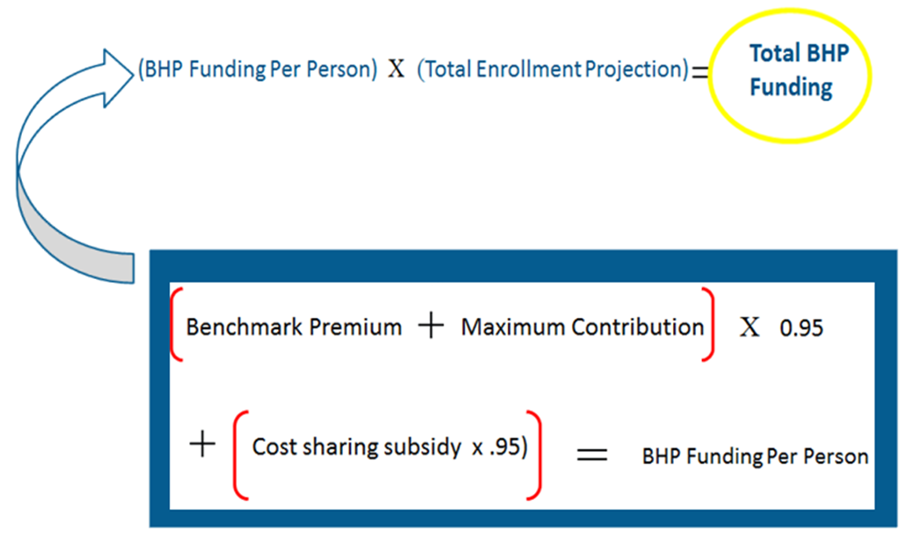
BHP Federal Funding Formula
-
Notes:
BHP Funding Per Person is based on the formula in the blue box.
Benchmark premium is set annually based on approved premium rates by Commerce for the second lowest silver product offered through Mnsure.
The maximum contribution is based on the standard set out under the ACA for the maximum amount an individual at a certain income level should have to spend on premium costs for the year.

Slide 39
BHP State Funding Formula
State share costs for the BHP are funded by the Health Care Access Fund, which is funded with two sources of revenues:
2% tax on gross revenues of health care providers, hospitals, surgical centers, and wholesale drug distributors (also known as “provider tax”); and
1% premium tax on HMOs and nonprofit health service plan corporations.
Provider taxes are scheduled to be repealed, effective for gross revenues received after Dec. 31, 2019.

Slide 40
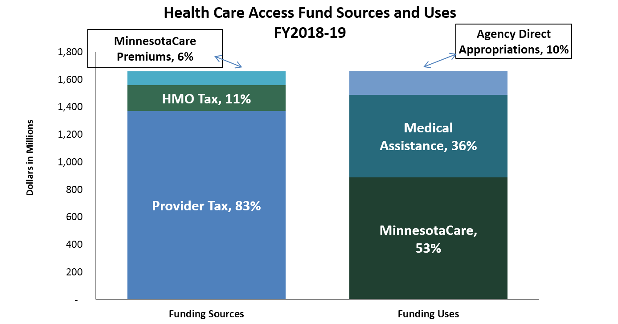
Health Care Access Fund
Source: Health Care Access Fund Statement, End of Session 2015

Slide 41
Advanced premium tax credits and cost-sharing subsidies
Katie Burns, MNsure
MNsure Overview
How is MNsure Funded
Governance
Introduction to Plans, Premiums and Cost Sharing
Coverage Levels
Cost structure
Financing of APTC & Cost-Sharing Subsidies
Private health plan offerings
Enrollment information

Slide 42
MNsure Overview
State-based exchange set up as part of implementing ACA in Minnesota.
One-stop shopping and “apples to apples” comparison information about health plan options available to consumers.
MNsure IT system also provides a single front door to coverage with financial assistance
Eligibility determination system for Medical Assistance and MinnesotaCare as well as for tax credits, cost sharing reductions and purchase of private health plans.

Slide 43
MNsure Overview (continued)
Who is eligible to use MNsure?
Residents of Minnesota
Citizens or lawfully present residents
Not incarcerated
Individual market
Small Employer Options Program (SHOP)
Outreach and free personal assistance
Navigators
Brokers
Certified Application Counselors

Slide 44
How MNsure is Funded
Federal grants
MNsure has received $189.4M in federal Exchange grant funds
Grant funds support IT development, planning work, first year operations and more narrowly defined non-IT purposes moving forward
MNsure is spending down existing grant funding and federal funding will not be available after calendar year 2016 under current federal policy
Premium withhold revenue
Collected on plans sold through MNsure
1.5% in 2014 and 3.5% for 2015
Future budget assumes 3.5% in 2016 and beyond
DHS share of IT and operations funding
Federal law requires that Exchanges are self-sustaining. States can determine their sustainability plans.

Slide 45
MNsure Governance
Board of Directors
Seven members
Appointed by governor
Staggered four-year terms; limited to two terms of service
Board of Directors hires Chief Executive Officer

Slide 46
Introduction to Plans, Premiums and Cost Sharing
MN Department of Commerce reviews/approves rates for all plans sold in Minnesota, both on MNsure and outside of MNsure (Commerce to provide overview at future workgroup meeting)
Rates for 2016 plans will become public on October 1
Among many other changes, ACA introduced new requirements for individual market insurance
Coverage (actuarial value or “metal”) levels
Factors used to determine premiums

Slide 47
Plan Levels of Coverage
Levels of Coverage | Plan Pays on Average | Enrollees Pay on Average (in addition to the monthly plan premium)
“Catastrophic” | Less than 60% | More than 40%
Bronze | 60 % | 40 %
Silver | 70 % | 30 %
Gold | 80 % | 20 %
Platinum | 90 % | 10 %

Slide 48
What impacts a person’s premium rate?
Rating Factors:
Age
Geographic location
Tobacco use status
Some people qualify for assistance that can lower their premium rates
Advanced Premium Tax Credits

Slide 49
How do Advanced Premium Tax Credits (APTC) Work?
Consumers with income between 201%-400% Federal Poverty Level (FPL) are eligible for APTC.
Consumers can use APTC with any metal level plan and must enroll through MNsure to receive tax credit
APTC is calculated using the following information:
Family size and ages of consumer(s)
Income and FPL percentage
Required Contribution (minimum amount consumer must pay)
Required contribution is based upon household income. Minnesotans between 201%FPL and 400%FPL have a required contribution on a sliding scale between 6.41%-9.66% of household income.
Rate of the second lowest cost silver plan (SLCSP) available to consumer

Slide 50
How are Advanced Premium Tax Credits (APTC) Calculated?
Example (using 2015 data):
Demographics: 40 year old, single, St. Louis County
Income: $23,341 per year which is at 201%FPL
Required Contribution at 201% FPL = 6.34%
$23,341(income)*(0.0634)(required contribution percentage)=
$1,479.82 annually or $123 monthly
Second Lowest Cost Silver Plan (SLCSP) price = $232
Calculation using Example data
APTC = SLCSP-Monthly Required Contribution
APTC =$232-$123=$109
APTC = $109

Slide 51
What is a Cost-Sharing Reduction (CSR)?
A cost reduction or discount that lowers the amount a person has to pay out-of-pocket for deductibles, coinsurance, and/or copayments.
A person can get this reduction in health care costs if they purchase their health insurance through MNsure, their household income is between 201-250% FPL and they choose a health plan from the Silver plan category.
American Indians and Alaskan Natives may qualify for additional cost-sharing benefits that can be applied to all metal levels.

Slide 52
Exchange Subsidy Program Funding
Federal government pays for the cost of advanced premium tax credits and cost sharing reductions
Funds go directly from the federal government to health plans
Funding for these programs is not part of MNsure’s budget

Slide 53
MNsure Health Plan Offerings (2015)
84 total plans; five insurance carriers
By metal level
Platinum: 4 plans
Gold: 24 plans
Silver: 25 plans
Bronze: 23 plans
Catastrophic: 8 plans
Number of plans available varies by service area

Slide 54
2015 MNsure Private Coverage Enrollees
Plans & Carriers –
Nov. 15, 2014 – Sept. 13, 2015
QHP Enrollee with Subsidies–
Nov. 15, 2014 – Sept. 13, 2015
Metal Level | 2015 Enrollment to Date | 2014
Platinum | 7% | 27%
Gold | 17% | 13%
Silver | 39% | 33%
Bronze | 36% | 26%
Catastrophic | 1% | 1%
Subsidy Type | 2015 Enrollment To Date | 2014
APTC | 55% | 39%
CSR | 15% | 13%
In 2015, the average APTC for effectuated enrollees is $155.32 per person.
MNsure enrollees received approximately $4.2 million in premium tax credits in August 2015.

Slide 55
2015 MNsure Private Coverage Enrollees, continued
Percent of Enrollees
by Carrier
Nov. 15, 2014 –
Sept. 13, 2015
Age of QHP Enrollees
Nov. 15, 2014 –
Sept. 13, 2015
Gender of QHP Enrollees
Nov. 15, 2014 – Sept. 13, 2015
Carrier | 2015 Enrollment To Date
Blue Cross Blue Shield | 43%
BluePlus | 7%
HealthPartners | 24%
Medica | 5%
UCare | 21%
Age | 2015 Enrollment To Date
<18 | 10%
18-25 | 7%
26-34 | 18%
35-44 | 15%
45-54 | 19%
55-64 | 31%
65+ | 0%
Sex | Percent
Male | 49%
Female | 51%

Slide 56
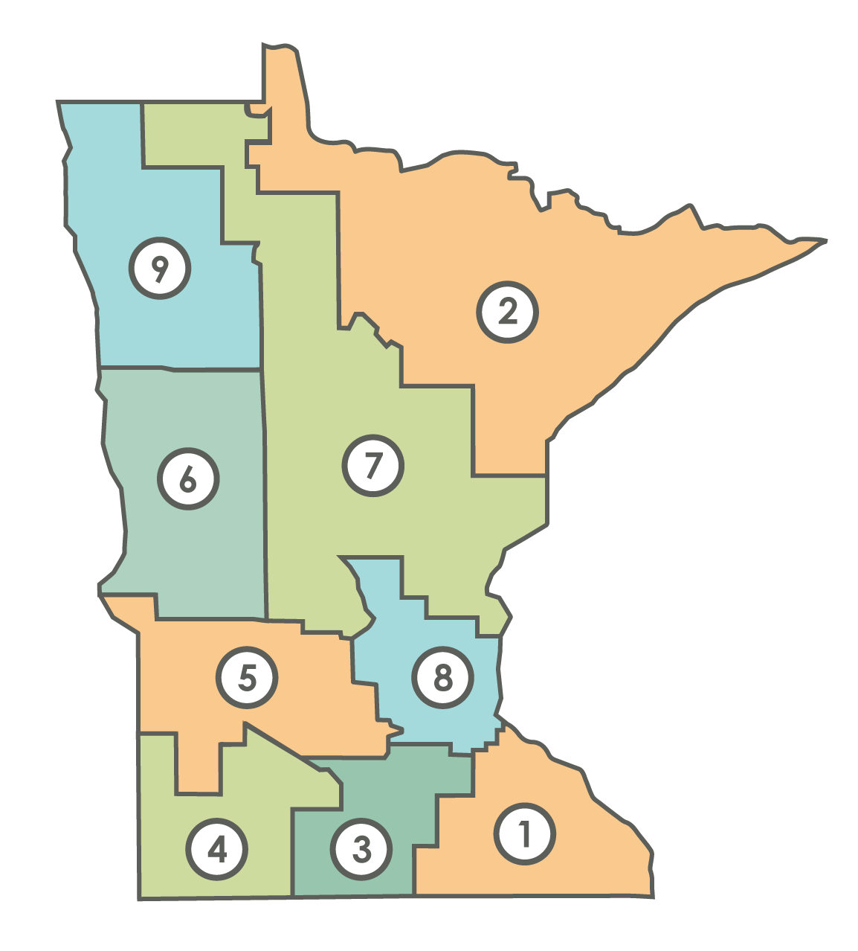
2015 Coverage Enrollment by Rating Area
Rating Area | Percent of State’s Population in Region | Percent of QHP Enrollees in Region
1 | 8.1% | 9.1%
2 | 5.9% | 6.3%
3 | 4.7% | 4.6%
4 | 2.2% | 1.9%
5 | 3.8% | 3.6%
6 | 4.2% | 4.2%
7 | 7.9% | 9.0%
8 | 61.6% | 60.4%
9 | 1.6% | 0.9%

