Slide 1
Minnesota Task Force on Health Care Financing Seamless Coverage and Market Stability Workgroup
Churning and Coverage Cliffs
September 25, 2015

Slide 2
Agenda
Overview on Churning
Potential Program Transitions and Cliffs
Illustrative Example
Strategies to Mitigate Churn and Address Cliffs

Slide 3
Overview on Churning
Overview on Churning

Slide 4
Churning
Churning: when consumers transition off or on coverage, or from one coverage program to another (e.g., Medical Assistance to Minnesota Care).

Slide 5
What is Churn?
Churn can occur at renewal or during the coverage year,
when consumers:
Fail to complete the process required to renew eligibility for coverage programs, and lose coverage
Experience a change in eligibility and, as a result, must transition from one coverage program to another
FOCUS
Changes that could affect eligibility
Income: An increase or decrease in work hours, a new job, a bonus, a raise or pay cut
Household Size: New baby, young adult moves out, marriage, divorce
Age: Turn 19 or 65
Estimated 48% of people will experience a change in program eligibility in Minnesota each year. ¹
¹ Source: Sommers, B., Graves, J., Swartz, K., Rosenbaum, S.; Medicaid and Marketplace Eligibility Changes Will Occur Often in All States; Policy Options Can Ease Impact; Health Affairs; April, 2014.

Slide 6
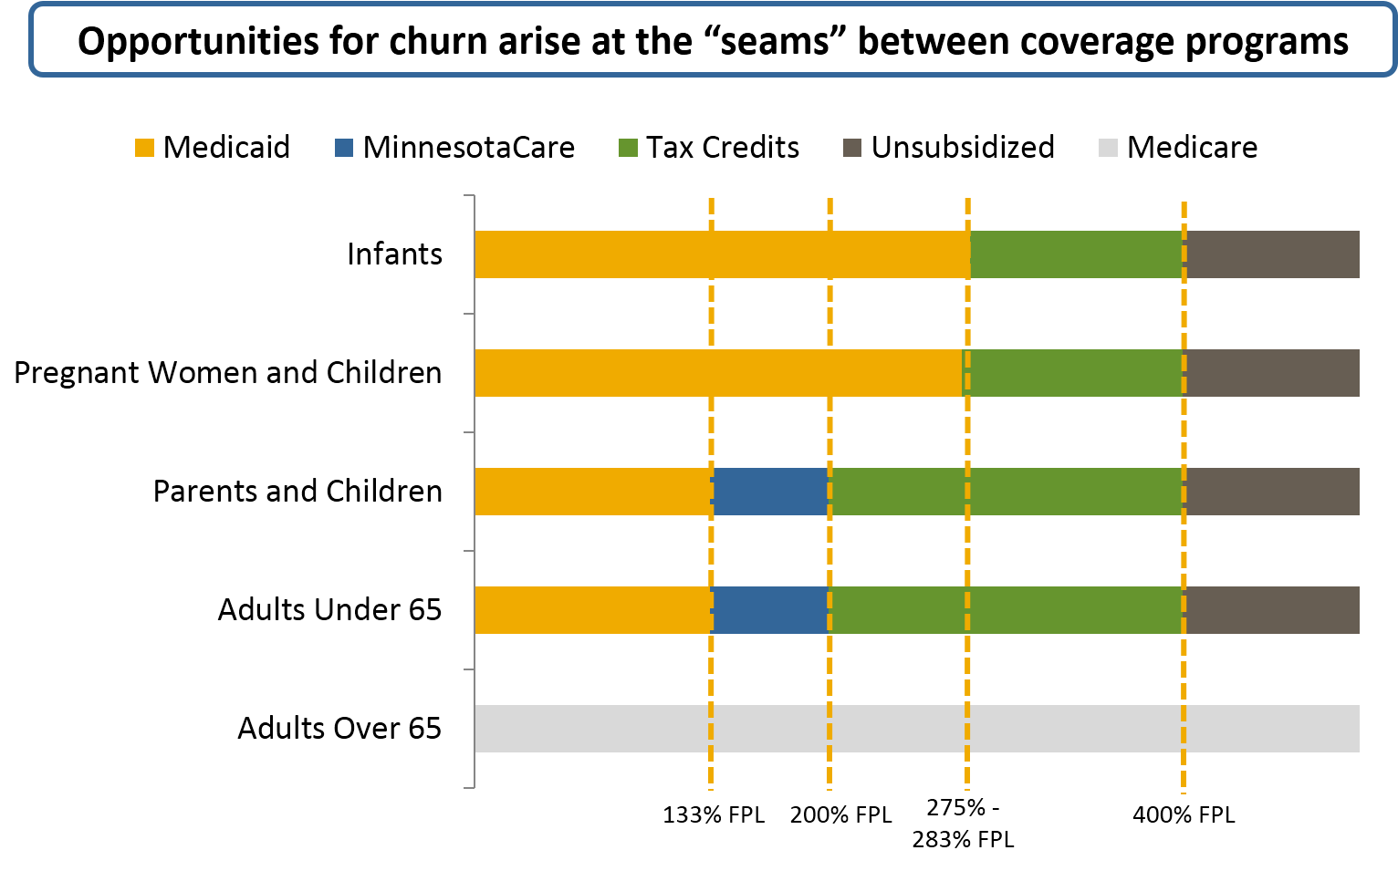
Minnesota Coverage Continuum
Notes:
MN coverage continuum is made up of a number of programs with different income eligibility levels.

Slide 7
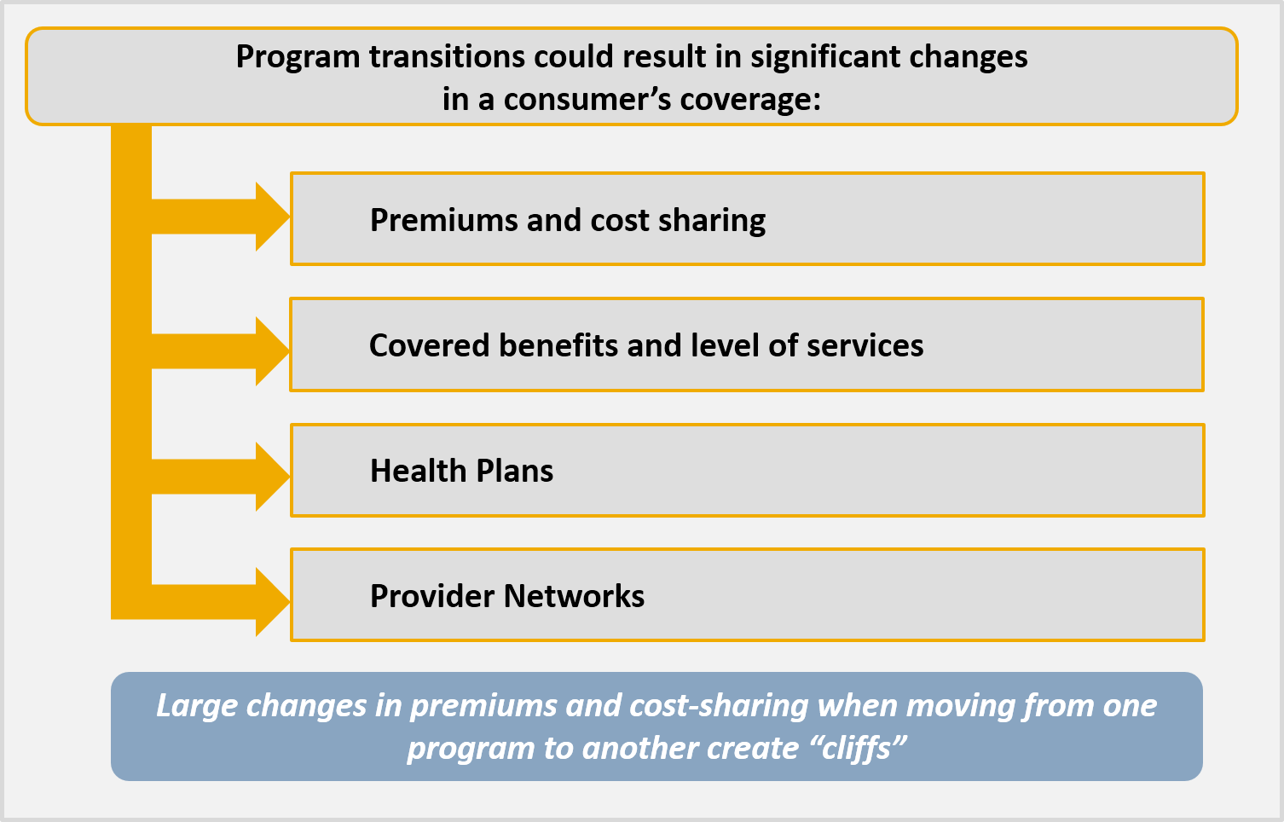
What are the Implications of Churn?

Slide 8
Potential Program Transitions and Cliffs
Potential Program Transitions and Cliffs

Slide 9
Premiums and Cost-Sharing
Minnesota (2015) | Medical Assistance (138% FPL) | MinnesotaCare (139% FPL)
Monthly Premium | $0 | $16
Annual Deductible | $34.20 | $34.20
Prescription drugs | $1 - $3 | $3
Specialty visit | $3 | $3
Inpatient hospital stay | $0 | $0
Sources: MNsure and Minnesota Department of Human Services

Slide 10
Premiums and Cost-Sharing, continued
Minnesota (2015) | MinnesotaCare (200% FPL) | MNsure Silver QHP* (201% FPL) | MNsure Bronze QHP (201% FPL)
Monthly Premium | $80 | $107 | $63
Annual Deductible | $34.20 | $2,000 | $3,500
Prescription drugs | $3 | $10 - $270 | 20% Coinsurance
Specialty visit | $3 | 0% 1st visit; 20% after | 20% Coinsurance
Inpatient hospital stay | $0 | 20% Coinsurance | 20% Coinsurance
*3% additional cost-sharing reductions have not been included in plan design
Notes:
MinnesotaCare amounts from DHS, OOP Cost Sharing Comparison
MNsure QHP premium amount from MNsure, Health Care Coverage and Plan Rates for 2015, Rating Region 7, 40 y.o.
Mnsure QHP cost-sharing figures reflect the BCBS 70% AV and 60% plans for 2015

Slide 11
Benefits
MA, MinnesotaCare and MNsure QHPs all cover at least EHBs
But consumers face changes in the scope and duration of benefits as they transition from one program to another
There are a few unique benefits that are covered by MA only:
Non-emergency medical transportation
Nursing facility care
Personal care attendants
Private duty nursing services
Minnesota Task Force on Health Care Financing | Manatt, Phelps & Phillips, LLP

Slide 12
Plans
2015 Plans | Medical Assistance | Minnesota Care | MNsure
Blue Cross and Blue Shield |  |  | •
Blue Plus | • | • | •
HealthPartners | • | • | •
Itasca Medical Care | • | •
Medica | • | • | •
Metropolitan Health Plan | •
PrimeWest Health | • | •
South Country Health Alliance | • | •
UCare | • | • | •

Slide 13
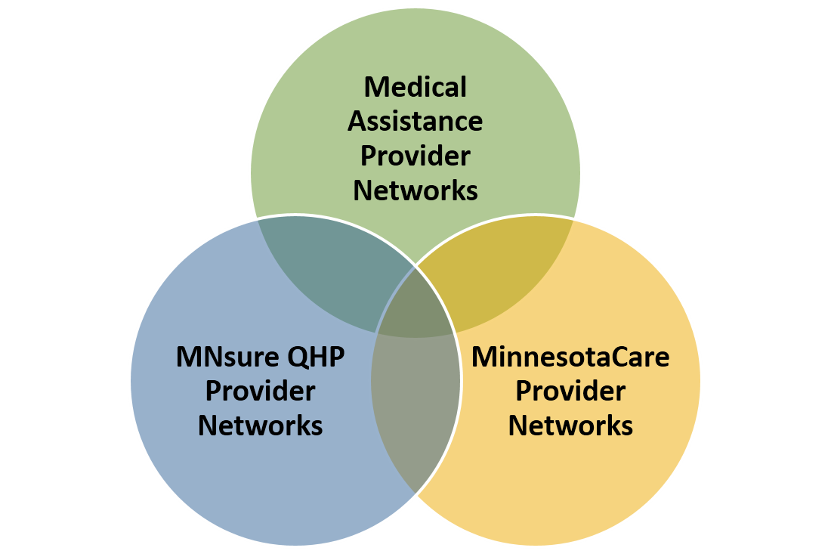
Providers

Slide 14
Illustrative Example
Illustrative Example

Slide 15
Meet Sarah
Sarah, age 40, is a household of one. She lives in Kanabec County (Rating Region 7).
In October 2014, Sarah applies for coverage. Her projected annual income is $20,422 (175% FPL), making her eligible for MinnesotaCare.
In March 2015, Sarah adds an extra day to her work schedule and her projected annual income increases to $23,658 (201% FPL). Sarah reports the change in her income and her eligibility is re-evaluated.
Sarah is now ineligible for MinnesotaCare but eligible for federal subsidies to purchase QHP coverage through MNsure.

Slide 16
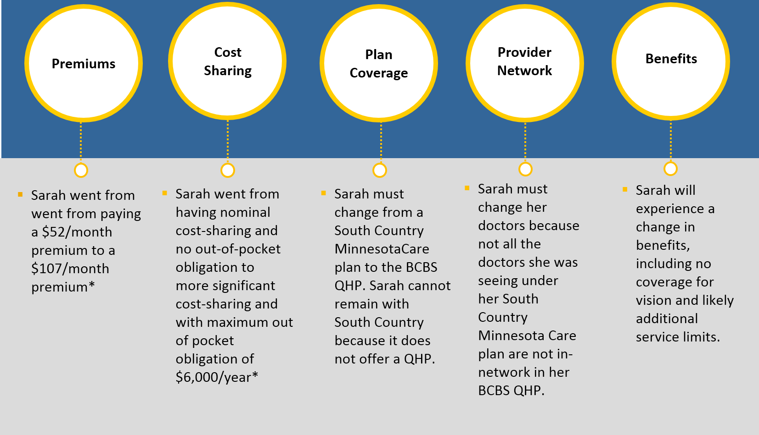
What Changes Does Sarah Experience if She Buys a Silver Plan?
* Based on MNSure Health Care Coverage and Plan Rates for 2015 and using BCBS 70% AV plan. 3% additional cost-sharing reductions have not been included in plan design

Slide 17
Strategies to Mitigate Churn and Address Cliffs
Strategies to Mitigate Churn and Address Cliffs

Slide 18
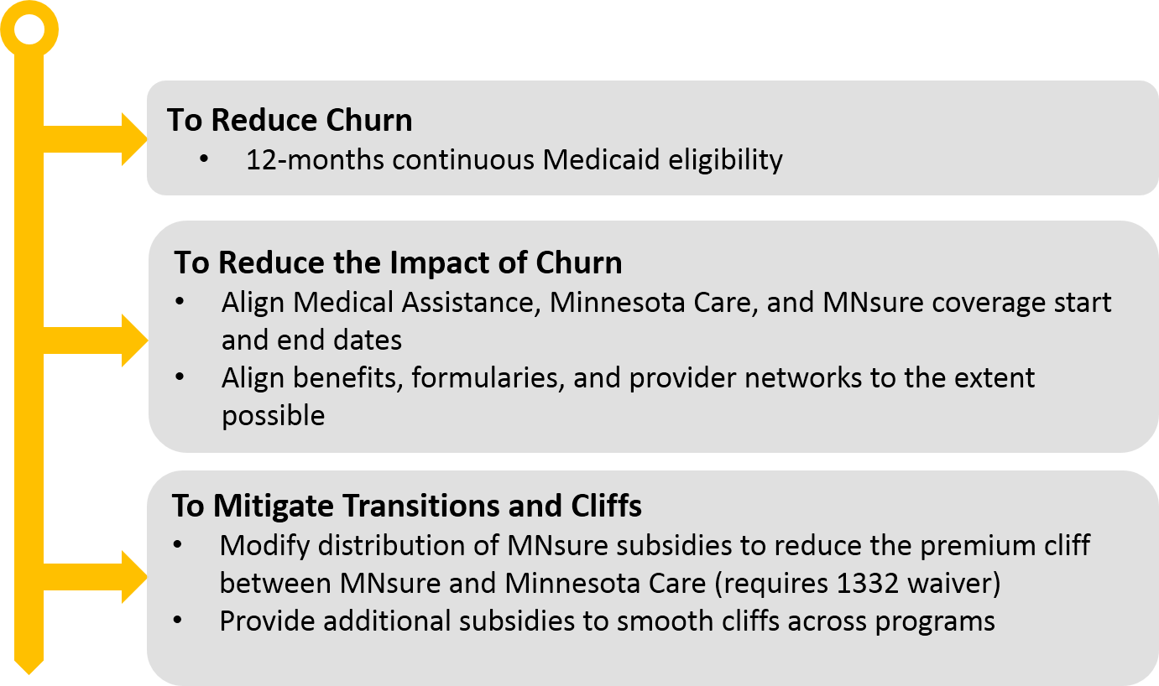
Strategies

Slide 19
Thank You!
Deborah Bachrach
dbachrach@manatt.com
212.790.4594
Patti Boozang
pboozang@manatt.com
212.790.4523
Alice Lam
ALam@manatt.com
212.790.4583
Anne Karl
AKarl@manatt.com
212.790.4578

