Slide 1
December 12, 2024 AMHI/CSP Statewide Meeting
Pam Sanchez (Supervisor), Breanna Bertozzi (Lead), Chris Ederer (Lead) & Jamie Preuss (American Indian Consultant)| AMHI/CSP Team

Slide 2
Agenda
Time | Topic
1:00 – 1:15 | Welcome
1:15 – 3:00 | Updates, Guidance & Questions

Slide 3
AMHI/CSP Team at DHS
Pamela Sanchez
Supervisor
Breanna Bertozzi
Team Lead
Christian Ederer
Team Lead
Jamie Preuss
American Indian Consultant

Slide 4
Equity Acknowledgement
Be willing to learn through listening
Respect Differences
Align efforts and focus on solutions for equity
Value others’ time
When speaking, re-introduce yourself (and the County/Region/Tribe you represent)​
Practice compassionate accountability
All members are encouraged to ask questions and share ideas during the meeting so that all members can be involved in the process
Hold each other accountable
Make explicit what is implicit
Allow yourself to be vulnerable
Offer recognition for others

Slide 5
Updates & Guidance
Pam Sanchez| AMHI/CSP Supervisor

Slide 6
General Information
Communication Request
Team email: MN_DHS_amhi.dhs@state.mn.us
Email subject and document naming convention
Ex. Naming Convention: Region 2, Beltrami Co. AMHI 2025 Budget Revision Request
Regions must include fiscal agent in subject of email and documents
AMHI/CSP team will include updated Organization chart with quarterly statewide meeting materials

Slide 7
Contracting Update
2023-2024 AMHI and CSP contracts end December 31, 2024
Remember to review expenses before submitting 2024 Q4 2895 report
87% of 2025-2026 AMHI and CSP contracts are fully executed
Cash advances will be dispersed early January 2025
Helpful Tip:
DocuSign initiations can expire
If your AMHI and/or CSP CY2025-2026 contract has not yet been executed, please connect with your agencies signers to ensure efficient contract execution
If you need a new DocuSign link sent, please reach out to the AMHI/CSP team at MN_DHS_amhi.dhs@state.mn.us

Slide 8
Important Reminder
Budget revisions will be needed from those who listed RFP/parked funds on 2025-2026 application/budget
All budget revisions need to be submitted together as ONE budget revision
Budget revisions should be submitted no more than quarterly
Why is it important to update DHS with budget revisions?
To be able to bill against correct BRASS codes
BRASS codes need sufficient funds allocated to them to reimburse for expenditures
1st Quarter ends March 31, 2025
Complete necessary budget revisions prior to the end of the quarter
Keep in mind - if an amendment is required (more than 10% of total allocation), additional time will be needed for processing

Slide 9
Budget Revisions
The Budget Revision form can be found on the AMHI website, under Forms
FYI – The Budget Revision form is currently being updated
Once the form is updated, it will automatically replace the current version on the AMHI website and via eDocs
Always access the Budget Revision form from the AMHI website or eDocs to ensure you are using the current version

Slide 10
2895 Instructions & Guidance
Instructions for Completing the BRASS-Based Grant Fiscal Report (DHS-2895)
2895s should be used to report only AMHI/CSP expenses
They should not reflect all mental health costs incurred by the agency
Amending Reports:
Agencies have one year to revise and submit corrected DHS-2895 reports
If the quarter to be amended does not appear in the ‘Quarter End Date’ drop down box, the deadline has passed and that quarter cannot be revised
Submission of a report within the one-year deadline is not a guarantee that legislative appropriations remain

Slide 11
BRASS Codes and AMHI/CSP
The Social Service Information System (SSIS) uses BRASS Codes as the basis for tracking county social service activity
BRASS Codes reflect the characteristics of a service
The AMHI and CSP statutes reflect the characteristics of our funding sources and the clients that can be served using AMHI and CSP funds

Slide 12
Maintenance of Effort (MOE)
MOE Statute states that counties must maintain a level of expenditures for mental health services
BRASS codes involved in overall MOE
All 400 series and 111
BRASS codes involved in community support programs MOE
403, 418, 434, 437, 446
Overall MOE does include community support programs MOE
All data used to compute MOE totals are submitted by the counties via SEAGR
2024 Mental Health CSP Maintenance of Effort Progress Report

Slide 13
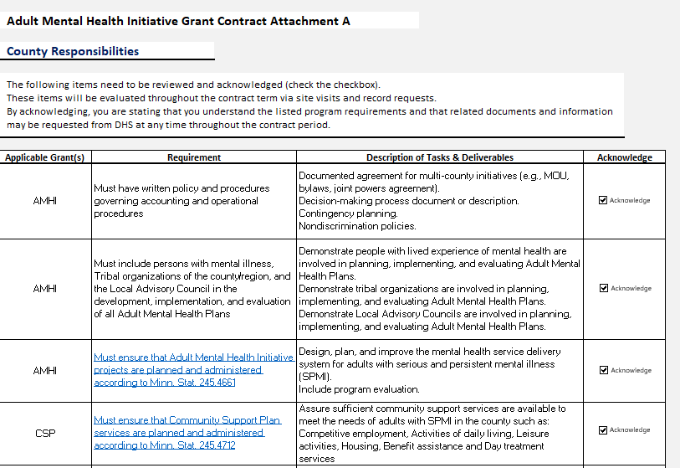
2.1 County Duties
COUNTY shall perform duties in accordance with Attachment A, County Duties, which is attached and incorporated into the CONTRACT.

Slide 14
3.1 Terms of Payment
a. Total obligation. The total obligation of STATE for all compensation and reimbursements to COUNTY shall not exceed ​XXX dollars ($​XXX​).
1. The total obligation covers two full calendar years.
2. In calendar year 2025, the COUNTY shall not invoice the STATE, and STATE shall not pay COUNTY more than half of the total obligation/total budget amount indicated in Attachment B.
3. Underspending in calendar year 2025 is not available for use in future calendar years.
b. Advance. The COUNTY will receive an initial payment of ADVANCE DOLLAR AMOUNT ($) which is granted pursuant to Minnesota Administrative Rule 9535.1740 at the start of each calendar year during the contract term.
c. Reconciliation. Any portion of the cash advances that are unspent must be returned to STATE at the end of each calendar year of the contract term.

Slide 15
4.3 Administrative Costs & Reimbursable Expenses
Pursuant to Minn. Stat. § 16B.98, subd. 1, COUNTY agrees to minimize administrative costs as a condition of this grant. COUNTY shall ensure that costs claimed for reimbursement shall be actual costs, to be determined in accordance with 2 C.F.R. § 200.0 et seq., COUNTY shall not invoice STATE for services that are reimbursable via a public or private health insurance plan. If COUNTY receives funds from a source other than STATE in exchange for services, then COUNTY may not receive payment from STATE for those same services. COUNTY shall seek reimbursement from all sources before seeking reimbursement pursuant to CONTRACT.

Slide 16
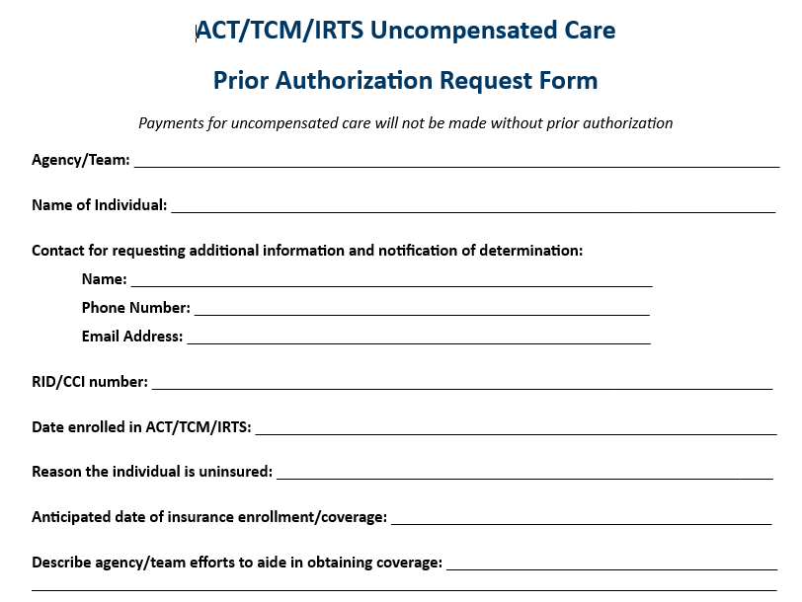
Uncompensated Care – Prior Authorization
ACT/TCM/IRTS Uncompensated Care Prior Authorization Request Form (TEMPLATE)

Slide 17
19. Sub Contracts
COUNTY, as an awardee organization, is legally and financially responsible for all aspects of this award that are subcontracted, including funds provided to sub-recipients and subcontractors, in accordance with 45 C.F.R. §§ 75.351-75.352. COUNTY shall ensure that the material obligations, borne by the COUNTY in this CONTRACT, apply as between COUNTY and subrecipients, in all subcontracts, to the same extent that the material obligations apply as between the STATE and COUNTY.

Slide 18
20.3 Grant Management Policies
COUNTY must comply with required Grants Management Policies and procedures as specified in Minn. Stat. § 16B.97, subd. 4(a)(1). Compliance under this paragraph includes, but is not limited to, participating in monitoring and financial reconciliation as required by Office of Grants Management (OGM) Policy 08-10.

Slide 19
Questions?

Slide 20
Resource Inquiries
Please place your name, contact information and area of expertise into the chat if you are willing to be a resource to others regarding these topics:
Joint Power Agreements (JPA)
Well-developed LACs
RFPs/getting bids for sub-contractors
Notes:
POLL Questions: Ask about interest in brown bag sessions and how often (monthly, quarterly, etc.)

Slide 21
2025 AMHI/CSP Statewide Meetings
Thursday, March 20th, 1pm-3pm
Thursday, June 12th, 1pm-3pm
Specific meeting details are posted on the AMHI website
Notes:
Mention AMHI Reform information available on the website and all previous statewide meeting materials.

Slide 22
Any Questions?
THANK YOU!
MN_DHS_amhi.dhs@state.mn.us

