Slide 1

Minnesota
Health Care Financing Task Force
Barriers to Access Workgroup
November 6, 2015
St Paul, MN
The presentation will be posted when accessibility standards are completed. In the meantime, if you desire a copy of the presentation, please contact smanasse@manatt.com.

Slide 2
Task Force Vision and Goals
Vision: Sustainable, quality health care for all Minnesotans
Guiding Principles
Realistic: The task force will make recommendations that can realistically be implemented.
High Value Impact: The task force will seek recommendations that have high value and are meaningful to Minnesota’s health care reform efforts.
Holistic Perspective: The task force understands that health care finance and our recommendations do not exist in a vacuum, and are components of the health care and population health systems.
Focus: The task force recognizes that health care financing and system reform is extremely complex and it will contribute to the broader policy debates by focusing its time and attention on the issues it is charged with addressing.
Innovation: The task force is encouraged to identify opportunities for innovation in Minnesota’s health care financing and delivery systems which show promise for lowering costs, improving population health and improving the patient experience.

Slide 3
Framework for Considering Barriers to Access
Access to care represents the degree of “fit” between health care consumers and the health care system, made up of the following dimensions:
  Availability: The volume and type of existing services available for the consumers’ volume and needs, including the adequacy of those services
  Accessibility: The relationship between the location of services and the location of consumers including; transportation resources, distance, time, and cost
  Accommodation: The relationship between the organization of supply resources and the consumers ability to accept those factors (i.e. appointment systems)
  Affordability: The relationship between prices of services and providers’ insurance to the consumer’s income, ability to pay, and health insurance coverage
  Acceptability: The relationship between the consumer’s attitudes about personal and practice characteristics of providers to the actual characteristics of providers
Source: R. Penchansky and J. Thomas. The Concept of Access: Definition and Relationship to Consumer Satisfaction. Medical Care (19)(2). Feb. 1981. pp. 127 – 140.
3

Slide 4
Agenda
Time | Item | Presenter/Facilitator
8:30 – 8:35 am | Welcome and approval of minutes | Dr. Marilyn Peitso
8:35 – 9:00 am | Discuss rural health access issues and potential options to address barriers to rural health access | Mark Schoenbaum, MDH
9:00 – 10:00 am | Review options and preliminary recommendations on: Consumer assistance/health literacy Provider/plan alignment Plan design Benefits alignment | Manatt
10:00 – 10:15 am | Public comment
10:15 – 10:45 am | Joint session: Seamless Coverage and Barriers to Access Workgroups | Manatt
4

Slide 5
ACCESS ISSUES IN RURAL MINNESOTA
Mark Schoenbaum, Director
Office of Rural Health & Primary Care
Minnesota Department of Health
October 2015

Slide 6
Access Components
Availability:
  Adequacy of the health workforce supply, facilities, technology and the continuum of services
Accessibility:
  Location of supply vs. the location of clients - transportation resources and travel time, distance and cost.
Accommodation:
  Appointment systems, hours of operation, walk-in facilities, telephone services and the clients' ability to accommodate to these factors.
Affordability:
  Prices of services and insurance or payment requirements vs. clients' income, ability to pay, and coverage.
Acceptability:
  Concordance, similarity, or shared identity between provider and patient on culture, language, demographic and other attributes, such as race, sex, or age. Client comfort with type of facility, location of facility, or religious affiliation of facility or provider. Providers attitudes about the attributes of clients or their financing mechanisms.

Slide 7
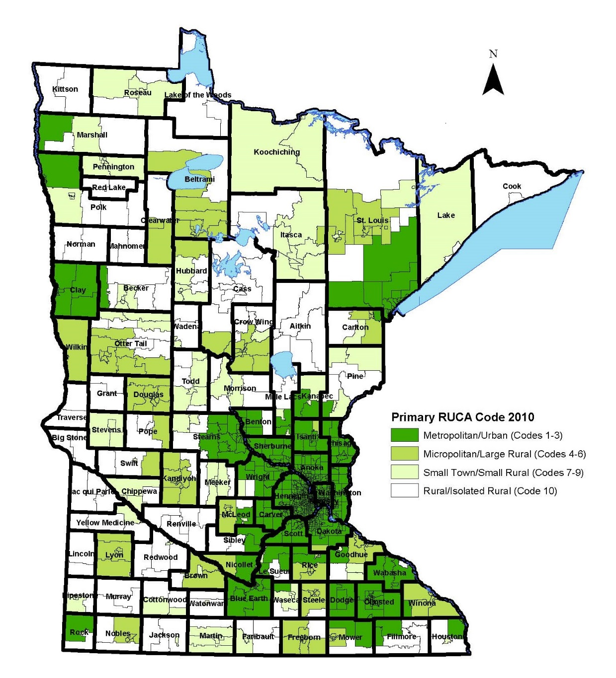
Rural-Urban Commuting Areas (RUCAs)
2010 Census Tracts - Minnesota
Notes:
About 15% of children less than 18 years of age were living in poverty in Minnesota in 2011. A higher proportion of children were in poverty in the Northwest, Northeast, and Central regions of Minnesota (see Minnesota Counties and Tribes by SCHSAC Region). With the exception of Hennepin and Ramsey Counties, a lower proportion of children were living in poverty in the Metro Area than the statewide average.
For related data on income, see Median Household Income: Facts & Figures.

Slide 8
Population in poverty, all ages, 2010

Slide 9
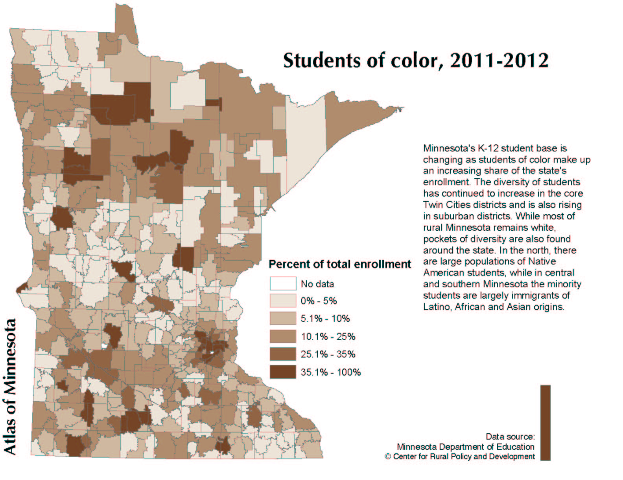
Students of color, 2011-2012

Slide 10
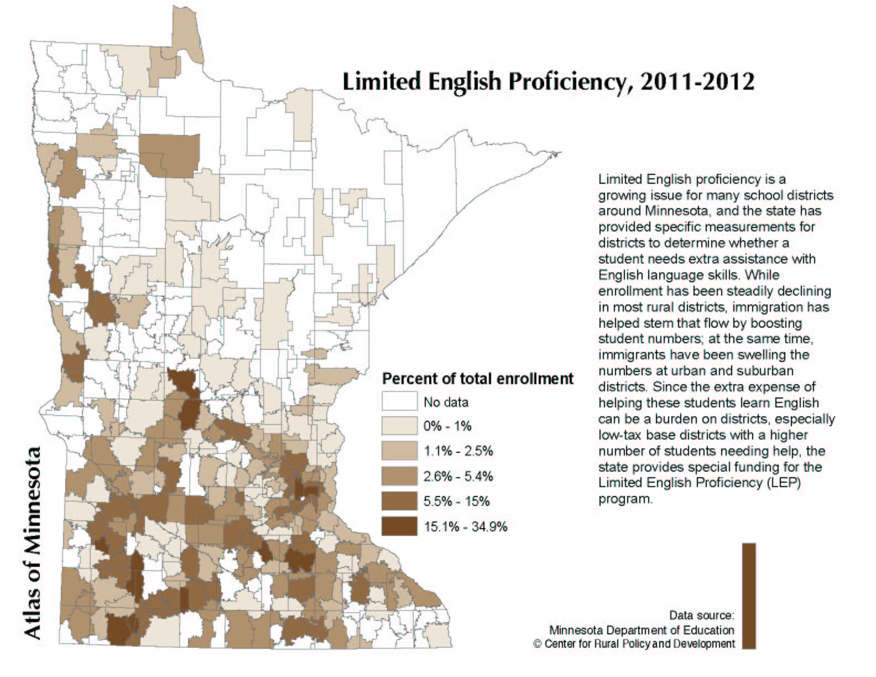
Limited English Proficiency, 2011-2012

Slide 11
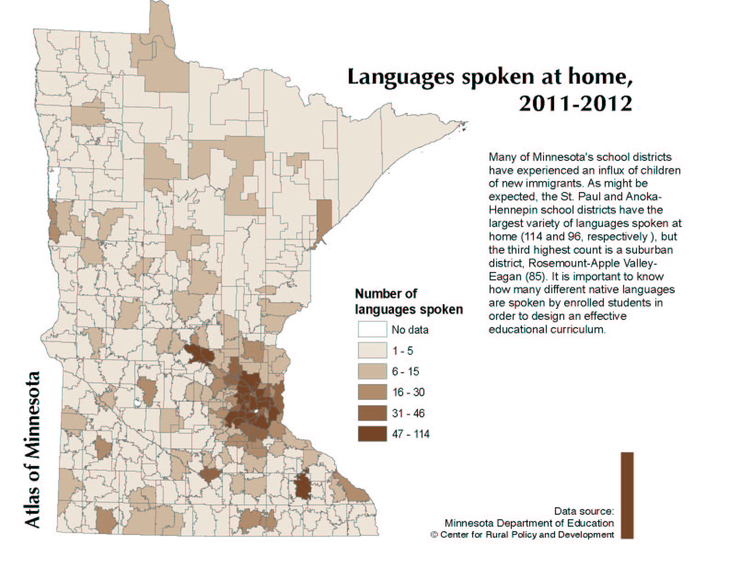
Languages spoken at home, 2011-2012

Slide 12
Statistics on non-English language spoken at home
County | % of students speaking non-English language at home
Nobles | 43.2%
Ramsey | 33.5%
Watonwan | 31.9%
Kandiyohi | 24.6%
Polk | 24.2%
Hennepin | 23.6%
Mower | 21.8%
Rice | 21.1%
Olmsted | 19.0%
Cottonwood | 16.2%
Anoka | 15.6%
Dakota | 14.8%
Lyon | 14.0%
Stearns | 13.6%
Sibley | 13.2%
Freeborn | 12.0%
Anoka | 11.7%
Steele | 10.8%
Renville | 10.7%
Pipestone | 10.5%

Slide 13
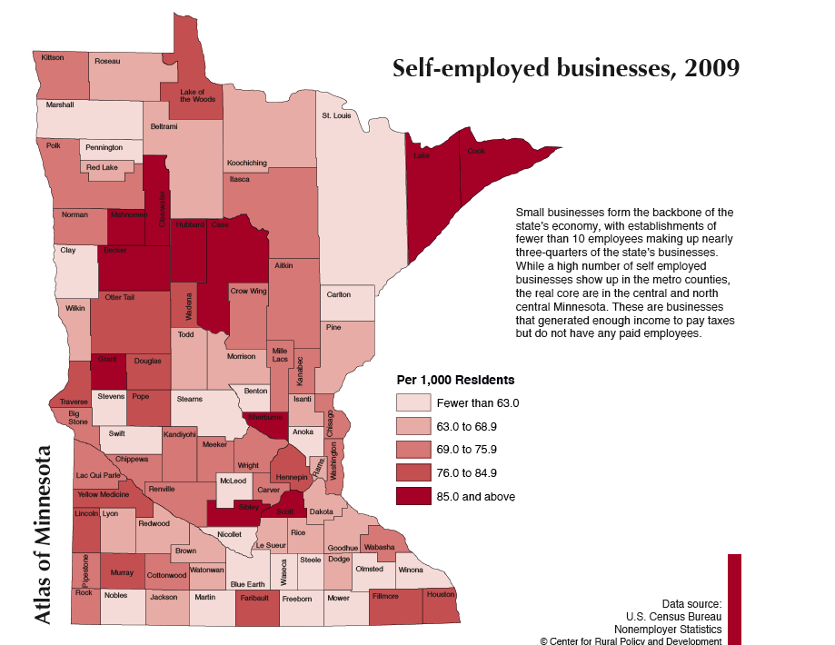
Self-employed businesses, 2009
Rural employment also disproportionately characterized by low-wage, part-time and seasonal jobs

Slide 14
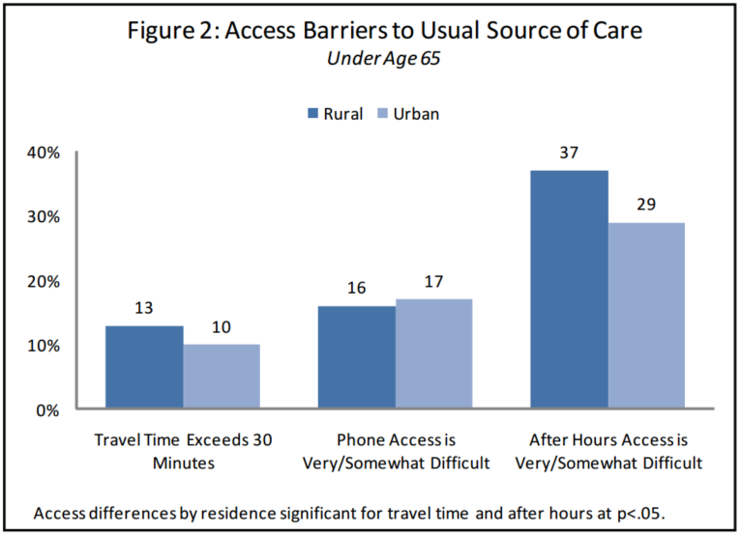
Access Barriers to Usual Source of Care: under age 65

Slide 15
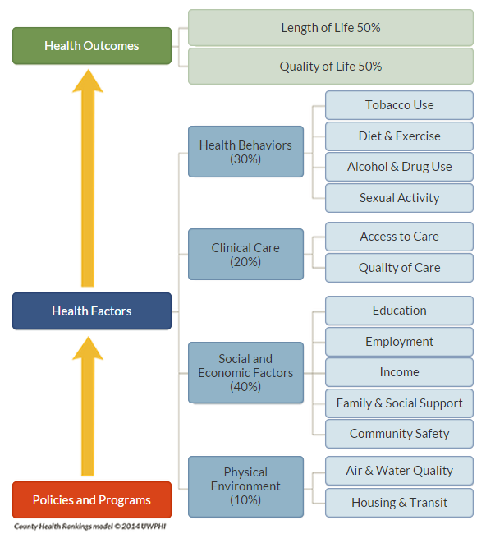
County Health Rankings
Premature Death
Health-related Q of L/ Low Birth weight
Collaboration between RWJF & U of Wisconsin Population Health Institute
Use county-level measures standardized and combined using scientifically-informed weights.

Slide 16
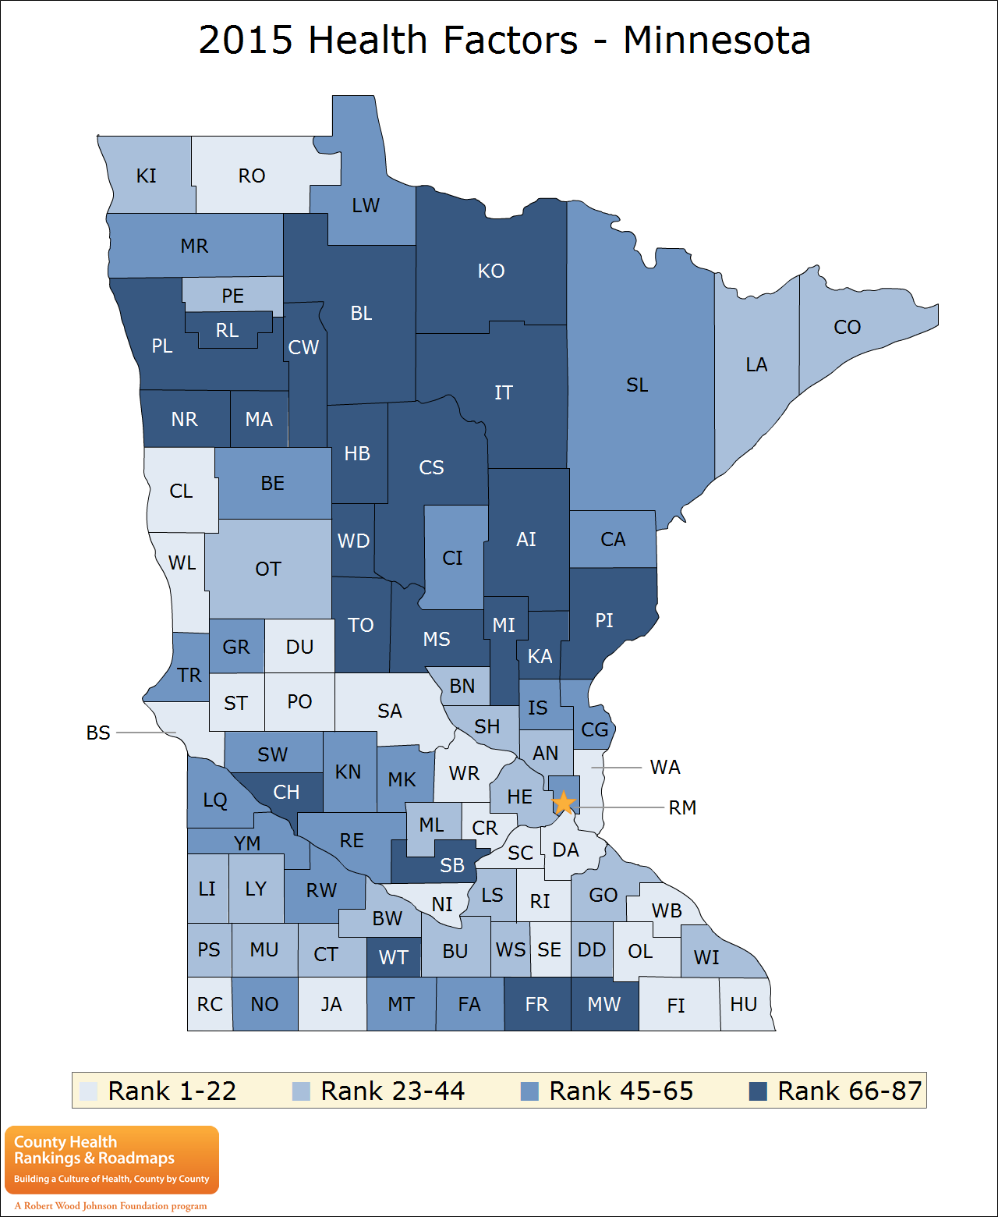
2015 Health Factors - Minnesota

Slide 17
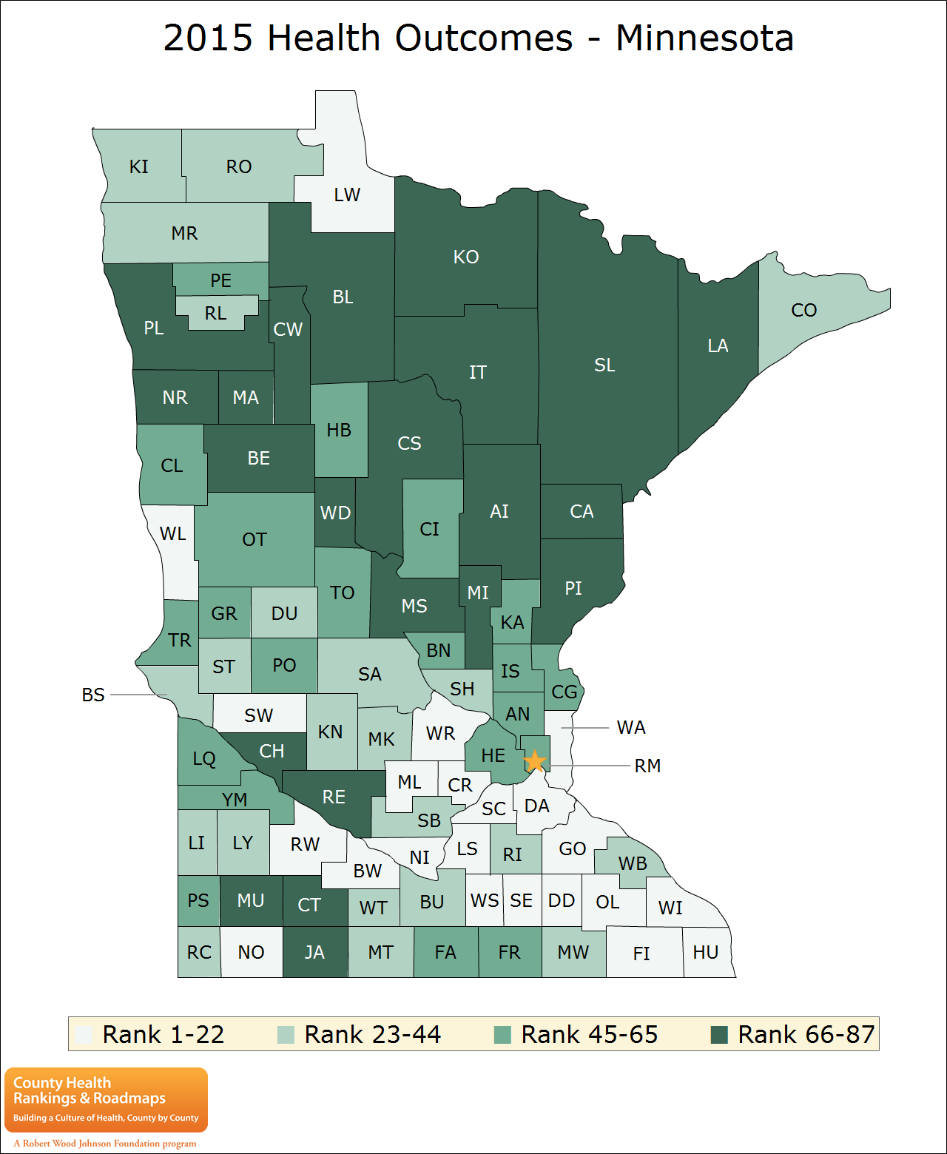
2015 Health Outcomes - Minnesota

Slide 18
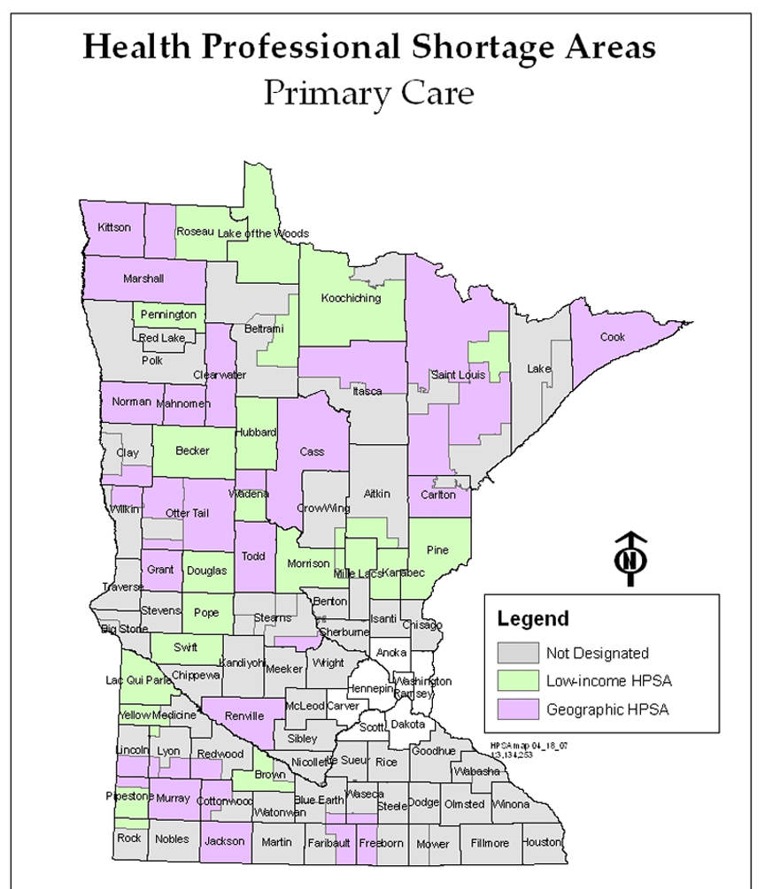
Minnesota’s Health Professional Shortage Areas

Slide 19
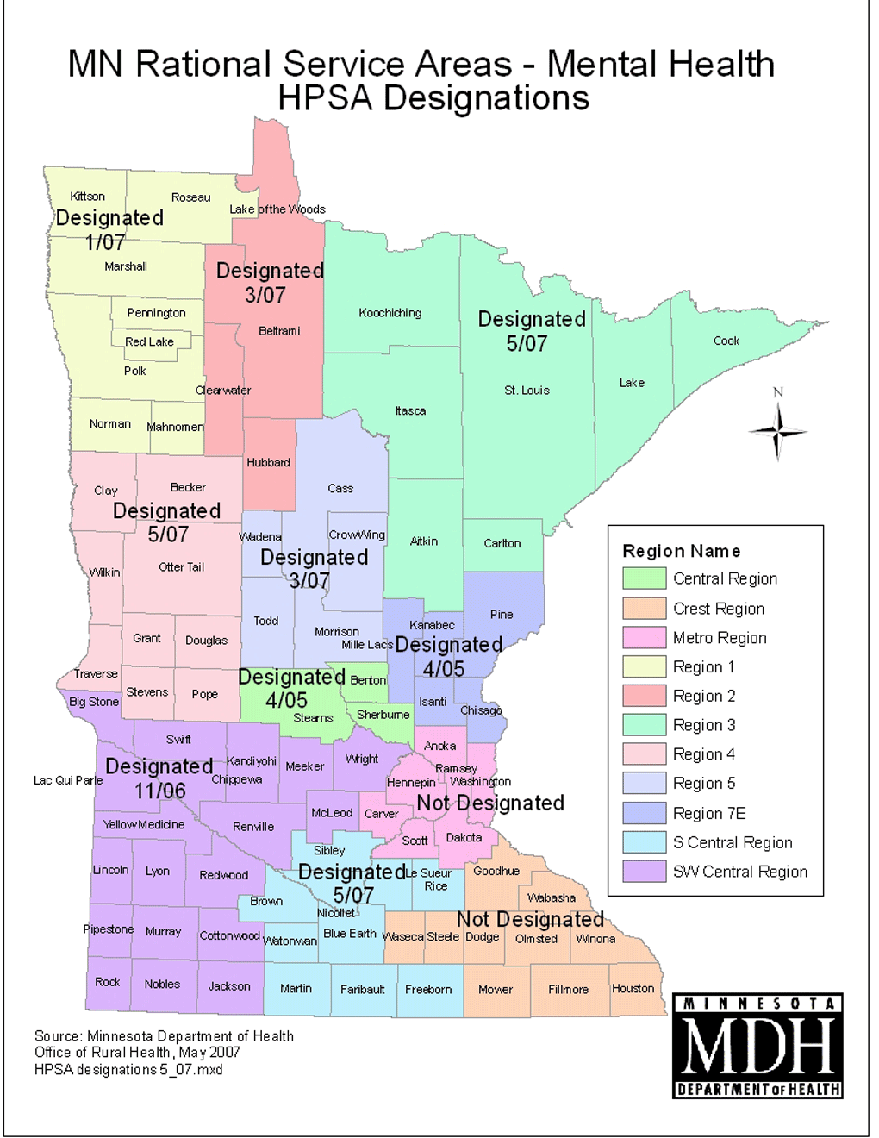
MN Rational Service Areas – Mental Health HPSA Designations

Slide 20
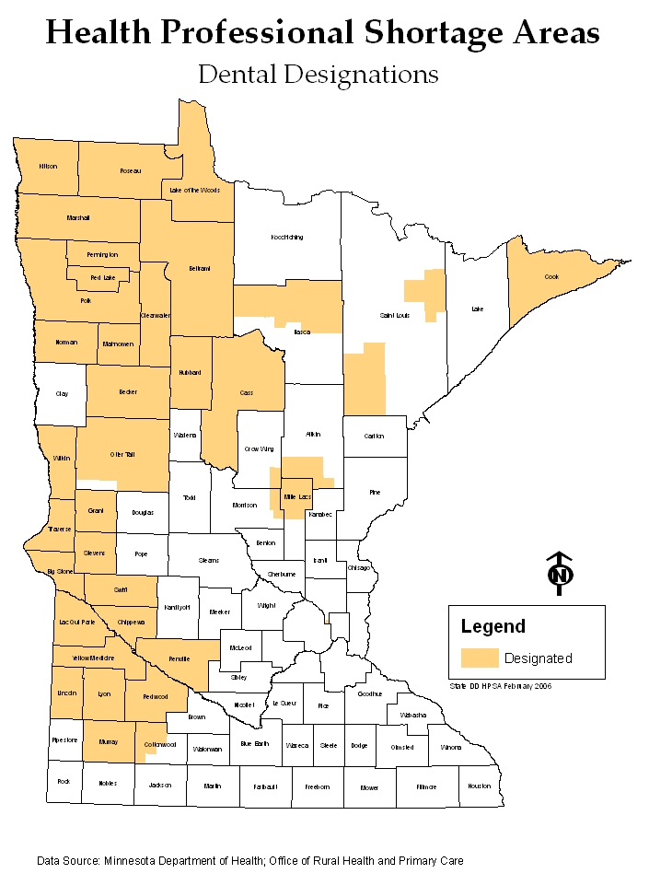
Health Professional Shortage Areas Dental Designations

Slide 21
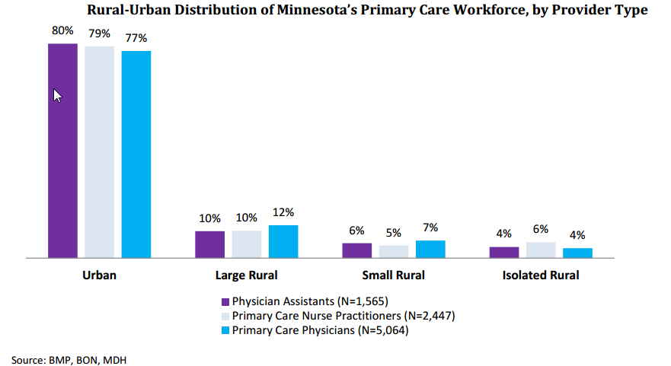
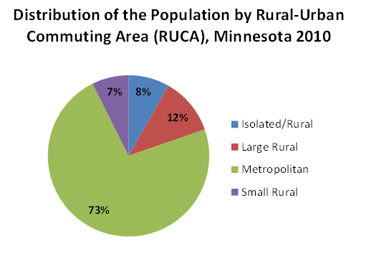
Rural-Urban Distribution of Minnesota’s Primary Care Workforce, by Provider Type

Slide 22
Race of Minnesota Physicians, by Region
Sources: Race of Minnesota physicians comes from the Minnesota Department of Health Physician Workforce Survey, 2013. Just under half (49.9 percent) of all licensed physicians responded to this survey (among those with a Minnesota business address, the response rate was 50.1 percent for a total N of 7,712.
Race of the Minnesota population comes from the Minnesota Compass project (estimates are for 2010-2012, see http://www.mncompass.org/demographics/race#1-5492-g).
Notes:
More than 1/3 (37 percent) of MN physicians are 55 or older. This is high relative to U.S. occupations overall, where only 21 percent are 55 or older. Supported by data in the MDH survey, too, in which roughly 40% of primary care physicians said they intended to practice only 10 years or less into the future.

Slide 23
Key Takeaways
  A framework and definition of access is key to fully understand adequacy of access and developing effective policy responses to addressing access barriers
Access to care varies significantly across Minnesota
Rural areas face particular challenges:
  Growing diversity in rural MN – leading to language, culture, health literacy and follow-up challenges
    Growing diversity not yet reflected in the health care workforce
  Shortages in providers
  Significant travel times to access available providers
  Poorer performance on key health indicators

Slide 24

Contact Information
Mark Schoenbaum
mark.schoenbaum@state.mn.us , 651-201-3859

Slide 25
Minnesota
Health Care Financing Task Force
Barriers to Access Workgroup
REACHING CONSENSUS ON PRELIMINARY RECOMMENDATIONS on STRUCTURAL BARRIERS, FoLLOW-UP ON ADDRESSING HIGH DEDUCTIBLE hEALTH PLANS
The presentation will be posted when accessibility standards are completed. In the meantime, if you desire a copy of the presentation, please contact smanasse@manatt.com.

Slide 26
Overview of Goals and Process
Reach consensus on Barriers to Access Workgroup preliminary recommendations on consumer assistance and health literacy, alignment of benefits/plans/providers, and affordability
The Barriers to Access Workgroup will present these recommendations to the Task Force on November 13th
26

Slide 27
Improve Consumer Assistance Resources
Recommendation: Explore options for improving and enhancing consumer assistance resources (e.g., Navigators, in-person assisters, community health workers)
Potential Option
Ensure that the state’s selection of Navigators prioritizes entities able to provide linguistically and culturally appropriate assistance
Potential Option
Expand scope and payment of consumer assistance resources to include support in accessing coverage (i.e., health and financial literacy)
Other Options?
27

Slide 28
Plan and Provider Differences Across the Coverage Continuum
Significant overlap in Medical Assistance and MinnesotaCare plans.
Less overlap with QHP options.
2015 Plans | Medical Assistance | Minnesota Care | MNsure
Blue Cross and Blue Shield | - | - | •
Blue Plus | • | • | •
HealthPartners | • | • | •
Itasca Medical Care | • | •
Medica | • | • | •
Metropolitan Health Plan | • | - | -
PrimeWest Health | • | • | -
South Country Health Alliance | • | • | -
UCare | • | • | •
28
Notes:
Does not show service area or provider network.

Slide 29
Plan and Provider Differences Across the Coverage Continuum, continued
Overarching state provider network adequacy requirements across Medical Assistance, MinnesotaCare, and QHPs in MNsure
  Time and distance standards for access primary care and specialty care within plan service area
  Some exceptions may apply
Plans offering MA and MinnesotaCare products in same service area use the same provider network
Plans offering MA, Minnesota Care and QHP products may have different MA/MinnesotaCare vs. QHP provider networks
29
Notes:
Provider network alignment subject to further analysis

Slide 30
Address Provider and Plan Alignment Differences
Recommendation: Explore options to create plan and provider alignment across the coverage continuum
Potential Option
Encourage or require issuers to participate in Medical Assistance, MinnesotaCare, and MNsure
New York
New QHP entrants after 2014 must be existing MMC and CHIP plans, unless state determines exceptions
Potential Option
Encourage or require issuers to offer same provider networks in Medical Assistance, MinnesotaCare, and MNsure
Nevada
Medicaid plans must offer at least one silver and gold QHP with comparable geographic region and provider network
30

Slide 31
Address High Deductible QHP Products
Recommendation: Explore options to address high deductibles in QHP products in the Marketplace
Potential Option
Low or No
Deductible Plans
Require that carriers offer products with standard cost sharing designs featuring low or no deductible options (in addition to other products they choose to offer)
Potential Option
Exempt High-Value Services
Exempt certain services from deductibles to incentivize utilization of primary care and generic prescription drugs
Potential Option
Require Standard Designs
Create standard cost-sharing designs (deductibles plus co-insurance and co-payments) to create comparable products across carriers
Potential Option
Limit Non-Standard Designs
Limit the number of “non-standard” plans a carrier may offer to reduce consumer confusion regarding the number of plan choices
31

Slide 32
Address Benefit Differences
Recommendation: Explore options to create alignment across the coverage continuum and/or provide access to high value benefits
Potential Option
Add adult dental benefits in QHPs through MNsure on par with Medical Assistance and MinnesotaCare
Potential Option
Provide all or some unique Medical Assistance benefits through MinnesotaCare (e.g., add non-emergency medical transportation)
32

Slide 33
Address Benefit Differences
Modeling Needs
Number of individuals impacted
Potential additional take-up in coverage and utilization with additional benefits
Impact on broader individual and small group market
Overall state fiscal impact
33

Slide 34
Thank you!
Patti Boozang
PBoozang@manatt.com
212.790.4523
Alice Lam
ALam@manatt.com
212.790.4583
Anne Karl
AKarl@manatt.com
212.790.4578

