Slide 1
ACCESS ISSUES IN RURAL MINNESOTA
Mark Schoenbaum, Director
Office of Rural Health & Primary Care
Minnesota Department of Health
October 2015

Slide 2
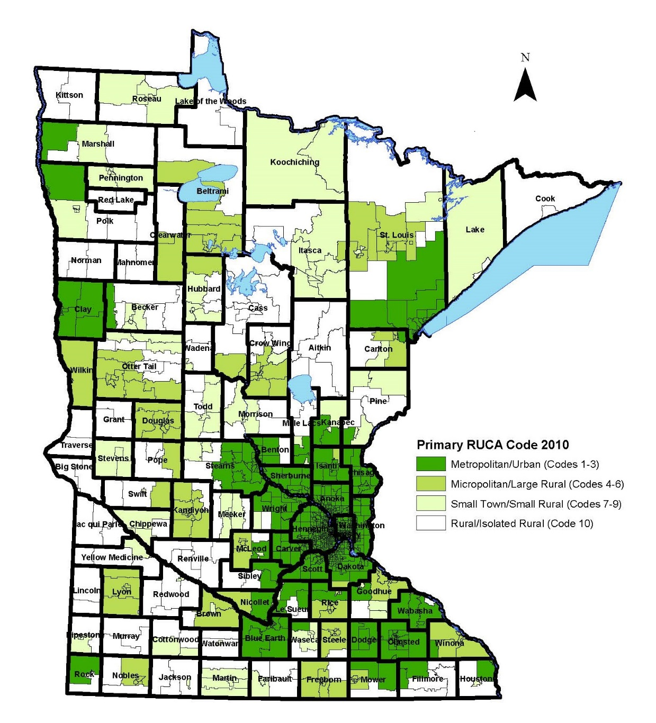
Rural-Urban Commuting Areas (RUCAs)
2010 Census Tracts - Minnesota
Notes:
About 15% of children less than 18 years of age were living in poverty in Minnesota in 2011. A higher proportion of children were in poverty in the Northwest, Northeast, and Central regions of Minnesota (see Minnesota Counties and Tribes by SCHSAC Region). With the exception of Hennepin and Ramsey Counties, a lower proportion of children were living in poverty in the Metro Area than the statewide average.
For related data on income, see Median Household Income: Facts & Figures.

Slide 3
Population in poverty, all ages, 2010

Slide 4
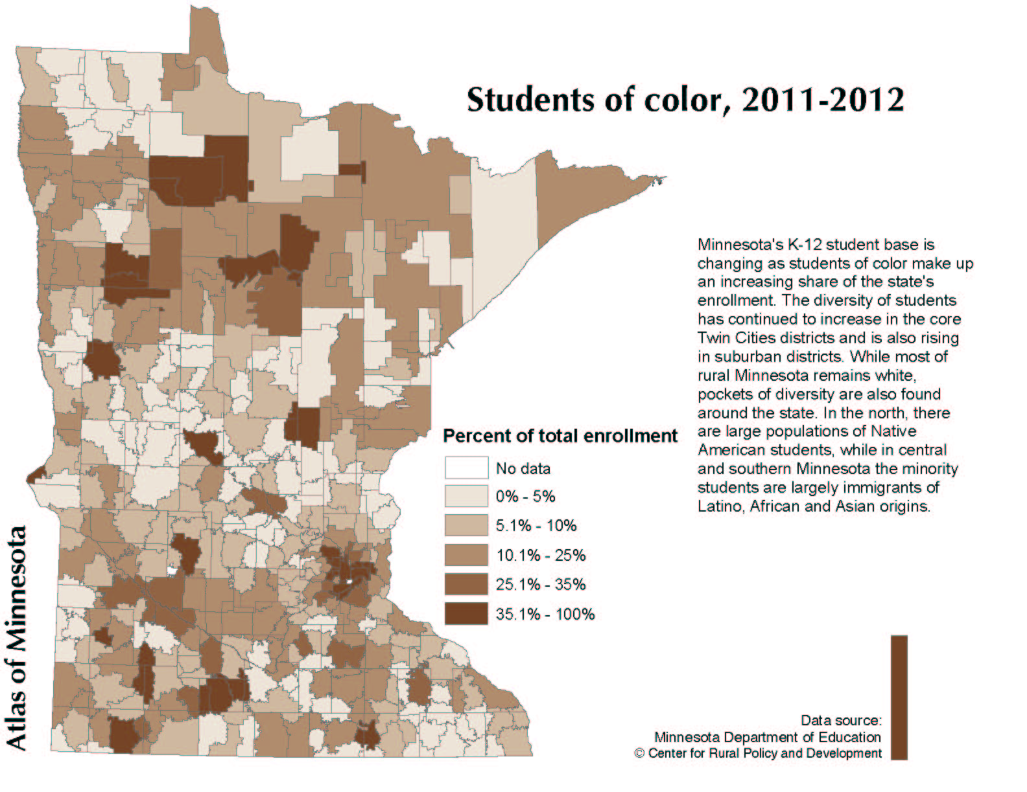
Map of Students of color, 2011-2012

Slide 5
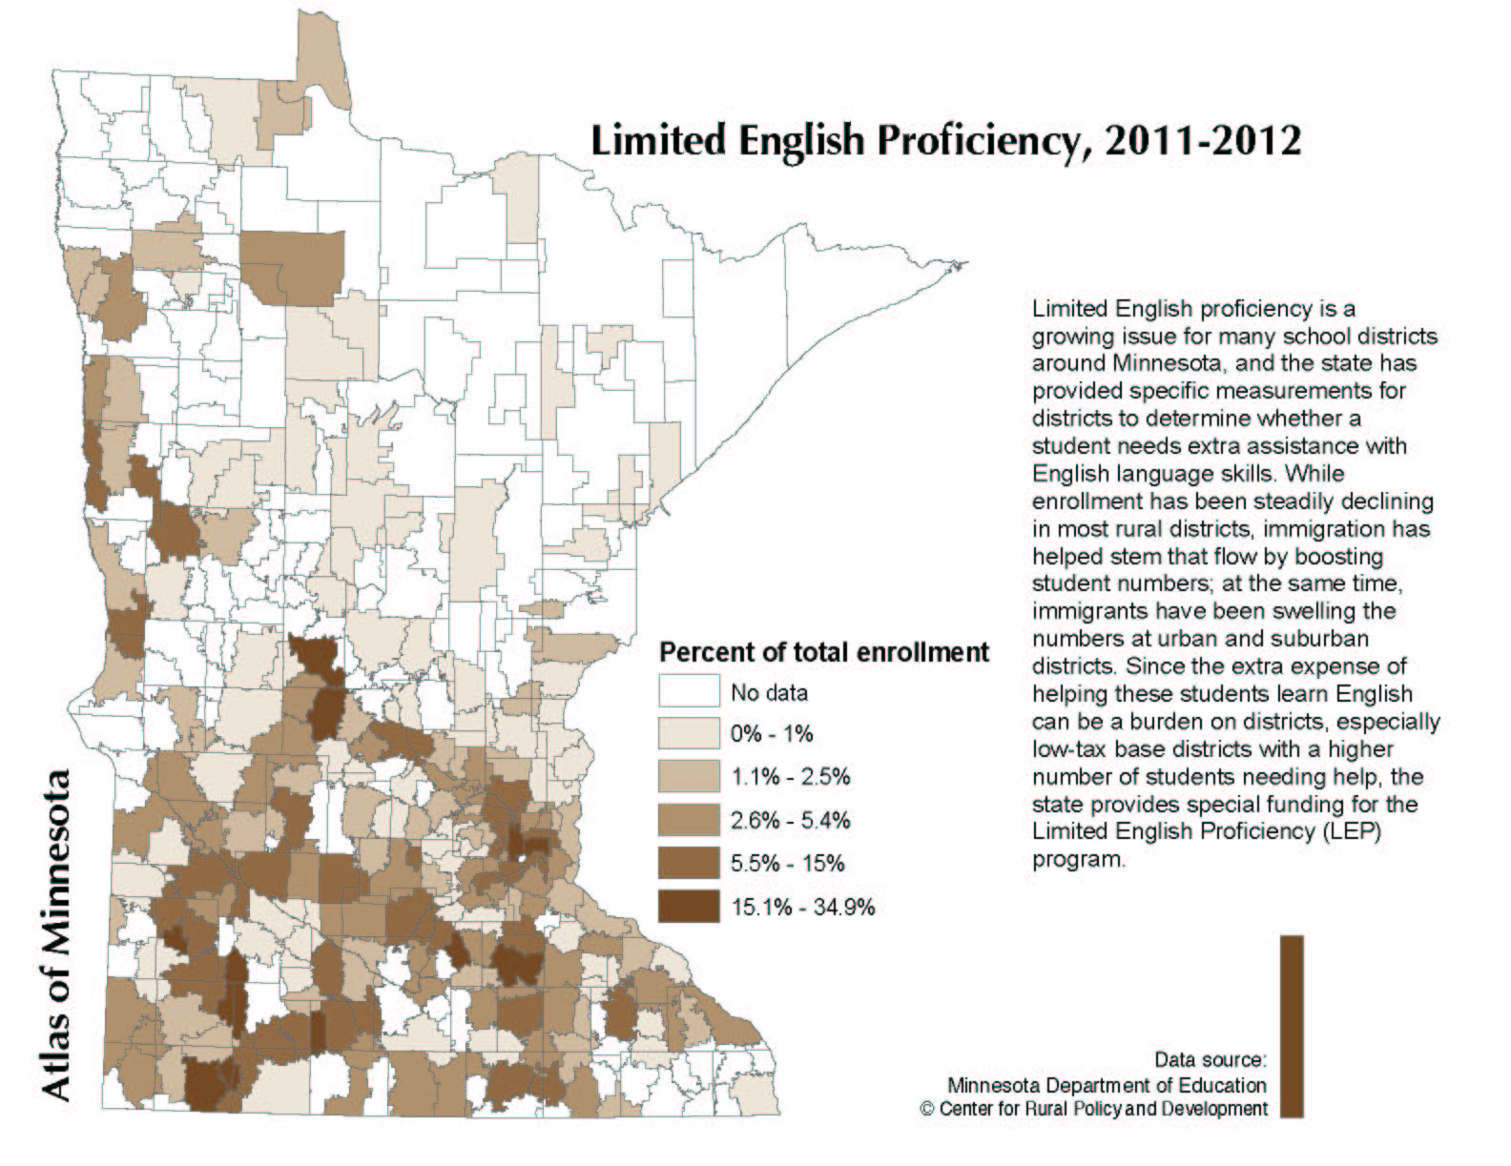
Map of Limited English Proficiency, 2011-2012

Slide 6
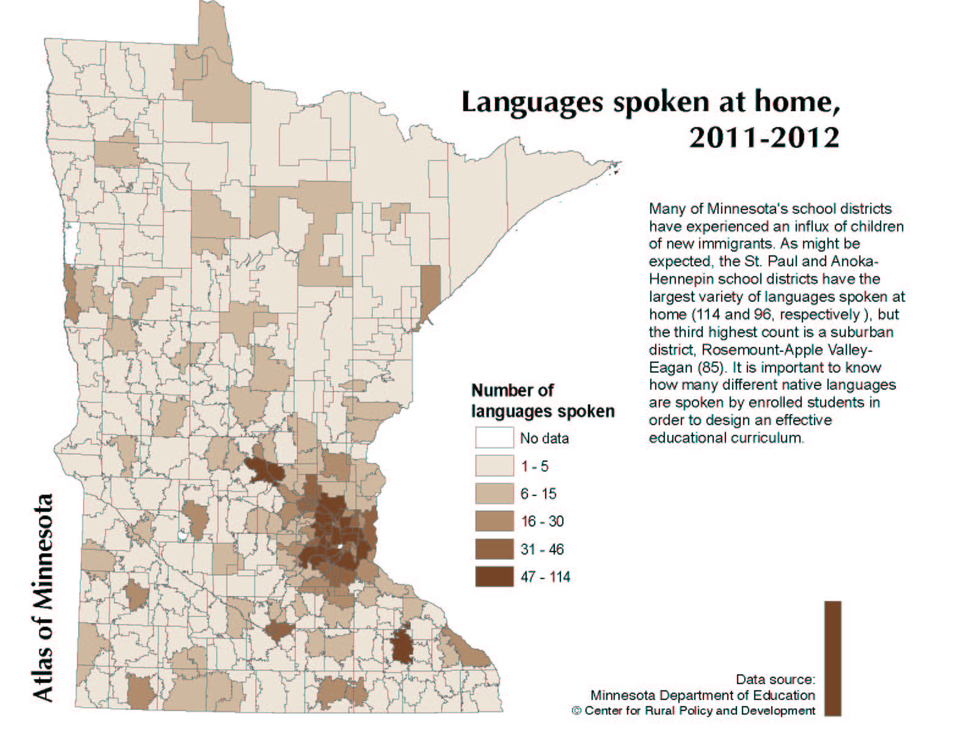
Map of languages spoken at home, 2011-2012

Slide 7
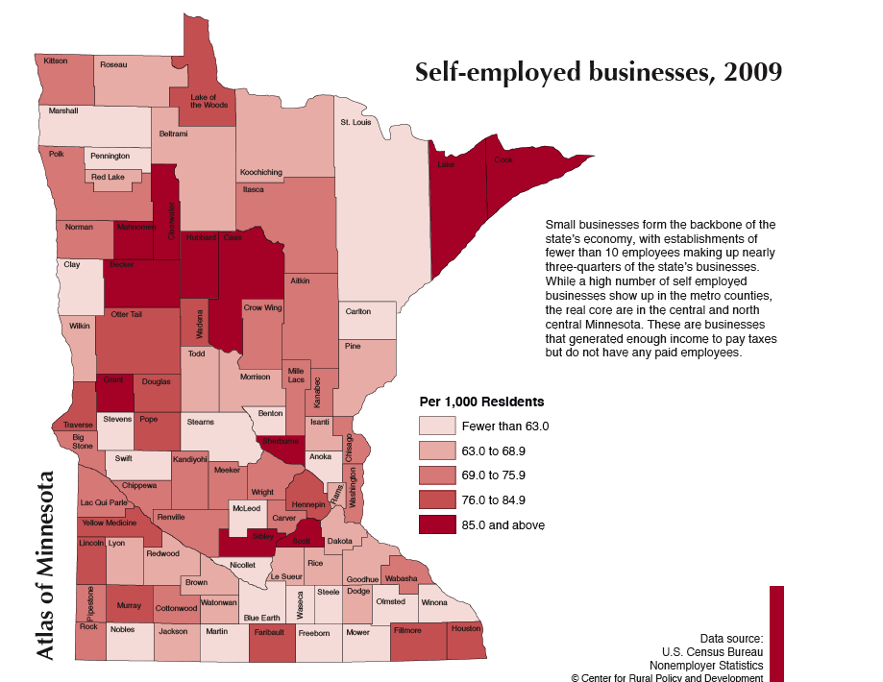
Map of Self-employed businesses, 2009
Rural employment also disproportionately characterized by low-wage, part-time, and seasonal jobs

Slide 8
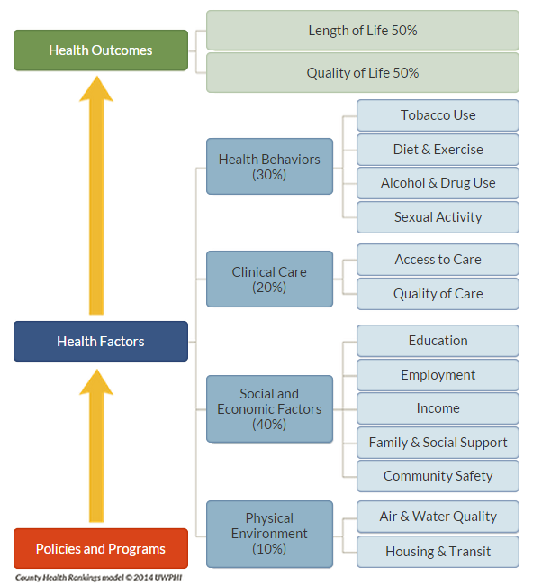
County Health Rankings
Premature Death
Health-related Q of L/ Low Birth weight
Collaboration between RWJF & U of Wisconsin Population Health Institute
Use county-level measures standardized and combined using scientifically-informed weights.

Slide 9
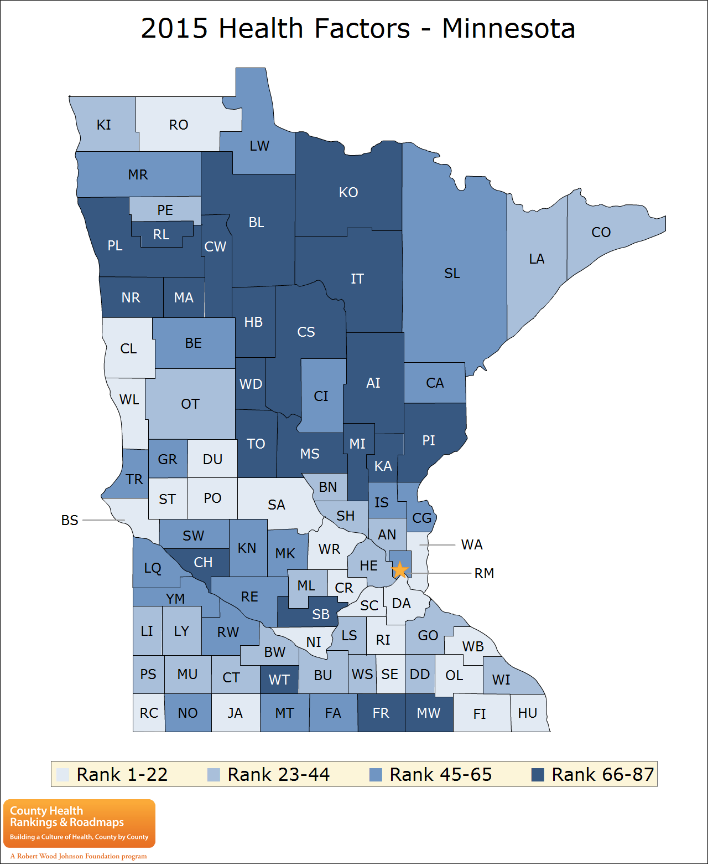
2015 Health Factors – Minnesota Ranking

Slide 10
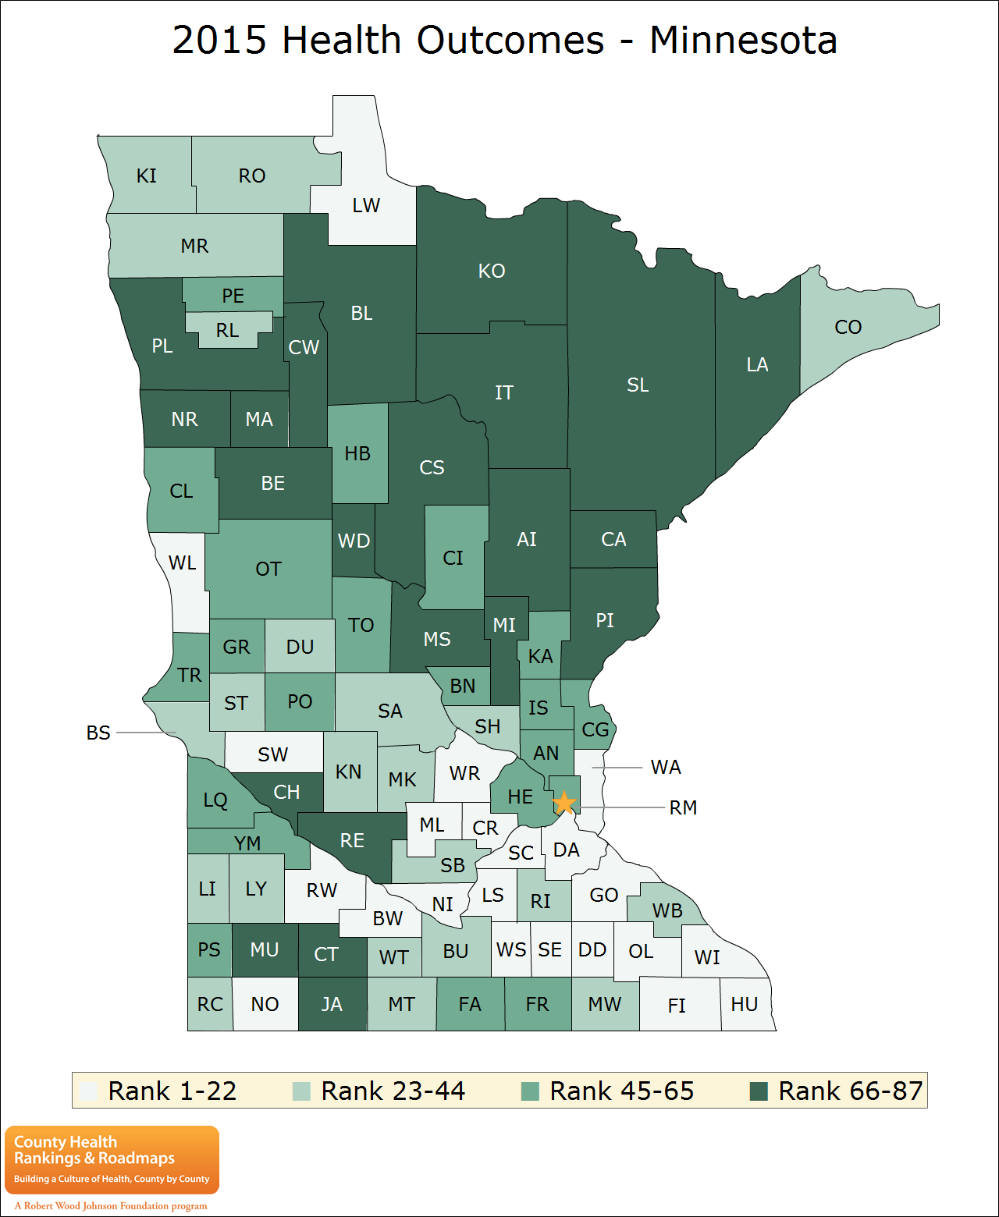
2015 Health Outcomes – Minnesota Ranking

Slide 11
Access Definitions
The use of services, not simply the presence of a facility (Donabedian 1972)
The availability of services whenever or wherever the need for such services arose (Freeborn and Greenlick 1973)
The ability to reach, afford, and obtain entrance to services (Parker 1974)
The fit between population/need attributes and provider/supply attributes (Penchansky and Thomas 1981)
The timely use of personal health services to achieve the best possible health outcomes (IOM 1993)
The ability of a population or a segment of the population to obtain health services (Khan and Bhardwarj 1994)
The end result of a process flowing from predisposing characteristics and enabling resources through need to ultimate health outcomes (Andersen 1995)
The provision of the right service, at the right time, in the right place (Rogers, Flowers, and Pencheon 1999)
The availability of an adequate supply of health care services and the individual’s opportunity to obtain health care when it is wanted or needed (Gulliford et al. 2002)
Considered in terms of four key aspects: availability, utilisation, relevance and effectiveness, and equity (Chapman et al. 2002)

Slide 12
Access Components
Availability:
  Adequacy of the health workforce supply, facilities, technology and the continuum of services
Accessibility:
  Location of supply vs. the location of clients - transportation resources and travel time, distance and cost.
Accommodation:
  Appointment systems, hours of operation, walk-in facilities, telephone services and the clients' ability to accommodate to these factors.
Affordability:
  Prices of services and insurance or payment requirements vs. clients' income, ability to pay, and coverage.
Acceptability:
  Concordance, similarity, or shared identity between provider and patient on culture, language, demographic and other attributes, such as race, sex, or age. Client comfort with type of facility, location of facility, or religious affiliation of facility or provider. Providers attitudes about the attributes of clients or their financing mechanisms.

Slide 13
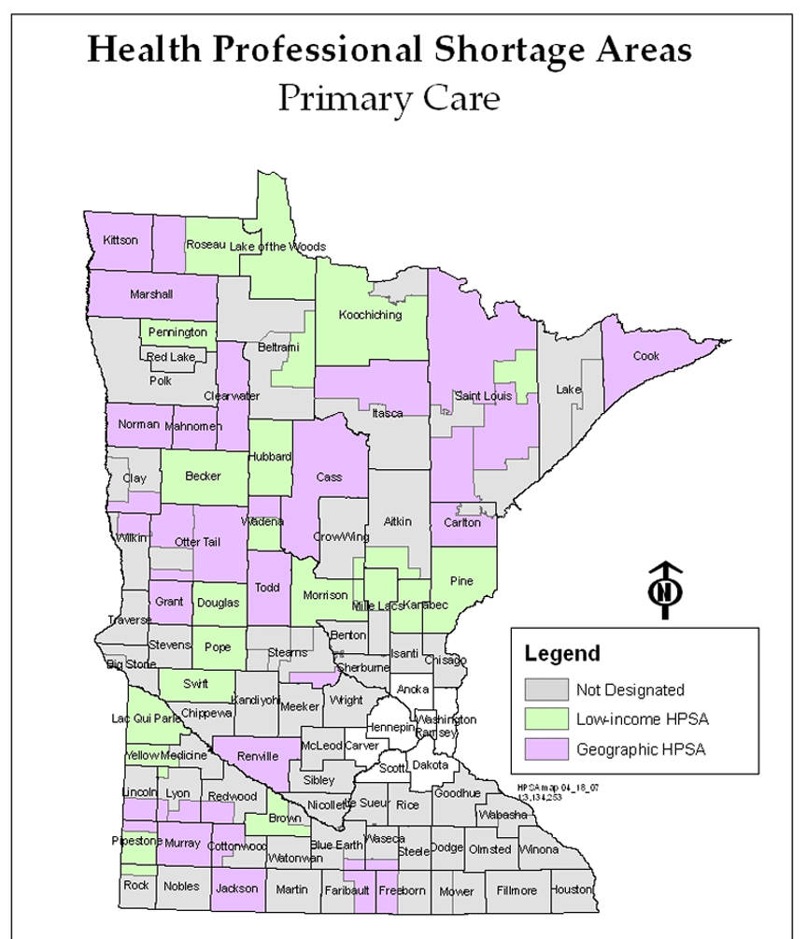
Minnesota’s Health Professional Shortage Areas

Slide 14
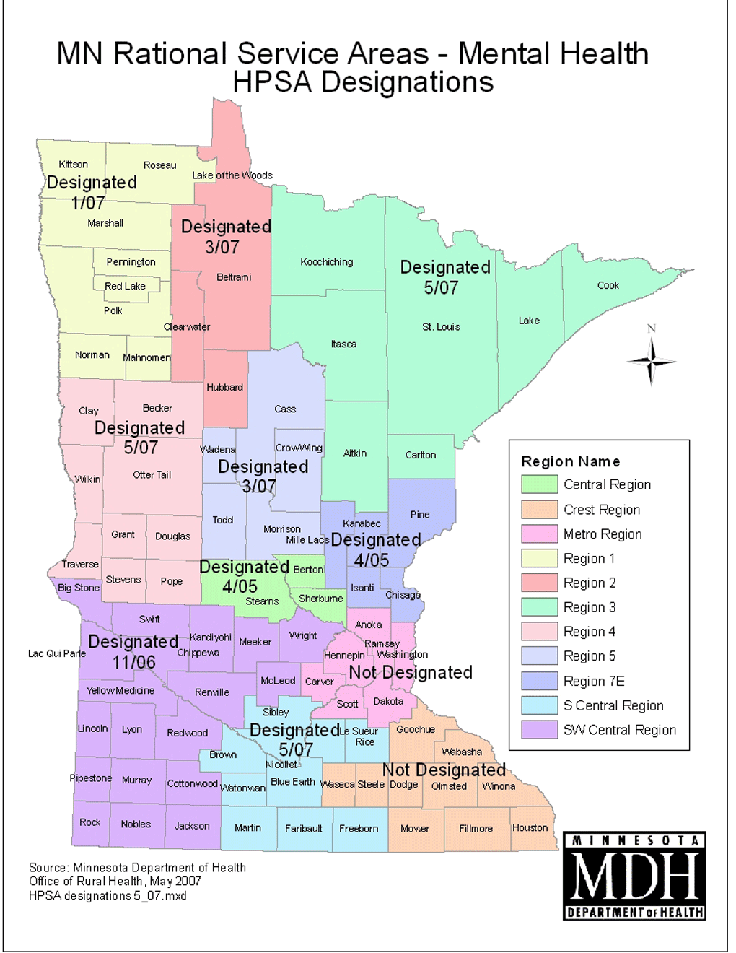
MN Rational Service Areas – Mental Health HPSA Designations

Slide 15
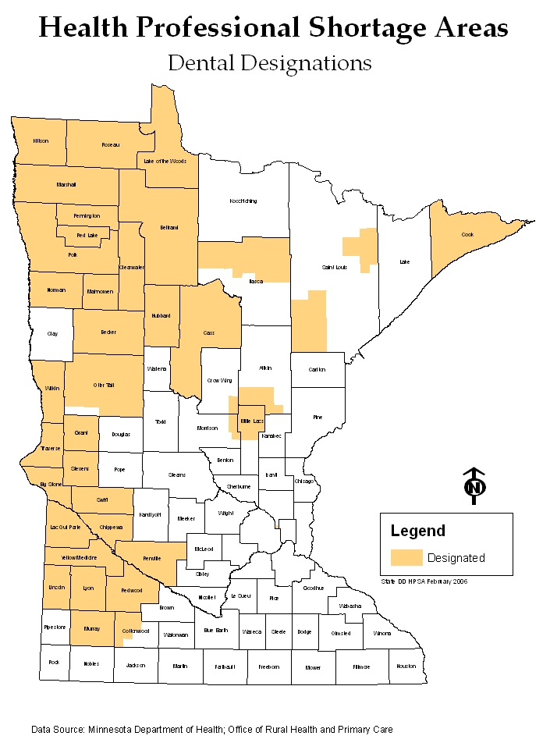
Health Professional Shortage Areas
Dental Designations

Slide 16
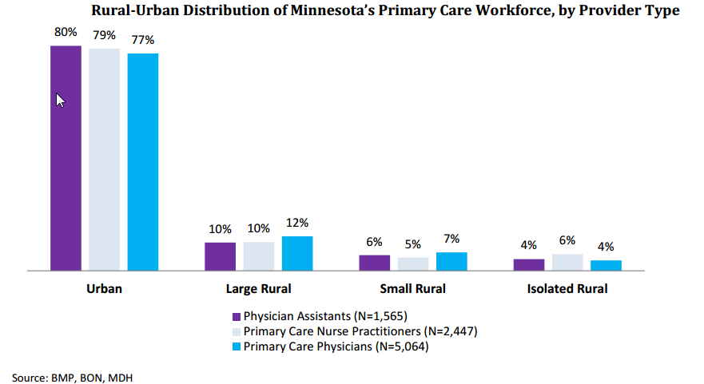
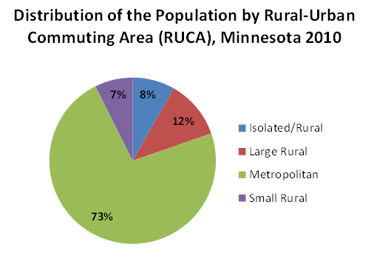
Rural-Urban Distribution of Minnesota’s Primary Care Workforce, by Provider Type

Slide 17
Race of Minnesota physicians, by region
Sources: Race of Minnesota physicians comes from the Minnesota Department of Health Physician Workforce Survey, 2013. Just under half (49.9 percent) of all licensed physicians responded to this survey (among those with a Minnesota business address, the response rate was 50.1 percent for a total N of 7,712.
Race of the Minnesota population comes from the Minnesota Compass project (estimates are for 2010-2012, see Minnesota Compass at http://www.mncompass.org/demographics/race#1-5492-g ).
Notes:
More than 1/3 (37 percent) of MN physicians are 55 or older. This is high relative to U.S. occupations overall, where only 21 percent are 55 or older. Supported by data in the MDH survey, too, in which roughly 40% of primary care physicians said they intended to practice only 10 years or less into the future.

Slide 18
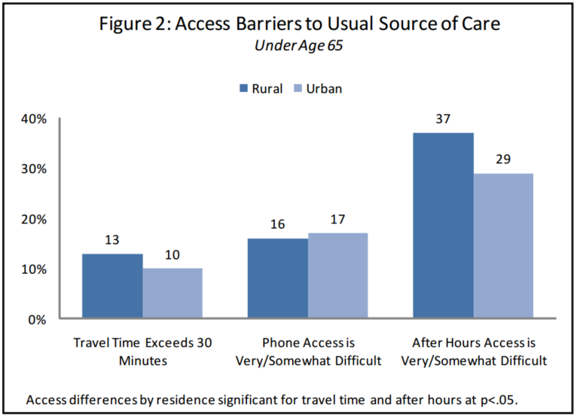
Figure 2: Access Barriers to Usual Source of Care
Under Age 65

Slide 19

Contact Information
Mark Schoenbaum
mark.schoenbaum@state.mn.us , 651-201-3859

