Slide 1
Minnesota Health Care Financing Task Force Seamless Coverage Workgroup
November 6, 2015
St. paul, MN
The presentation will be posted when accessibility standards are completed. In the meantime, if you desire a copy of the presentation, please contact smanasse@manatt.com.

Slide 2
Task Force Vision and Goals
Vision: Sustainable, quality health care for all Minnesotans
Guiding Principles
Realistic: The task force will make recommendations that can realistically be implemented.
High Value Impact: The task force will seek recommendations that have high value and are meaningful to Minnesota’s health care reform efforts.
Holistic Perspective: The task force understands that health care finance and our recommendations do not exist in a vacuum, and are components of the health care and population health systems.
Focus: The task force recognizes that health care financing and system reform is extremely complex and it will contribute to the broader policy debates by focusing its time and attention on the issues it is charged with addressing.
Innovation: The task force is encouraged to identify opportunities for innovation in Minnesota’s health care financing and delivery systems which show promise for lowering costs, improving population health and improving the patient experience.

Slide 3
Agenda
Time | Item | Presenter/Facilitator
10:15 – 10:45 am | Joint Workgroup Meeting Path to Final Recommendations | Manatt
10:45 – 10:50 am | Welcome & Review of Agenda | Lynn Blewett
10:50 – 11:20 am | Premium Stability Conclude 10/30 discussion | Manatt
11:20 am – 12:45 pm | Discuss Options & Considerations for Financing a Sustainable & Seamless Coverage Continuum | Manatt
12:45 – 12:55 pm | Public Comment | Lynn Blewett
12:55 – 1:00 pm | Wrap Up & Next Steps | Lynn Blewett
3

Slide 4
Minnesota Health Care Financing Task Force Seamless Coverage & Barriers To Access Workgroups
JOINT SESSION ON PATH TO FINAL RECOMMENDATIONS
November 6, 2015
The presentation will be posted when accessibility standards are completed. In the meantime, if you desire a copy of the presentation, please contact smanasse@manatt.com.

Slide 5
Path to Final Recommendations
“Running List” of recommendations to be shared at each Task Force meeting as attachment to the meeting agenda and record (see Attachment)
Manatt to revise workplans/timeline to reflect plan for remaining meetings to drive to final recommendations – 11/13
Milliman modeling – 12/4 to 12/18
Draft recommendations report – 12/18
5

Slide 6
Approach to the Final Recommendations/Report
Executive summary-like format to maximize impact and ease of use.
No surprises – the Draft Report will reflect Task Force deliberations and discussion.
Report will acknowledge the other options and considerations that were discussed, even if such options are ultimately not reflected as part of the recommendations.
If necessary, report can also reflect a dissenting point of view or opinion.
6

Slide 7
Approving the Final Report
Task Force members will vote to approve the report
A vote to approve means a Member:
Agrees with most of the recommendations
Affirms that the process for determining recommendations was inclusive and balanced
7

Slide 8
Minnesota Health Care Financing Task Force Seamless Coverage Workgroup
Premium stability
November 6, 2015
The presentation will be posted when accessibility standards are completed. In the meantime, if you desire a copy of the presentation, please contact smanasse@manatt.com.

Slide 9
Introduction
Ensure affordable health insurance and avoid large rate increases
Goal of Market Stability Strategies
Predictable rates enhance consumer confidence and minimize enrollment losses due to unaffordable rate increases
Some stabilization strategies also slow rate of medical inflation by reducing underlying costs of care
Importance of Market Stability
Notes:
t

Slide 10
Recap of Commerce Proposals to Increase Premium Stability
Create Minnesota-specific price stability mechanisms (e.g., reinsurance)
Merge individual and small group markets
Closer scrutiny of insurer profits
Cost transparency

Slide 11
State-Specific Price Stability Mechanism Considerations
Pros:
Spreads the costs of expensive enrollees
Reduces volatility in claims experience for insurers which may reduce premium
Can have bigger premium impact if financing comes from revenue sources beyond only insurers in the individual market
Cons:
Requires financing
Significant implementation questions
Complex to administer
May be less helpful as volatility declines

Slide 12
Merging Markets Considerations
Pros:
Larger pool helps stabilize premiums
Reduces disruption in cases where small employer eliminates group plan and employees move to individual market
Simplifies regulatory oversight
Cons:
Creates winners and losers to extent there are premium differences between markets
Requires detailed data analysis to assess impact

Slide 13
Limits on Reserves: Considerations
Pros:
MLR ensures that premium dollars go to cover medical costs
Surplus regulation levels playing field (large surplus creates market advantages, including predatory pricing)
Ensures excess premium revenue is returned to consumers
Cons:
May constrain insurer investment in longer term cost saving measures
Could impact solvency if too aggressive
Significant implementation questions

Slide 14
Increase Transparency in Rate-Setting
What is it?
Make the rate filing and rate review process more transparent and open to public input
ACA Requirements:
ACA requires public disclosure and actuarial justification when insurers propose rate increases above 10%
States have widely varying rate review practices but general trend is toward expanded transparency and more public input into the process

Slide 15
Increasing Transparency Considerations
Pros:
Enhances public accountability by allowing public scrutiny of rate filings
Increases public understanding of factors impacting rates
Facilitates comparative analysis of insurer rate filings
Cons:
May affect competitive dynamics in the marketplace
May create upward pressure on requested rates

Slide 16
Discussion Questions
Are there short-term stabilization initiatives that the Task Force should move forward?
Are there longer-term stabilizations that the Task Force should suggest be studied further?
Next Steps

Slide 17
Minnesota Health Care Financing Task Force Seamless Coverage Workgroup
Financing a Sustainable & Seamless coverage continuum
November 6, 2015
The presentation will be posted when accessibility standards are completed. In the meantime, if you desire a copy of the presentation, please contact smanasse@manatt.com.

Slide 18
Approach to Developing Financing Recommendations
Today’s conversation focuses on:
Developing recommendations for how to fund Minnesota’s public programs and Marketplace
Not how much it will cost
Milliman modeling will address costs of options, including savings due to delivery system and payment reform
Not what the cost will cover, in terms of program features
Seamless workgroup will make separate but related recommendations around program features and consolidation

Slide 19
Framework for Developing Financing Recommendations
Goal: Develop recommendations related to sustainable funding of the Minnesota coverage continuum
Maximize federal dollars
Create predictability from year-to-year for legislators, providers and consumers
Stabilize the portion of the State’s budget dedicated to funding the coverage continuum
Other?
Financing public programs (focusing on supporting affordability for populations with incomes from 138% - 200% FPL) and
financing the Marketplace are two distinct issues to be addressed
19

Slide 20
Key Questions
Public Programs
What additional federal funds might be available to reduce the State’s portion of Minnesota’s affordability scale?
Should Minnesota continue to have a provider assessment to fund the State’s portion of Minnesota’s affordability scale > 138% FPL?
Should Minnesota continue dedicate funding through its Health Care Access Fund (based on revenue from provider assessments) to fund the State of Minnesota’s affordability scale > 138% FPL
Marketplace: Should Minnesota expand the user fee to include on- and off-Marketplace products?
20

Slide 21
Agenda: Financing Public Programs
Financing Public Programs
Financing the Marketplace
21

Slide 22
Summary of Current Funding
Program | Federal Funds (Source) | State Funds (Source) | Enrollee Premium Contributions
Medical Assistance | 58% (average) | 42% (average) | 0%
Medical Assistance | Medicaid Match | General Fund & Health Care Access Fund | 0%
MinnesotaCare* | 2015: 49% 2016: Analysis in process | 2015: 48% 2016: Analysis in process | 2015: 3%
MinnesotaCare* | APTC/CSRs through BHP | Health Care Access Fund | 2016: Analysis in process
*Funding for MinnesotaCare can change on annual basis. Factors driving the state versus federal share include the overall cost of the program (based on state’s negotiated capitation rate paid to MCOs) and the QHP benchmark rate (based on the approved premium rates by Commerce).
Source: Health Care Access Fund Statement, End of Session 2015

Slide 23
Overview of Funding Options to Support Affordability for Populations > 138% FPL
Federal Funding
APTCs/CSRs*
Medicaid match (in addition to APTCs/CSRs)
State Funding
Provider assessments/Health Care Access Fund*
General fund
* Current funding sources
23

Slide 24
Federal Funding Options >138%: APTCs/CSRs
Minnesota can leverage APTC/CSRs through one of three mechanisms:
Basic Health Program. State receives 95% of the value of the APTCs/CSRs that would have been available through the Marketplace (current federal funding source)
1332 Waiver. State receives 100% of the value of the APTCs/CSRs that would have been available through the Marketplace. (Note: Waivers are not available until 2017 and funding formula has not been announced.)
Marketplace. Consumers receive 100% of the value of APTC/CSRs when they enroll in silver-level plans in the Marketplace.
Milliman modeling will inform recommendations regarding the coverage program mechanism for populations above 138% FPL
24

Slide 25
Future Federal Funding Options: Medicaid Match for Populations > 138%
MN previously covered this population using a Medicaid match under an 1115 waiver.
In 2015, MN converted people with incomes between 138-200% FPL to the Basic Health Program.
Today, MinnesotaCare receives no Medicaid dollars for this population.
State could consider submitting an 1115 waiver to draw down a Medicaid match to supplement federal ATPC/CSR funding for people with incomes >138% FPL.
25

Slide 26
Medicaid Match for Populations > 138% FPL: State Examples
Other states have used 1115 waivers to receive a Medicaid match to improve coverage affordability for populations > 138% FPL, while continuing to access APTC/CSR dollars
Vermont
Massachusetts
Additional subsidy for Marketplace premiums
Individuals with incomes up to 300% FPL
Effective January 1, 2014
Additional subsidy for Marketplace premiums
Individuals with incomes up to 300% FPL
Effective January 1, 2014
26
Notes:
VT source: http://www.medicaid.gov/Medicaid-CHIP-Program-Information/By-Topics/Waivers/1115/downloads/vt/vt-global-commitment-to-health-ca.pdf

Slide 27
Medicaid Match for Populations > 138% FPL
Pros:
Brings additional federal dollars into State, reducing State’s fiscal obligations
Cons:
Requires CMS approval of 1115 waiver through a discretionary process; new administration may have a different view on waivers
27

Slide 28
Overview of Future Funding Options: Public Programs
Federal Funding
APTC/CSRs*
Medicaid match (for additional funding)
State Funding
Provider assessments/ Health Care Access Fund*
General fund
* Current funding sources
28

Slide 29
Future State Funding Options: Provider Assessments Overview
CMS Provider Assessment Definition: A health care-related fee, assessment or mandatory payment for which at least 85% of the burden of the assessment falls on health care providers.*
All states, except Alaska, have provider assessments.
Nursing homes, hospitals and ICFs are the most common providers that are subject to an assessment.
Enacting provider taxes, as a practical matter, requires agreement of the providers being taxed.
* 42 C.F.R. § 433.55.
29
Notes:
CMS may find fees or assessments to be “health care related” (and thus subject to the provider assessment requirements) even if less than 85% of the burden of the assesment falls on health care providers but the fee or assessment is targeted in some way toward Medicaid providers or Medicaid payments
For example, if only Medicaid MCOs are subject to a state sales tax, but other MCOs are not, CMS may find that the sales tax constitutes a provider assessment

Slide 30
Future State Funding Options: Provider Assessments Rules
In order to receive federal Medicaid matching funds for provider assessment revenue, the assessment must:
be broad-based
be imposed uniformly
not exceed 25% of the non-federal share of Medicaid costs
not hold providers “harmless”
Tax rates of <6% generally meet the hold harmless test.
Constraints do not apply to BHP or 1332 funding
30
Notes:
be broad-based, meaning that the assessment is imposed on at least all health care items or services in the class furnished by all non-federal, non-public providers in the State
Example: A hospital assessment must apply to all non-federal, non-public hospitals. A Veterans’ Administration or county hospital may be exempt, but a private academic medical center may not.
be imposed uniformly on all providers within a specified class of providers (or the state must prove that the assessment is generally redistributive in order to receive a federal waiver of the broad-based and/or uniformity requirements)
Example: An assessment on nursing facility revenue must apply at the same rate to all providers. High-volume Medicaid providers cannot be assessed 4% of revenue, while low-volume Medicaid providers are assessed 2% of revenue
not exceed 25% of the non-federal share of Medicaid costs
not hold providers “harmless” or guarantee providers will receive their money back (there is a presumption that the providers are not “held harmless” if the rate < 6%)
Example: A state cannot guarantee that a hospital will receive its assessment back in the form of a supplemental payment

Slide 31
Future State Funding Options: Provider Assessment Examples
State | State Share of Medicaid Expenditures*^ | Provider Assessment Revenue^ | Percentage of State Share Funded with Provider Assessment Revenue^ | Nursing Homes+ | Hospitals+ | ICFs+ | Health Plans+ | Other+
Arkansas | $1,091,681,218 | $139,712,997 | 12.80% | x | x | x | - | -
Colorado | $2,289,072,342 | $587,401,602 | 25.70% | x | x | x | - | -
Maryland | $3,634,166,238 | $717,307,156 | 19.70% | x | x | x | x | -
Minnesota | $4,568,231,916 | $795,059,666 | 17.40% | x | x | x | x | x
Oklahoma | $1,558,015,278 | $190,006,111 | 12.20% | x | x | x | - | -
Wisconsin | $2,586,229,227 | $527,086,836 | 20.40% | x | x | x | - | x
^FY 2012
+Provider Assessments (2014)
Source: GAO, Medicaid Financing: Questionnaire Data on States' Methods for Financing Medicaid Payments from 2008 through 2012 (GAO-15-227SP, March 2015), an E-supplement to GAO-14-627. Minnesota figures include HCAF revenue and the state share of MinnesotaCare expenditures: http://www.house.leg.state.mn.us/comm/docs/HCAFNovember2012Statement.pdf
31
Notes:
be broad-based, meaning that the assessment is imposed on at least all health care items or services in the class furnished by all non-federal, non-public providers in the State
Example: A hospital assessment must apply to all non-federal, non-public hospitals. A Veterans’ Administration or county hospital may be exempt, but a private academic medical center may not.
be imposed uniformly on all providers within a specified class of providers (or the state must prove that the assessment is generally redistributive in order to receive a federal waiver of the broad-based and/or uniformity requirements)
Example: An assessment on nursing facility revenue must apply at the same rate to all providers. High-volume Medicaid providers cannot be assessed 4% of revenue, while low-volume Medicaid providers are assessed 2% of revenue
not exceed 25% of the non-federal share of Medicaid costs
not hold providers “harmless” or guarantee providers will receive their money back (there is a presumption that the providers are not “held harmless” if the rate < 6%)
Example: A state cannot guarantee that a hospital will receive its assessment back in the form of a supplemental payment

Slide 32
Health Care Access Fund Sources
2% Tax on gross revenues of providers, hospitals, surgical centers, and wholesale drug distributors
1% Tax on gross premiums of HMOs, nonprofit health service plan corporations, and community integrated service networks
MinnesotaCare premiums
Federal match on administrative costs
Investment income
Transfers in from other funds

Slide 33
Health Care Access Fund Tax Revenue

Slide 34
Health Care Access Fund Uses

Slide 35
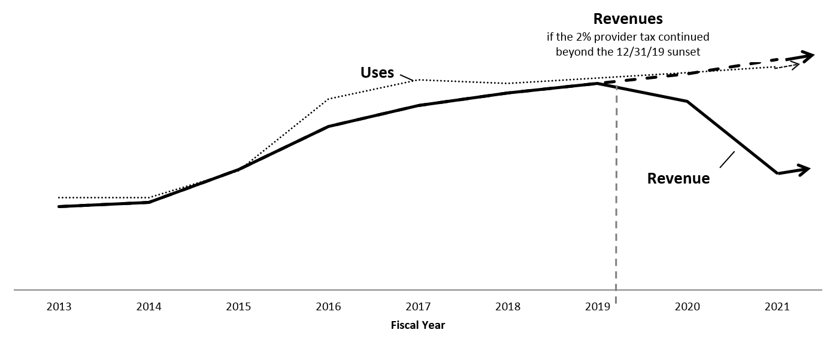
Health Care Access Fund Long Term Outlook (Based on November 2013 Forecast*)
*This chart is included to illustrate the long term solvency of the fund. Forecast and legislative changes have improved the solvency of the fund from 2015-2019 and made other adjustments ,such as the movement of the federal portion of the BHP to the federal fund.

Slide 36
Future State Funding Options: Provider Assessments
Pros:
Longstanding history of provider assessments and surcharges
Draws funding from entities most likely to benefit from expanded access to coverage
Revenue collected on these assessments may be dedicated to health care spending
Cons:
Largest provider assessment (i.e., provider tax) scheduled to expire in 2019
Politically challenging to authorize new assessments
Subject to CMS constraints (if used to draw federal Medicaid dollars)
Revenue may be placed in general fund and not dedicated to health care spending
36

Slide 37
Future State Funding Options: General Fund Overview
States may use general fund revenue to cover the non-federal share of public program expenditures
The state share of Medical Assistance in the current budget is $10.3 billion during the FY2016-17 biennium. About 91% of the state share is funded out of the General Fund and 9% is funded out of the Health Care Access Fund (HCAF)
The HCAF provides the remaining $938 million of the state share of MA
37

Slide 38
Future State Funding Options: General Fund
Pros:
May be allocated to any program
Does not require federal approval
Cons:
Politically challenging to allocate more funding to health care programs/State Health and Human Services Budget
General fund availability may vary considerably from year to year
Available funding competes with other important State needs outside of HHS budget
38

Slide 39
Developing Recommendations for Financing Public Programs: Modeling Needs
Path forward requires modeling to identify projected:
Total costs of insurance affordability programs (based on recommendations for coverage options and affordability scale)
Likely availability of federal funds
Revenue from state sources, including and excluding provider assessments, dedicated to the state share of insurance affordability programs
39

Slide 40
Agenda: Financing the Marketplace
Financing Public Programs
Financing the Marketplace
40

Slide 41
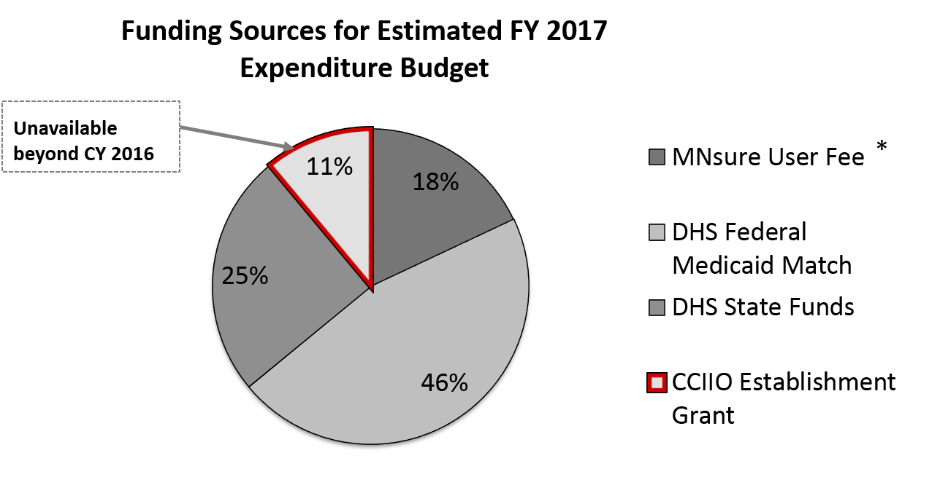
Overview of Current Funding: MNsure, cont.
Additional details in appendix
* Also referred to as “Premium Withhold”
Source: MNsure
41
Notes:
Public assistance cost allocation plan

Slide 42
Marketplace Sustainability
Federal law requires that Exchanges are self-sustaining (42 C.F.R. § 155.160)
“Self-sustaining” means funded without federal dollars
States can determine their sustainability plans, funding their marketplaces from the following sources:
User fees/premium withholds
State general funds
Cost allocation to other state agencies
Any other revenue source selected by the State
42

Slide 43
Overview of Future Financing Options: Marketplace
*Options for Consideration
Maintain Public Program Cost Allocation
Maintain user fee only on on-Marketplace products*
Expand user fee to on- and off-Marketplace products*
Federal user fee
SBM or Partially Privatized Marketplace
FFM or SSBM

Slide 44
Future Marketplace Financing Options: Maintain Cost Allocation Model
Cost allocation will be a core piece of the Marketplace sustainability (unless Minnesota elects to transition to an FFM model)
MNsure is the State’s single application and eligibility determination portal for most populations in Minnesota coverage programs including Medicaid, CHIP, MinnesotaCare and QHPs in the Marketplace
Like all states with integrated application, eligibility and enrollment systems, Minnesota allocates a portion of Marketplace costs to DHS (because MNsure is serving public program eligible consumers)
Minnesota refined its cost allocation methodology in 2014 to capture MNsure E&E costs and consumer support costs attributable to public programs.
44

Slide 45
Future Marketplace Financing Options: Cost Allocation Model – Other State Examples
Share of Marketplace Costs
State | Medicaid | Marketplace
Kentucky | 75% | 25%
Maryland | 86% | 14%
Minnesota | 70% | 30%
New York | 70% | 30%
Source for KY, MD, NY data: State Health Reform Assistance Network, Medicaid, Marketplace, and Insurance Inter-agency Relationships, Sept. 24, 2015.
45

Slide 46
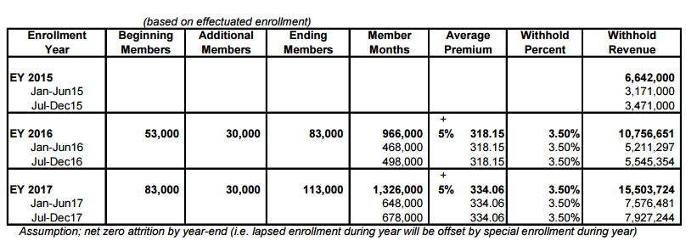
Future Marketplace Financing Options: User Fee Only On-Marketplace Products
Option: Maintain user fee on on-Marketplace products only
MNsure User Fee Revenue Projections
46

Slide 47
Future Marketplace Financing Options: Maintain User Fee on On-Marketplace Products Only
Pros:
Does not require any changes
Cons:
Creates incentives for insurers to favor coverage sold off-MNsure
Depending on enrollment, funding may not be sufficient to cover costs
47

Slide 48
Future Marketplace Financing Options: Expand User Fee
Option: Expand user fee to on- and off-Marketplace products
Minnesota currently assesses a user fee only on plans offered through the Marketplace.
Many other states with SBMs, including Kentucky, New York, Connecticut, assess plans inside and outside the Marketplace.
48

Slide 49
Future Marketplace Financing Options: Expand User Fee, continued
State | On-Marketplace Only | On- and Off-Marketplace | 2015 User Fee
FFM | ✓ | - | 3.5%
California | ✓ | - | $13.95 PMPM
Colorado | - | ✓ | 1.4% plus $1.25 PMPM broad-based fee
Connecticut | - | ✓ | 1.35%
DC | - | ✓ | 1%
Hawaii | ✓ | - | 2%
Idaho | ✓ | - | 1.5%
Kentucky | - | ✓ | 1%
Maryland | - | ✓ | 2%
Massachusetts | ✓ | - | 2.5%
Minnesota | ✓ | - | 3.5%
Nevada | ✓ | - | $13 PMPM
New Mexico | - | ✓ | Assessment pegged to insurer market share and SBM operating expenses
New York | - | ✓ | Varies by region
Oregon | ✓ | - | $9.66 PMPM
Rhode Island | - | ✓ | -
Vermont | N/A | N/A | N/A State Appropriations
Washington | ✓ | - | 2% plus $4.19 PMPM
49
*Source: Commonwealth Fund http://www.commonwealthfund.org/publications/blog/2015/may/state-marketplaces-and-financing-stability

Slide 50
Future Marketplace Financing Options: Expand User Fee, part 3
Pros:
Reduces incentives for insurers to favor off-Marketplace coverage
Spreads cost to broader base of those that benefit from higher coverage levels
Broadening base may enable State to reduce user fee rate
Increases flexibility in funding MNsure
Stabilizes resources to fund MNsure
Cons:
Some may resist mid-course change
Federal system only applies to on-Marketplace products
50

Slide 51
Federal User Fee
If Minnesota converts Marketplace to SSBM or FFM, the federal government will charge for all plans sold through HealthCare.gov
FFM
Federal government collects 3.5% user fee on all plans sold through HealthCare.gov to cover all Marketplace functions
SSBM
State may collect user fee
Federal government will charge ~2.8%* for all plans sold through HealthCare.gov for E&E functions
State keeps remainder
0.7% of on-Marketplace premiums may not be sufficient to fund State’s retained Marketplace functions
* 2.8% is an estimate. The final rate will be proposed in the 2017 Payment Notice.
51

Slide 52
User Fee in SSBM Model
Value | On-Marketplace Only (Low) | On-Marketplace Only (High) | On- and Off-Marketplace (Low) | On- and Off-Marketplace (High)
Enrollment | 50,000 | 100,000 | 330,000 (50,000 on Marketplace) | 330,000 (100,000 on Marketplace)
Est. Avg. Monthly Premium | $318.15 | $318.15 | $318.15 | $318.15
FFM Fee as Upper Limit | 3.5% | 3.5% | 3.5% | 3.5%
Annual Fee for Federal IT (80% of on-Marketplace) | $ 5.34 M | $ 10.69 M | $ 5.34 M | $ 10.69 M
Annual Budget for State (Remainder) | $ 1.34 M* | $ 2.67 M* | $ 38.75 M^ | $ 33.41 M ^
Total | $ 6.68 M | $ 13.36 M | $ 44.10 M | $ 44.10 M
*May not be sufficient to fund remaining State functions, including consumer assistance (e.g., contact center, navigators, marketing, outreach, etc.) and MNsure staff
^May be more funding than needed. User fee could be lowered.
52

Slide 53
Future Marketplace Financing Options: Federal User Fee
Pros:
Established feature of using HealthCare.gov
Cons:
State has no control over level of federal user fee
Creates disincentive to offer coverage on the Marketplace (FFM only)
State may have little revenue remaining to fund consumer assistance programs (SSBM only)
53

Slide 54
Developing Recommendations for Financing the Marketplace: Modeling Needs
Path forward requires modeling to identify:
Projected costs of Marketplace under various Marketplace models
Potential revenue from varying level of user fees on Marketplace products only and on broader insurance market
54

Slide 55
Thank you!
Patti Boozang
PBoozang@manatt.com
212.790.4523
Joel Ario
JArio@manatt.com
518.431.6719
Alice Lam
ALam@manatt.com
212.790.4583
Anne Karl
AKarl@manatt.com
212.790.4578

Slide 56
Appendix

Slide 57
Current Financing of Medical Assistance
The current projected cost of the Medical Assistance program in FY2017 is about $12.5 billion
About 41% of FY2017 program costs are funded by the State, 58% by the federal government, and 1% from counties
57

Slide 58
Current Financing of Medical Assistance, continued
Medical Assistance (Medicaid) is jointly funded by the state and federal government
States must use non-federal dollars to draw down the federal Medicaid matching funds
Federal Medical Assistance Percentage (FMAP) determines the federal government’s share
Minnesota’s FMAP is 50%
Under the ACA, states expanding Medicaid receive enhanced FMAP for certain populations
For childless adults between 0-133% FPL, MN receives 100% FMAP from 2014-2016, falling to 90% in 2020 and beyond.
58

Slide 59
Current Financing of MinnesotaCare
In FY 2017, MinnesotaCare program expenditures are expected to reach $782 million
For FY 2017, about 50% of program costs are funded by the state (via Health Care Access Fund), 44% by the federal government, and 6% from enrollee premiums
FY 2017 numbers will change, due to a likely increase in federal funding available because of changes in QHP benchmark premium

Slide 60
Summary of Current Health Care Taxes and Surcharges
Health Care Access Fund
2% Provide Tax—Scheduled to sunset December 31, 2019
1% HMO Premium Tax
Medical Assistance Surcharges (General Fund Revenue)
1.56% Hospital Surcharge
.6% HMO Surcharge
$2,815/licensed bed Nursing Home Surcharge
$3,979/licensed bed ICF/DD Surcharge
These surcharges are deposited into the General Fund and are general purpose funds
60

Slide 61
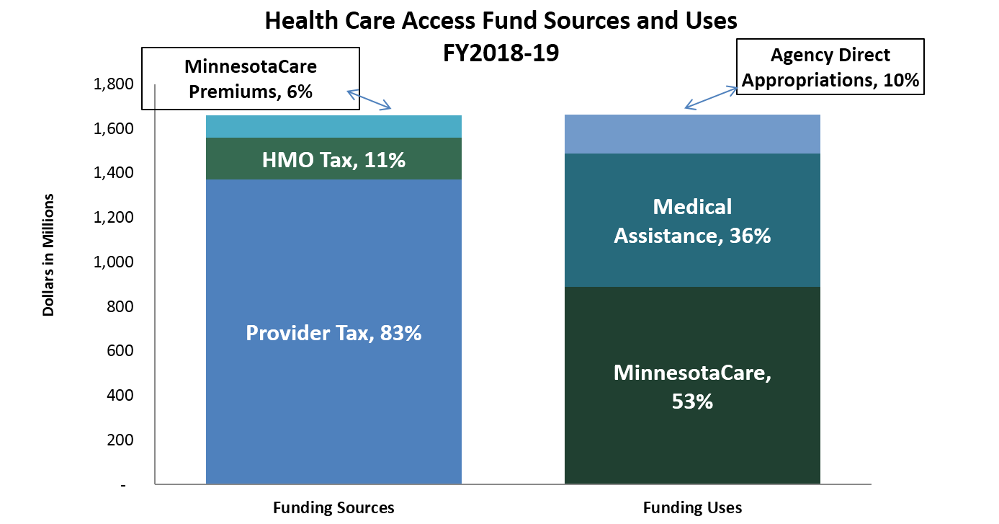
Health Care Access Fund
Source: Health Care Access Fund Statement, End of Session 2015

Slide 62
Overview of Current Funding: MNsure
Federal grants
MNsure has received $189.4M in federal Exchange grant funds
Grant funds support IT development, planning work, first year operations and more narrowly defined non-IT purposes moving forward
MNsure is spending down existing grant funding and federal funding will not be available after CY2016 under current federal policy
Premium withhold revenue
Collected on plans sold through MNsure
1.5% in 2014 and 3.5% for 2015
Future budget assumes 3.5% in 2016 and beyond
Public Program Cost Allocation (to DHS)
62

