Slide 1
Minnesota Health Care Financing Task Force Seamless Coverage Workgroup
December 21, 2015
St. Paul
The presentation will be posted when accessibility standards are completed. In the meantime, if you desire a copy of the presentation, please contact smanasse@manatt.com.

Slide 2
Task Force Vision and Goals
Vision: Sustainable, quality health care for all Minnesotans
Guiding Principles
Realistic: The task force will make recommendations that can realistically be implemented.
High Value Impact: The task force will seek recommendations that have high value and are meaningful to Minnesota’s health care reform efforts.
Holistic Perspective: The task force understands that health care finance and our recommendations do not exist in a vacuum, and are components of the health care and population health systems.
Focus: The task force recognizes that health care financing and system reform is extremely complex and it will contribute to the broader policy debates by focusing its time and attention on the issues it is charged with addressing.
Innovation: The task force is encouraged to identify opportunities for innovation in Minnesota’s health care financing and delivery systems which show promise for lowering costs, improving population health and improving the patient experience.

Slide 3
Agenda: December 21st
Time | Item | Presenter/Facilitator
11:30 am – 11:40 am | Welcome and Agenda Review | Lynn Blewett
11:40 am – 12:30 pm | Review Modeling Results of MN affordability programs & eligibility | Milliman/DHS/Commerce/MNsure/MDH
12:30 pm – 1:15 pm | Refine preliminary recommendations of MN affordability program | Lynn Blewett/Manatt
1:15 pm – 1:30 pm | Review modeling results of fixing the family glitch | Milliman/DHS
1:30 pm - 1:45 pm | Refine preliminary recommendations on fixing the family glitch | Lynn Blewett/Manatt
1:45 pm - 1:55 pm | BREAK
1:55 pm – 2:20 pm | Review modeling results of State and Federal financing | MMB/DHS
2:20 pm – 2:40 pm | Refine preliminary recommendations on financing | Lynn Blewett/Manatt
2:40 pm – 3:00 pm | Review modeling of Marketplace revenue | MNsure
3:00 pm – 3:15 pm | Refine preliminary recommendations on Marketplace revenue | Lynn Blewett/Manatt
3:15 pm – 3:25 pm | Public Comment | Lynn Blewett
3:25 pm – 3:30 pm | Wrap Up & Next Steps | Lynn Blewett
3

Slide 4
Minnesota Health Care Financing Task Force Seamless Coverage Workgroup
Review modeling results of MN affordability programs & eligibility & Refine preliminary recommendations
DECEMBER 21, 2015
The presentation will be posted when accessibility standards are completed. In the meantime, if you desire a copy of the presentation, please contact smanasse@manatt.com.

Slide 5
Today’s Objectives
Review modeling results on Minnesota affordability program models
Determine if we can narrow program consolidation models
Use new Federal 1332 guidance and modeling results to inform decision

Slide 6
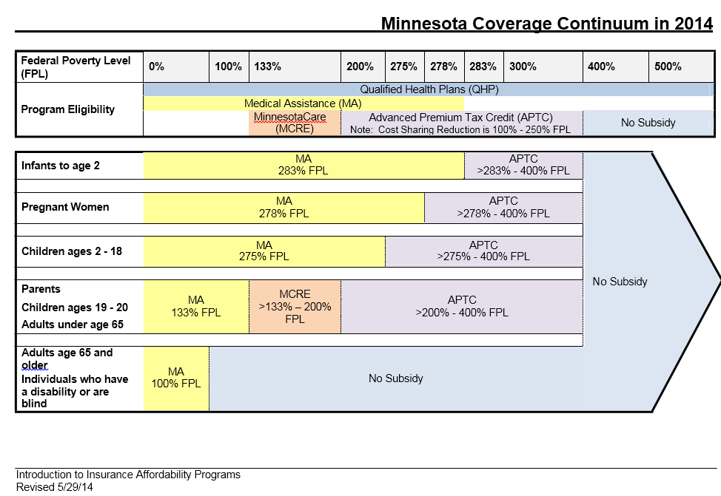
Snapshot of Today’s Coverage System
Premium and Cost-sharing Cliff at 200% FPL
6

Slide 7
Overview of Program Alignment & Consolidation Models
Focus: Smooth cliff at 200% FPL
Public Program Expansion
Individuals from 138% FPL to 275% FPL enroll in MinnesotaCare
Private Market Consolidation
Individuals from 138% FPL to 275% FPL, including MinnesotaCare enrollees, enroll in Marketplace coverage with state subsidies in addition to federal subsidies
Hybrid (Public/Private)
Individuals from 138% FPL to 200% FPL remain in MinnesotaCare and individuals from 201% FPL to 275% FPL enroll in Marketplace coverage with state subsidies in addition to federal subsidies

Slide 8
Overview of Modeling Process
Milliman, Milwaukee – Modeling & Analysis
Michael Cook
Amy Giese
Kelly Backes
Data & Input Support provided by State staff
DHS
MDH
Commerce
Mnsure
8

Slide 9
Data Sources
Detailed encounter data and enrollment records (PMAP & MinnesotaCare for CY 2012 to 2014)
Analysis of capitation rate development related to benefit differences between PMAP and MinnesotaCare (2014 to 2016)
Risk scores for PMAP and MinnesotaCare populations (2014)
PMAP and MinnesotaCare MCO rates (2016)
Integrated Health Partnership (IHP) risk-share calculations (2014 & 2015)
Milliman Health Cost Guidelines – Dental (2015)
MN Health Access Survey & Federal American Community Survey (2013) for uninsured and individual market
Health plan enrollment, claim costs and premiums from 2014 Small Group and Individual Market Survey (by metal level, age/rating region levels)
Summaries of 2015 enrollment, premiums, premium tax credits (APTC) and cost sharing reduction (CSR) for On-Exchange and Off-Exchange plans
Estimates for program-wide enrollment for On-Exchange and Off-Exchange individual plans and percentages of On-Exchange eligible for subsidies (2014-2016)
2016 Filed health plan Individual Market Unified Rate Review Templates (URRTs)

Slide 10
Modeling Parameters
This analysis is not a fiscal note.
Systems or other administrative costs for implementation are not included in this analysis.(Includes the timing for implementation, or interaction effects with other proposals or fiscal impacts at other state agencies.)
Results reflect costs of program changes for one year (2016).
Results reflect net state impact of recommended changes on the current program, which means results assume current existing state and federal investment in the program
10

Slide 11
Modeling Results of Affordability Programs Option 1: Public Program Expansion
11

Slide 12
Overview: Public Program Expansion
Affordability scale: Implement recommended affordability scale (premiums and cost sharing) to smooth cliff at 200% FPL
138-200% FPL: Remain in MinnesotaCare at 94% AV (cost and funding levels remain unchanged)
201-275% FPL: Enroll in MinnesotaCare at 87% AV/73% AV
Benefit Set: Provide MinnesotaCare benefit up to 275% FPL
Purchaser: State (public program)
1332 impact: Likely not available under a SSBM/FFM model
12

Slide 13
Implications of New 1332 Guidance on Model
Requires 1332 waiver to make individuals with incomes 201-275% FPL ineligible for APTCs through Marketplace
Would likely require State to develop process to administer all subsidies from 100-400% FPL (per 1332 guidance)
13

Slide 14
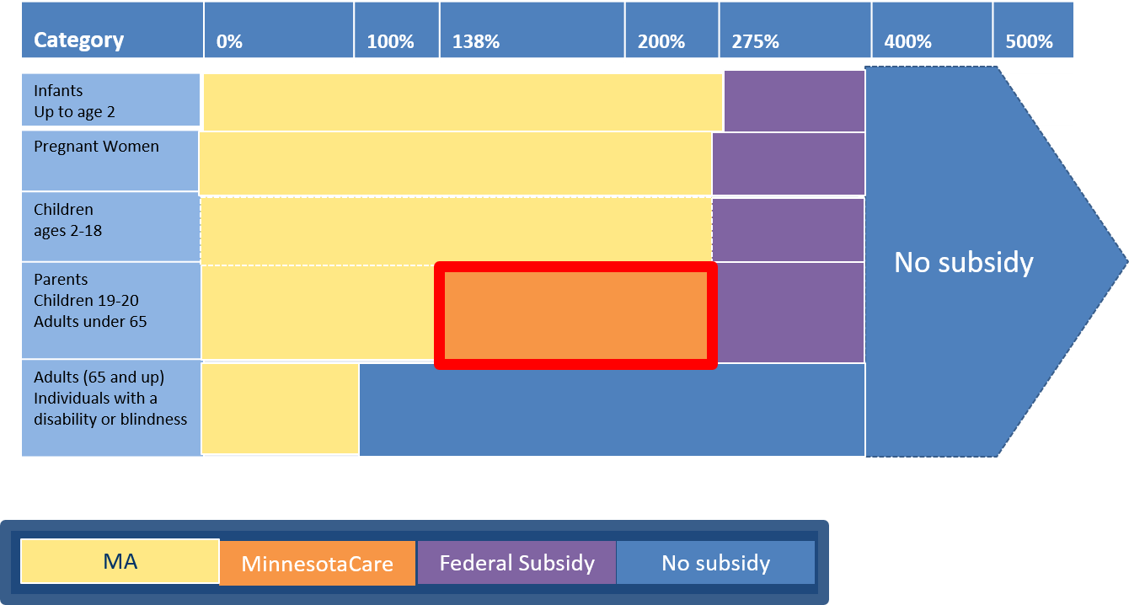
MinnesotaCare up to 275% FPL (Public)

Slide 15
Modeling Results: MinnesotaCare Expanded to 275% FPL
Estimated Population Impacted: 42,700 Average Monthly Enrollees
Category | Financial Impact
Total New State Cost (without new federal dollars) | $70 M $62 M - 37,000 current on-Exchange 200-275% FPL $ 8 M - 5,700 current uninsured 200-275% FPL
Potential New Federal Dollars | $35 M to $94 M $35 - 1115 waiver or $94 M - 1332 waiver
TOTAL NET STATE IMPACT (Assuming New Federal Dollars) | ($24 M) to $35 M
15

Slide 16
Key Drivers
Cost Estimate Modeling for the Public Program Expansion Option
Current MinnesotaCare capitation payments lower than QHP premiums (provider rates and admin cost)
MinnesotaCare benefit set
AV higher for 200-275% FPL than current QHP, but lower than MinnesotaCare from 138-200%
Uninsured take up rate is 10%.
16

Slide 17
Potential Consumer Impact
Option 1: Public Program Expansion up to 275% FPL
Current On-Exchange Enrollee (200-275% FPL)
Monthly Premium ($28)
Monthly Cost-Sharing ($70)
Total ($98)
Saves consumers > $1,100 /year
17

Slide 18
Public Program Expansion: Pros and Cons
Pros:
Smooths affordability cliff
Reduce program churn for consumers with income fluctuating above and below 200% FPL
Population from 201-275% FPL benefits from state purchasing with public programs (more affordable coverage)
Projected savings for consumers: $1,100 a year
May result in savings for adding 200-275% FPL under a 1332 waiver scenario (up to $24M/year)
Cons:
Shifts potential churn to 275% FPL level (though consumers have more financial resources)
Reduces Marketplace enrollment
Most likely unavailable option under SSBM/FFM model (per 1332 guidance)
Likely requires that State administer all tax credits (per 1332 guidance)
18

Slide 19
Modeling Results of Affordability Programs Option 2: Private Market Consolidation
19

Slide 20
Overview: Private Market Consolidation
Affordability Scale: Implement recommended affordability scale (to smooth cliff at 200% FPL) (premiums & cost sharing)
138-200% FPL: Enroll in Marketplace/QHP with state subsidies, in addition to APTCs/CSRs (94% AV)
201-275% FPL: Provide state subsidies, in addition to APTCs/CSRs, for in Marketplace/QHP (87% AV/73% AV)
Benefit Set: Provide MinnesotaCare benefit up to 275% FPL
Purchaser: Individual/Consumer on Marketplace
1332 impact: Likely not available under a SSBM/FFM model
20

Slide 21
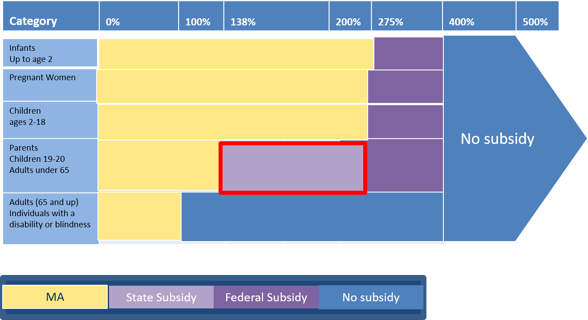
Private Market Consolidation up to 275% FPL

Slide 22
Modeling Results: Private Option from 138%FPL to 275% FPL
Population Impacted: 160,700 Average Monthly Enrollees
Category | Financial Impact
Total New State Cost (without new federal dollars) | $425 M $365 M - 118,000 currently MinnesotaCare 138-200% FPL $53 M - 37,000 currently on-Exchange 200-275% FPL $ 7 M - 5,700 currently uninsured 200-275% FPL
Potential New Federal Dollars | $0 to $212.5 M 1115 waiver, if available for state subsidies and benefits, would reduce cost of change in half ($212.5 M)
TOTAL NET STATE IMPACT (Assuming New Federal Dollars) | $212.5 M to $425 M
Projections reflect net state impact of recommended changes on the current program, which assume current state and federal investment in the program.
22

Slide 23
Cost Estimate Modeling for the Private Market Consolidation
Key Drivers
Current MinnesotaCare Population (138-200% FPL)
Products in the private market have higher provider reimbursement rates and higher administrative cost structure
Cost increase to buy up to 94% AV
Current On-Exchange Population from 200-to-275% FPL
Lower cost sharing for current QHP enrollee (87%/73% AV vs 70%/73% AV for Silver)
MinnesotaCare benefit set.
Uninsured Population (200-275% FPL)
Uninsured take up rate is at 10%
23

Slide 24
Option 2 Potential Consumer Impact
Option 2: Private Market Consolidation up to 275% FPL
Current MinnesotaCare Enrollee (138-200% FPL)
Monthly Premium $0
Monthly Cost Sharing $12
Total Impact per month $12
Current On-Exchange Enrollee (200-275% FPL)
Monthly Premium ($28)
Monthly Cost Sharing ($43)
Total Impact per month ($71)
Costs consumers >
$144 /year
Saves consumers >
$850 /year
*Premium impact reflects cost difference between ACA affordability scale (the set percentage of income that someone is expected to spend on health care premiums in a year) and a recommended affordability scale to smooth the cliff at 200% FPL.
24

Slide 25
Private Market Consolidation: Pros and Cons
Pros:
Smooths affordability cliff
Reduce program churn for consumers with income fluctuating above and below 200% FPL
Increase Marketplace enrollment and improve risk pool
Does not require 1332 waiver
Projected savings for consumers in Exchange: $850/year
Cons:
Likely unable to implement MN-specific affordability scale under SSBM/FFM (per 1332 guidance)
Removes purchasing power of state public programs
Requires State develop process to “wrap” subsidies and benefits
Significant increase to state costs
Uncertainty of 1115 waiver approval for federal financing.
Projected costs to MinnesotaCare enrollees: $144/year in cost sharing.
25

Slide 26
Modeling Results of Affordability Programs Option 3: Hybrid Model
26

Slide 27
Overview: Hybrid (Public/Private)
Affordability Scale: Implement recommended affordability scale (premiums and cost sharing) to smooth cliff at 200% FPL
138-200% FPL: Remain in MinnesotaCare at 94% AV (cost and funding levels remain unchanged)
201-275% FPL: Provide state subsidies in the Marketplace, in addition to APTC/CSR at 87% AV
Benefit Set: Status quo; no new benefits added to QHP or MinnesotaCare.
Purchaser: State for 138-200% FPL; Individual Consumer for 201-275% FPL
Portability: Modeling reflects tax credit and subsidies on/off-exchange for 201-400% FPL
NOTE: It is likely Minnesota would not be able to provide for such portability of cost-sharing subsidies for individuals under 275% FPL, unlike premium subsidies, due to administrative complexities at state and federal levels.
1332 Impact: Likely cannot be implemented in an SSBM/FFM model. Likely that portable subsidy option would require State administer all APTCs/CSRs.
27

Slide 28
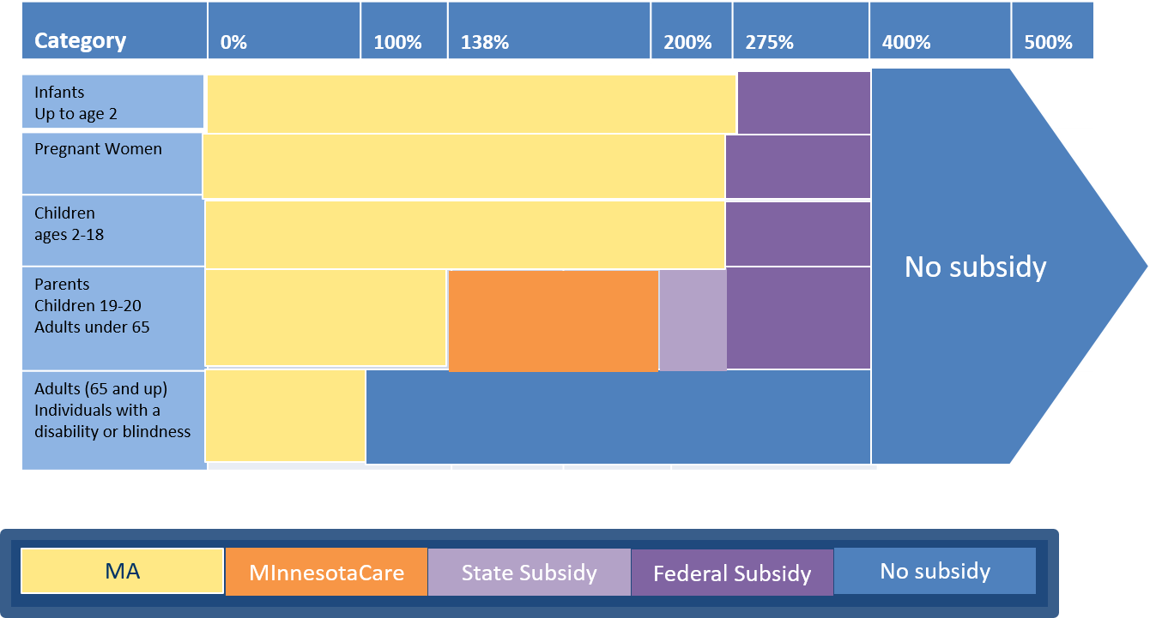
Hybrid (Public/Private)

Slide 29
Modeling Results: Hybrid Model up to 275% FPL
Population Impacted: 55,700 Average Monthly Enrollees
Category | Financial Impact
Total New State Cost (without new federal dollars) | $55 M $ 36 M - 37,000 currently on-Exchange 200-275% FPL $ 12 M - 13,000 currently off-Exchange 200-275% FPL $ 7 M - 5,700 currently uninsured 200-275% FPL
Potential New Federal Dollars | $0 to $27.5 M 1115 waiver, if available for state subsidies and benefits, would reduce state cost in half ($27.5 M)
TOTAL NET STATE IMPACT (Assuming New Federal Dollars) | $27.5 M to $55 M
It costs approximately $20 M to add MinnesotaCare benefit set to on-exchange plans from 200 to 400 % FPL.
29

Slide 30
Option 3: Hybrid Approach Key Drivers
Option 3:
Hybrid Approach
On-Exchange Population 200-250% FPL
Lower cost sharing for current QHP enrollee at 87% AV up to 250% FPL
Off-Exchange Population from 200-275% FPL
All Off-Exchange would complete eligibility process through Marketplace to claim portable subsidies
30

Slide 31
Option 3 Potential Consumer Impact
Option 3:
Hybrid Approach
Current On-Exchange
(200-275%FPL)
Monthly Premium ($28)
Cost Sharing ($44)
Total impact (per month) ($72)
Saves consumers >
$860 /year
*Premium impact reflects cost difference between ACA affordability scale/limits (the maximum amount of one’s income he/she should have to spend on premiums in a year) and a recommended affordability scale to smooth the cliff at 200% FPL.
31

Slide 32
Hybrid Model: Pros and Cons
Pros:
Smooths affordability cliff
Maintains Marketplace enrollment and risk pool
Does not require 1332 waiver, except to create portable subsidies
Saves current Exchange consumers > $860/year
Cons:
May require State to implement process to “wrap” subsidies and benefits 201-275% FPL
Adds additional layer of complexity to the coverage continuum for consumers.
Increase to state cost by approximately $27.5M-$55M
Uncertainty of 1115 waiver approval for federal financing.
32

Slide 33
Preliminary Recommendations for Survey Inclusion: Program Alignment & Consolidation
Program Alignment & Consolidation Recommendations | Score
Public Program Expansion model: Expand MinnesotaCare up to 275% FPL and maintain Marketplace coverage for consumers >275% FPL | y/n
Private Market Consolidation model: Enroll 138-200% FPL population in Marketplace, and provide additional subsidies to 138-275% FPL population in Marketplace | y/n
Hybrid model: Maintain MinnesotaCare for 138-200% FPL and provide additional subsidies to 201-275% FPL population in Marketplace | y/n
APTC portability for people in Marketplace to allow eligible consumers to use their subsidies to purchase coverage on or off the Marketplace. (Compatible with all models.) | y/n
Which of the program alignment and consolidation recommendations do we want to include in the Seamless Workgroup member survey for scoring?
33

Slide 34
Minnesota Health Care Financing Task Force Seamless Coverage Workgroup
Review modeling results on fixing the family glitch & refine preliminary recommendations
DECEMBER 21, 2015
The presentation will be posted when accessibility standards are completed. In the meantime, if you desire a copy of the presentation, please contact smanasse@manatt.com.

Slide 35
Rationalize Affordability Definition
Recommendation: Rationalize affordability definition for families with access to employer sponsored insurance (ESI) (i.e., fix the family glitch)
Low- to moderate-income families are precluded from obtaining federal tax credits to purchase coverage through MNsure because the family is deemed as having access to affordable ESI
Affordability of ESI for spouses and dependents is based on the cost of individual coverage—not on the cost of family coverage—which may be unaffordable
Through a 1332 waiver, change this ESI affordability definition for families to affordability on a family rather than individual basis
Cannot be implemented in a SSBM/FFM model
The Family Glitch
35

Slide 36
Modeling Results: Rationalize Affordability Definition
Population Impacted: 820 Average Monthly Enrollees*
Category | Financial Impact
Total New State Cost (without new federal dollars) | $1.9 M
Potential New Federal Dollars | $0
NET STATE IMPACT | $1.9 M
*This analysis is not complete at the time of this presentation. Updated numbers will be provided in final report.
36

Slide 37
Fixing the Family Glitch
Pros:
Makes coverage more affordable for families
Cons:
Per 1332 guidance, can only be implemented under SBM or private vendor option, not SSBM or FFM
There is potential for increased costs to state, if employers increase family coverage costs, making employees eligible for state/federal coverage programs.
37

Slide 38
Preliminary Recommendations for Survey Inclusion: Fixing the Family Glitch
Fixing the Family Glitch Recommendation | Score
Rationalize affordability definition for families with access to employer sponsored insurance (ESI) (i.e., fix the family glitch) | y/n
Do we want to include this recommendation in the Seamless Workgroup member survey for scoring?
38

Slide 39
BREAK ☺

Slide 40
Minnesota Health Care Financing Task Force Seamless Coverage Workgroup
Review modeling results of State and Federal financing & refine preliminary recommendations
DECEMBER 21, 2015
The presentation will be posted when accessibility standards are completed. In the meantime, if you desire a copy of the presentation, please contact smanasse@manatt.com.

Slide 41
Recap of the Financing of Minnesota’s Affordability Programs
State Funding Sources
General Fund – Medical Assistance
Health Care Access Fund (Provider & HMO Taxes) – MinnesotaCare & Medical Assistance
Other Funding Sources
Federal Share
County Share
Enrollee Premium
41

Slide 42
Key Issue: Provider Tax Set to Sunset in 2019
Provider Tax Sunset
Makes up about 80% of the revenue in the health care access fund.
Produces roughly $700 million in state revenue
Source of state (dedicated) revenue for the MinnesotaCare program
There is currently a surplus of $586M in 2017 and $1.149B in 2019.
Sunsets in 2019
Questions for the Workgroup
Should state continue the provider tax to support the state contribution for the existing MinnesotaCare program?
Should the state manage the revenues (taxes) and expenditures (cost of coverage) of the HCAF to ensure program financial sustainability?
42

Slide 43
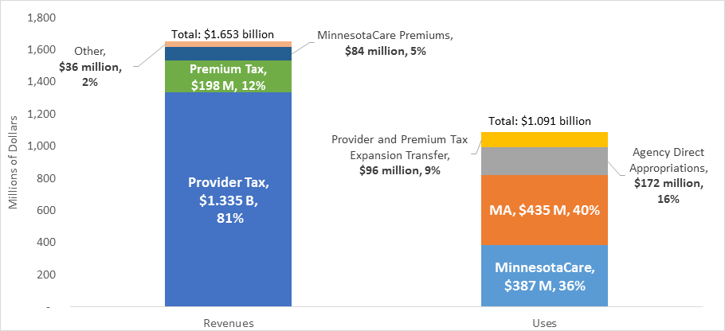
HCAF Sources and Uses, FY2018-19
43

Slide 44
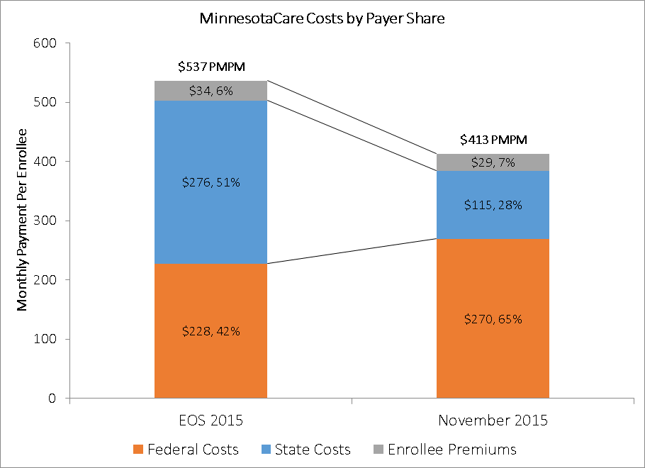
Change in Estimated State Cost of MinnesotaCare

Slide 45
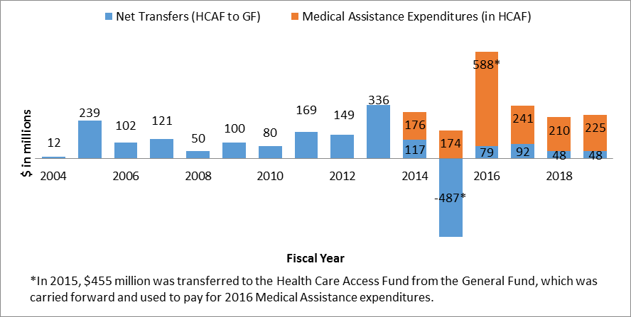
Health Care Inter-Fund Cost Sharing
45

Slide 46
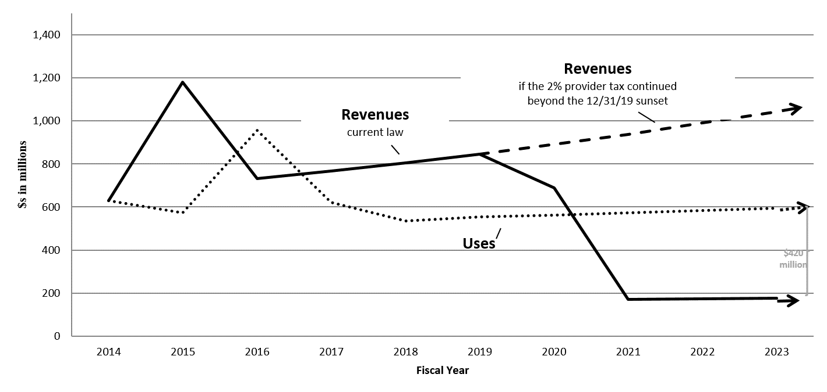
Health Care Access Fund Projections
46

Slide 47
Preliminary Recommendations for Survey Inclusion: State & Federal Financing for Affordability Scale
State & Federal Financing Recommendations | Score
Seek Medicaid match to provide additional subsidies to population with income > 138% FPL | Y/N
Recommend Minnesota repeal the sunset of provider tax to continue a dedicated state funding stream to support health care for low-income Minnesotans | Y/N
Use General Fund dollars to fund health care for low-income Minnesotans | Y/N
Which of the state and federal financing recommendations do we want to include in the Seamless Workgroup member survey for scoring?
47

Slide 48
Minnesota Health Care Financing Task Force Seamless Coverage Workgroup
Review modeling results on Marketplace revenue & refine preliminary recommendations
DECEMBER 21, 2015
The presentation will be posted when accessibility standards are completed. In the meantime, if you desire a copy of the presentation, please contact smanasse@manatt.com.

Slide 49
Marketplace Sustainability
Federal law requires that Exchanges are self-sustaining (42 C.F.R. § 155.160)
“Self-sustaining” means funded without federal dollars
States can determine their sustainability plans, funding their marketplaces from the following sources:
User fees/premium withholds
State general funds
Cost allocation to other state agencies
Any other revenue source selected by the State
49

Slide 50
Future Marketplace Financing Options: Expand User Fee
Option: Expand user fee to on- and off-Marketplace products
Minnesota currently assesses a user fee only on plans offered through the Marketplace.
Many other states with SBMs, including Kentucky, New York, Connecticut, assess plans inside and outside the Marketplace.
50

Slide 51
Expand User Fee
Pros:
Reduces incentives for insurers to favor off-Marketplace coverage
Spreads cost to broader base of those that benefit from higher coverage levels
Broadening base may enable State to reduce user fee rate
Increases flexibility in funding MNsure
Stabilizes resources to fund MNsure
Cons:
Some may resist mid-course change
Federal system only applies to on-Marketplace products
51

Slide 52
Impact of Affordability Program Changes on Marketplace Revenue
1. MinnesotaCare up to 275% FPL
Reduces size of Marketplace enrollment and therefore revenue generated by premium withhold
Increases share of MNsure operational costs paid for by DHS because more enrollees are in public programs
May require spreading premium withhold outside of Marketplace (broader base but lower rate) to sustain MNsure for costs unrelated to public programs
2. Private Option up to 275% FPL
Expands Marketplace enrollment and amount of premium withhold revenue
Reduces share of MNsure operational costs paid for by DHS
3. Hybrid Approach up to 275% FPL
Increases Marketplace enrollment
May keep premium withhold only on-Marketplace OR
May expand premium withhold to off-Marketplace with broader base/lower rate approach
52

Slide 53
Marketplace Revenue under Affordability Program Options
Category | Marketplace Enrollment | On-Marketplace Only Premium Withhold Revenue | On- and Off-Marketplace Premium Withhold Revenue
Status Quo | 83,000 | $10.7 M | $22 M at 1.5%
MinnesotaCare to 275% FPL (Public Program) | 46,000 | $4.9 M | Not Modeled
Private Marketplace/subsidy 138 – 275% FPL | 206,700 | $33.8 M | Not Modeled
Hybrid Approach | 96,000 | $14.2 M | Not Modeled
Assumes:
MNsure meets its enrollment targets in 2015
Premium withhold of 3.5%.
Does not account for effects on DHS’ share of MNsure’s budget
53

Slide 54
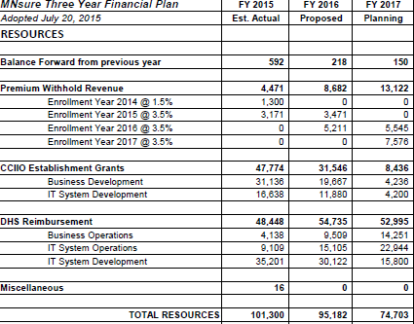
MNsure 3-Year Operating Budget (Resources)

Slide 55
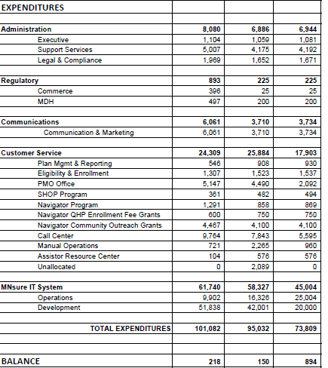
MNsure 3-Year Operating Budget (Expenditures)

Slide 56
Preliminary Recommendations for Survey Inclusion: Marketplace Revenue
Marketplace Revenue Recommendations | Score
Maintain user fee on on-Marketplace products only | y/n
Expand user fee to on and off Marketplace products | y/n
Which of the Marketplace revenue recommendations do we want to include in the Seamless Workgroup member survey for scoring?
56

Slide 57
Next Steps
OPTION 1
Manatt sends out Seamless Workgroup survey this afternoon
Seamless Workgroup members complete survey by December 23rd at 11:59pm CT
Manatt drafts package with input from Workgroup Leads and sends to Workgroup on January 4th
OPTION 2
Manatt sends out Seamless Workgroup survey this afternoon
Seamless Workgroup members complete survey by December 27th at 11:59pm CT
Manatt drafts package with input from Workgroup Leads and sends to Workgroup on January 6th
57

Slide 58
Thank you!
Patti Boozang
PBoozang@manatt.com
212.790.4523
Alice Lam
ALam@manatt.com
212.790.4583
Anne Karl
AKarl@manatt.com
212.790.4578
Joel Ario
JArio@manatt.com
518.431.6719

Slide 59
APPENDIX
The presentation will be posted when accessibility standards are completed. In the meantime, if you desire a copy of the presentation, please contact smanasse@manatt.com.

Slide 60
Key Assumptions
Not a fiscal note estimate: Projections only reflect the total costs for one year without any others costs or delays associated with implementation and ramp up related to programmatic changes.
Relationship to Current Investment: Projections reflect net state impact of recommended changes on the current program, which means results assume current state and federal investment in program.
Uninsured rate & income mix – 2016 uninsured rate and income mix would remain same as 2014.
Uninsured take-up rate for enhanced subsidies – 10% take-up rate of uninsured impacted by enhanced subsidy will enroll in coverage program.

Slide 61
Key Assumptions (cont.)
Provider Reimbursement Rates - 50% higher provider-reimbursement rates for QHP/Private plans, when compared to public program rates.
Average morbidity between MinnesotaCare and On-Exchange enrollees – No material difference in average morbidity.
2016 On-Exchange Enrollment & Subsidy Eligibility – 83,000 members participate, with 70% being subsidy-eligible (MNsure projections)
Off-Exchange Population Enrollment/Migration Assumptions: Off-Exchange population is assumed to include all of the On-Exchange membership increase, including more than 50% transition for the population with incomes of 200% - 275% FPL.
61

Slide 62
Modeling: Average Monthly Enrollees by Population (2016)
Population Segment | Average Monthly Enrollees
MinnesotaCare (138-200% FPL) | 117,570
On-Exchange (200-275% FPL) | 37,144
On-Exchange (275-400% FPL) | 20,956
Uninsured (200-275% FPL) | 57,142
Uninsured (275-400% FPL) | 29,915
Off-Exchange (200-275% FPL) | 12,875
Off-Exchange (275-400% FPL) | 62,356
62

Slide 63
Modeling: New Premium Affordability Scale v. ACA Affordability Scale (200-275% FPL)
Income Level (FPL) | Current/ACA Scale (% of income) | Recommended Scale (% of income)
201% - 250% | 6.42% - 8.18% | 4.09% - 7.25%
251% - 275% | 8.19% - 8.92% | 7.26% - 8.92%
63

Slide 64
Modeling: New Actuarial Value Scale v. ACA-Required AV Scale (200-275% FPL)
Income Level (FPL) | Current/ACA AV for Silver Product (% of income) | Recommended AV Scale (% of income)
201% - 250% | 73% | 87%
251% - 275% | 70% | 73%*
*For Hybrid Option, this AV is reduced to 70% as CSR are not available above 250% of FPL and portability of CSR for off exchange products would be complex to implement
64

Slide 65
Maintain User Fee on On-Marketplace Products Only
Pros:
Does not require any changes
Cons:
Creates incentives for insurers to favor coverage sold off-MNsure
Depending on enrollment, funding may not be sufficient to cover costs
65

Slide 66
Expand User Fee Pros and Cons
Pros:
Reduces incentives for insurers to favor off-Marketplace coverage
Spreads cost to broader base of those that benefit from higher coverage levels
Broadening base may enable State to reduce user fee rate
Increases flexibility in funding MNsure
Stabilizes resources to fund MNsure
Cons:
Some may resist mid-course change
Federal system only applies to on-Marketplace products
66

