Slide 1
Minnesota Task Force on Health Care Financing Joint Meeting of Seamless Coverage and Market Stability Workgroup Barriers to Access Workgroup
Options & Considerations for Seamless Coverage Continuum/
Reducing Financial Barriers, Part 1
October 2, 2015

Slide 2
Agenda
Potential Cliffs in Minnesota’s Coverage Programs
Options and Considerations for Reducing Financial Cliffs/Churn >138% FPL
Alternative Medicaid Models (For People with Incomes <138% FPL)
Additional Options for Improving Affordability
Discussion

Slide 3
Potential Cliffs in Minnesota’s Coverage Programs

Slide 4
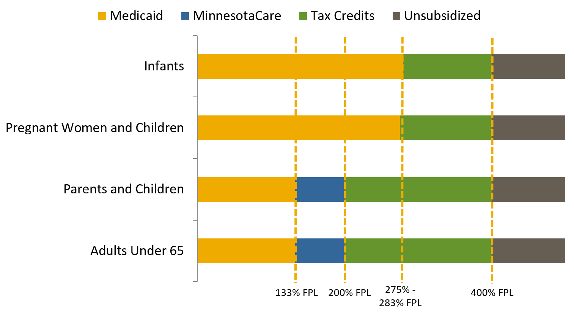
Minnesota Coverage Continuum
Notes:
MN coverage continuum is made up of a number of programs with different income eligibility levels.

Slide 5
Minnesota is an “Innovator State”
Early Mover in Affordable, Comprehensive Coverage
Early Medicaid Expansion
MinnesotaCare
IHP/Delivery System Reform
Minnesota Task Force on Health Care Financing | Manatt, Phelps & Phillips, LLP

Slide 6
Impact of MinnesotaCare
With MinnesotaCare, the State has largely smoothed the financial impact of transition from Medical Assistance for consumers (the “cliff” at 139% FPL)
Minnesota | 2015 Medical Assistance (138% FPL) | 2015 MinnesotaCare (139% FPL)* | 2015 Silver QHP with CSR (139% FPL)
Monthly premium | $0 | $16 | $48
Annual deductible | $39.20 | $39.20 | $0
Prescription drugs | $1 - $3 ($12 max./mo.) | $3 ($12 max./mo.) | $6-$65
Non-Preventive Care Visit | $3 | $3 | $20
Inpatient hospital stay | $0 | $0 | $200
Sources: MNsure and Minnesota Department of Human Services, NYS for Sample Silver QHP with CSR
*MinnesotaCare cost-sharing reflects 98% AV design for 2015. Cost-sharing will increase in 2016 when AV changes to 94%.

Slide 7
Affordability Issues Remain at Higher Income
Financial cliffs remain due to differences in premiums and cost-sharing:
MinnesotaCare and QHP coverage in MNsure for consumers at 201% of FPL
QHP coverage in MNsure for consumers with incomes above 251% and 401% of the FPL
Consumers could also face other significant changes:
Covered benefits and level of services
Health plans
Provider networks
Consumers may “churn” and experience coverage access barriers for other reasons in addition to affordability: e.g. immigration status changes, new disability, pregnancy
Minnesota Task Force on Health Care Financing | Manatt, Phelps & Phillips, LLP

Slide 8
MinnesotaCare → MNsure QHP
Consumers face significant changes in premiums and cost-sharing when moving from MinnesotaCare to QHP coverage in MNsure
Minnesota | 2015 MinnesotaCare (200% FPL) | MNsure 2016 Silver QHP* (201% FPL) | MNsure 2015 Bronze QHP (201% FPL)
Monthly premium | $80 | $117 | $63
Annual deductible | $34.20 | $1,450 | $5,000
Prescription drugs | $3 | $40 Copay or 20 – 50% coinsurance | Data Not Available
Specialty visit | $3 | $40 Copay before deductible / 20% Coinsurance after | $60 Copay before deductible / 20% Coinsurance after
Inpatient hospital stay | $0 | $0 Copay before deductible / 20% Coinsurance after | $0 Copay before deductible / 20% Coinsurance after
Notes:
MinnesotaCare amounts from DHS, OOP Cost Sharing Comparison
Mnsure QHP premium amounts assumes 40 y.o. in Rating Region 7.
Fairview UCare Choices 2015 Bronze and 2016 Silver plans (60% AV and 73% AV)

Slide 9
MNsure QHP with CSR → MNsure QHP without CSR
Consumers face increases in cost-sharing when they become ineligible for cost-sharing reductions
Minnesota (2015) | 2016 MNsure Silver QHP with CSR (250% FPL) | 2016 MNsure Silver QHP (251% FPL)
Monthly premium | $192 | $192
Annual deductible | $1,700 | $2,400
Prescription drugs | $40 Copay or 20 – 50% coinsurance | $40 Copay or 20 – 50% coinsurance
Specialty visit | $40 Copay before deductible / 20% Coinsurance after | $40 copay before deductible / 20% coinsurance after
Inpatient hospital stay | $0 Copay before deductible / 20% Coinsurance after | $0 copay before deductible / 20% coinsurance after

Slide 10
Options and Considerations for Smoothing Financial Cliffs and Improving the Seamless Coverage Continuum >138% FPL

Slide 11
Improving Coverage Affordability >138% FPL
Options
Increase subsidies to consumers with incomes 139-200% FPL
Expand subsidies to consumers with incomes 200-275% FPL
Do both: Increase subsidies for 139-200% FPL and expand to 275% FPL
Implementation Models
Current Model
Consolidate MinnesotaCare and Medical Assistance
Consolidate MinnesotaCare in the Marketplace

Slide 12
Considerations/Implications
Changes to the coverage continuum must be assessed for:
Consumer impact
coverage affordability
State funding impact
increased or decreased state spending
Administrative complexity
technical and operational changes, required federal authorities
Marketplace impact
risk pool implications (size and risk mix), feasibility in different Marketplace models
Stable coverage foundation will enhance state’s ability to improve access to care, drive payment and delivery form, reduce disparities and advance the Triple Aim

Slide 13
Affordability Option 1: Increase Subsidies to Consumers 139% - 200% FPL

Slide 14
Overview: Increase Subsidies 139-200% FPL
Description and Funding Sources
Increase subsidies to individuals with incomes from 139-200% FPL (currently enrolled in MinnesotaCare) Continue to use federal APTC/CSR funds Provide additional level of subsidy, potentially using federal Medicaid funds rather than all State funds
Opportunities to both: (1) Replace state funds for current subsidies with State/Federal Medicaid funds; and (2) Increase subsidies using State/Federal Medicaid funds
Affected | Implications
Consumer | Increases affordability and reduces churn from 139% - 200% FPL Does not address affordability issues > 200% FPL; creates greater financial cliff between 200% and 201%
State | May increase State fiscal obligation, depending on whether State is able to draw down federal Medicaid funding through a waiver

Slide 15
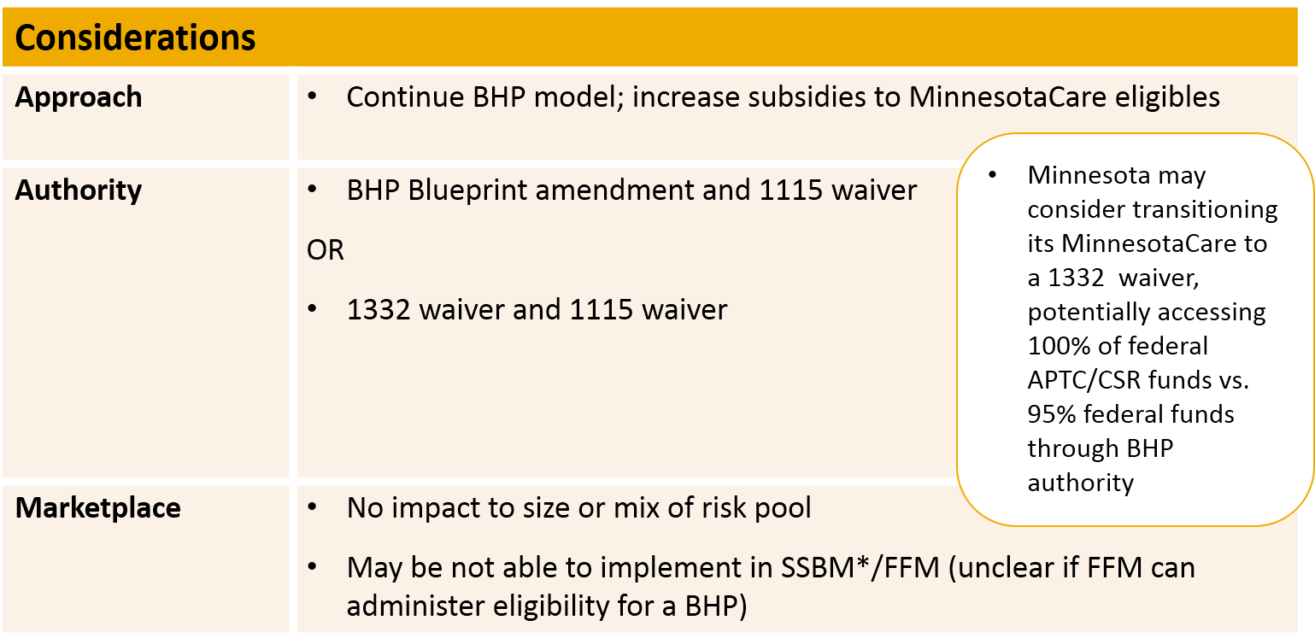
Implementation: Current Coverage Model
*Supported State Based Marketplace

Slide 16
Implementation: Medicaid Consolidation Model
Category | Considerations
Approach | •Consolidate MinnesotaCare into Medical Assistance to create a single insurance affordability program for consumers with incomes from 0-200% FPL – Medicaid and MinnesotaCare eligible consumers enroll in single set of plans •Use Medicaid funds with regular federal matching rate to enhance federal subsidies for consumers with incomes 139-200% FPL
Authority | •BHP Blueprint amendment and 1115 Waiver OR •1332 waiver and 1115 waiver
Marketplace | •No impact to size or mix of risk pool •May be not able to implement in SSBM/FFM (unclear if FFM can administer eligibility for a BHP)

Slide 17
Implementation: Marketplace Consolidation Model
Category | Considerations
Approach | •Consolidate MinnesotaCare into the Marketplace —MinnesotaCare eligible consumers enroll in Silver Level QHPs •Use Medicaid funds with regular federal matching rate to enhance federal subsidies for consumers with incomes 139-200% FPL
Authority | •Exchange Blueprint amendment and 1115 waiver
Marketplace | •Increases size of Marketplace risk pool; may improve risk •Increases tax revenue to support a SBM •Likely implementable in SSBM/FFM provided State able to directly provide additional subsidy to QHP carriers
State Example | •Massachusetts

Slide 18
Affordability Option 2: Expand Subsidies to Consumers 200 - 275% FPL

Slide 19
Overview: Expand Subsidies to 200-275% FPL
Description and Funding Sources
Expand enhanced subsidies from current level of 200% FPL to pre-ACA levels of 275% FPL Continue to use federal APTC/CSR funds Use Medicaid funds at regular federal match rate for 200% - 275% FPL (and at the same time replace State -only funds for the 139-200% FPL subsidies)
Category | Implications
Consumer | •Smooths current cliff at 200% FPL •Improves affordability for consumers 200-275% FPL •Reduces churn for consumers 139-275% FPL •Potentially decreases affordability for consumers > 275% FPL
State | •Increases state fiscal obligation; possibly offset if the State can get 1115 waver to use Medicaid funding for subsidies below 200% FPL

Slide 20
Implementation Revisited: Current Coverage Model
Category | Considerations
Approach | Continue BHP model; expand MinnesotaCare eligibility to 275% FPL
Authority | BHP Blueprint amendment and 1115 waiver OR 1332 waiver and 1115 waiver
Marketplace | Reduces size of Marketplace risk pool May not be able to implement in an SSBM /FFM (unclear if FFM can administer eligibility for a BHP)

Slide 21
Implementation Revisited: Medicaid Consolidation Model
Category | Considerations
Approach | Consolidate MinnesotaCare into Medical Assistance to create a single insurance affordability program for people with incomes from 0-275% FPL – Medicaid and MinnesotaCare eligible consumers enroll in single set of plans
Authority | BHP Blueprint amendment and 1115 waiver OR 1332 waiver and 1115 waiver
Marketplace | Reduces size of Marketplace risk pool May be not able to implement in SSBM/FFM (unclear if FFM can administer eligibility for a BHP)

Slide 22
Implementation Revisited: Marketplace Consolidation Model
Category | Considerations
Approach | Consolidate MinnesotaCare into Marketplace - MinnesotaCare eligible consumers enroll in Silver Level QHPs Maintain subsidies for consumers with incomes up to 200% FPL and expand enhanced subsidies to people with incomes up to 275% FPL
Authority | 1115 waiver
Marketplace | Increases size of Marketplace risk pool Increases tax revenue to support a SBM Likely implementable in SSBM/FFM provided State able to directly provide additional subsidy to QHP carriers
State Example | Massachusetts

Slide 23
Alternative Medicaid Models (For People with Incomes <138% FPL)
Notes:
Patricia Boozang 10/1/2015
Presentation note
We have focused above 138
No Qs on affordability for consumer < 138
Added bc of WG member interest in some of these other states models
Choices below 138 have implications for transition
Note here too - -administrative cost and complexity

Slide 24
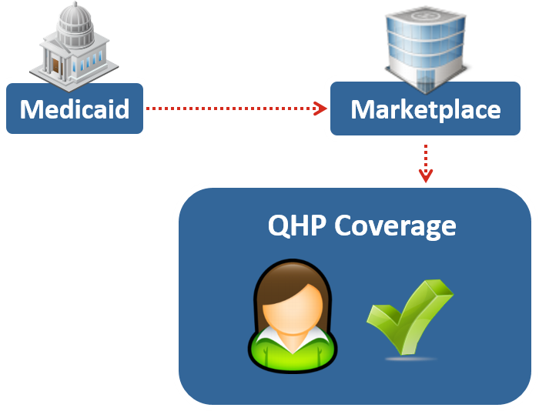
QHP Premium Assistance
States purchase qualified health plans (QHPs) certified for sale on the Marketplace for Medicaid eligible individuals
States meet all Medicaid benefits and cost-sharing protections
Promotes continuity of coverage
Ensures consistent access to providers and rationalizes provider reimbursement
Enhances integration and efficiency of public and private coverage
May create a more competitive Marketplace
May not be a strategy for states with established MMC programs

Slide 25
QHP Premium Assistance Implementation
ARKANSAS:
Newly eligible adults 0-138% FPL
Medically frail individuals are excluded
IOWA:
Newly eligible adults 100-138% FPL
Medically frail individuals are exempt
(Newly eligible adults <100% FPL are enrolled in fee-for-service Medicaid)
NEW HAMPSHIRE:
Newly eligible adults 0-138% FPL who do not have access to cost-effective employer-sponsored insurance
Medically frail individuals are excluded
APPROVED 9/27/13
APPROVED 12/10/13 Marketplace Premium Assistance only one component of expansion
APPROVED 3/4/15 Marketplace Premium Assistance only one component of expansion
Program currently voluntary
Program begins 1/1/2016

Slide 26
The Arkansas Private Option
Arkansas’s Private Option:
Mandatory premium assistance authorized by 1115 waiver
Eligible individuals are permitted to shop among and enroll in Silver metal level QHPs in the Marketplace
Enrollees >100% FPL make sliding scale premium-like contributions to Independence Accounts (similar to HSAs) ranging from $10/month to $15/month based on income
Enrollees use their Independence Account to pay their cost sharing up to maximum out-of-pocket limit
Cost sharing is for range of services for individuals >100% FPL, cost sharing at maximum levels permitted by law
Payment of Independence Account contributions is not a condition of eligibility; if enrollee does not make monthly contribution, must pay cost sharing at point of service
Coverage began on October 1, 2013

Slide 27
The Arkansas Private Option: Early Outcomes
As of the end of March 2015, approximately 230,000 individuals with incomes ≤138% FPL had gained coverage in Arkansas through the Private Option (90% enrolled in the Marketplace; 10% were determined to be medically frail and enrolled in traditional Medicaid)
≤ 138% FPL Coverage
As of March 2015, nearly 66,000 individuals with incomes ˃138% FPL had enrolled in the Arkansas marketplace (a 50% increase in total enrollment compared to 2014)
> 138% FPL Coverage
Average QHP premiums fell by 2% from 2014 to 2015 due to increased market competition and the entry of younger consumers into the market via the Private Option
Premium
Cost
For the 2015 plan year, five carriers (up from four the previous year) offered qualified health plans in Arkansas’ Marketplace, increasing choice of plans across the State
Marketplace Choice
Source: Arkansas Health Reform Legislative Task Force Report, June 2015 (Rockefeller Institute of Government; State University of New York; The Brookings Institution; Fels Institute of Government; University of Pennsylvania)

Slide 28
Arkansas Medicaid →QHP Cliff
Arkansas (2015) | Medicaid (138% FPL) | QHP (139% FPL) | Difference
Monthly premium | $0 | $47 | $47
Annual deductible | $0 | $150 | $150
Prescription drugs | $4 - $8 | $4 - $8 | $0
Specialty visit | $10 | $10 | $0
Inpatient hospital stay | $140 | $140 | $0
Maximum out-of-pocket | $754 | $754 | $0
* Note: QHP cost-sharing figures reflect the 94% AV second lowest-cost silver plan

Slide 29
Indiana’s Medicaid Expansion Waiver
EXPANSION DESIGN
High-Deductible Medicaid Managed Care (MMC) Plan with HSA-Like “POWER” Account*
Newly eligible adults with incomes 0-138% FPL
Previously eligible low-income parents and caretakers
Medically frail individuals are included
Health Insurance Payment Program (HIPP)
Premium assistance for Medicaid beneficiaries with access to cost-effective employer sponsored insurance (ESI Premium Assistance)
Voluntary for individuals ages 21 and older with incomes from 0-138% FPL
Medicaid covers employee premiums, deductibles and cost-sharing above Medicaid limits
Medically frail are not eligible

Slide 30
Indiana’s Expansion Waiver: Key Program Features
Premiums/Contributions
Sliding scale contributions to HSA-like “POWER” Account starting at 0% FPL
Vary based on income, starting at $1/month for lowest income individuals
Individuals with incomes > 5% FPL: up to 2% of income
Mandatory for individuals with incomes >100% FPL who are not medically frail; failure to pay within 60-day grace period results in disenrollment and 6 month bar on re-enrollment
Optional for individuals with incomes < 100% FPL; individuals who make contribution receive enhanced benefit package
Cost Sharing
Up to $25 co-payment for non-emergency use of ER
Newly eligible individuals with incomes < 100% FPL who do not contribute to POWER account subject to maximum permitted Medicaid cost sharing for other services beyond ER copay
Healthy Behavior Incentives
May reduce or eliminate POWER account contributions

Slide 31
Indiana’s Expansion Waiver: Key Program Features continued
Benefit and Eligibility Variations
No NEMT coverage for one year (waiver)
No retroactive coverage (waiver)
Employment-Related Provisions
Outside of the demonstration, State refers interested individuals to “Gateway to Work” job training and job search program

Slide 32
Additional Options for Improving Affordability

Slide 33
Additional Options for Smoothing Financial Cliffs
Rationalize Affordability Definition
Redistribute APTCs
Limit High-Deductible Health Plans

Slide 34
Rationalize Affordability Definition
Use 1332 waiver to define affordability for ESI for dependents
on the basis of “family coverage”
The Family Glitch
When low- to moderate-income families are precluded from obtaining federal tax credits to purchase coverage through MNsure because one or more members of the family is deemed as having access to “affordable” employer-sponsored insurance (ESI)
“Affordability” of ESI for spouses and dependents is based on the cost of individual coverage—not on the cost of family coverage—which may be unaffordable or not offered.
Notes:
if employee share of premium for single coverage < 9.5% of employee’s income, not family coverage.

Slide 35
Redistribute APTCs
Use coordinated 1332 and 1115 waivers to modify cost-sharing requirements and smooth subsidies and costs across the coverage continuum
Medicaid
(subject to 1115 waiver authority)
% FPL | Premiums | Deductibles | Co-payments | Max Out of Pocket Costs
0-100% | vary by state with waiver | not permissible | vary by state within federal limits | $0-500
100-138% | vary by state with waiver | not permissible | vary by state within federal limits | $501-$750
Marketplace - Premium Tax Credits and Cost Sharing Reductions
(subject to 1132 waiver authority)
% FPL | Premiums | Deductibles | Co-payments | Max Out of Pocket Costs
138-150% | 3-4% of income | Vary by plan | Vary by plan 94% AV silver plan | $2,250
150-200% | 4-6.3% of income | Vary by plan | Vary by plan 87% AV silver plan | $2,250
200-250% | 6.3-9.5% of income | Vary by plan | Vary by plan 73% AV silver plan | $5,450
250-400% | 9.5% of income | Vary by plan | Vary by plan 70% AV silver plan | $6,850

Slide 36
Limit High Deductible Health Plans
Use standardized plan designs to keep cost-sharing affordable for consumers
Require silver plans with low or no deductibles: New York’s Silver CSR plan designs feature deductibles from $0 (94% AV) to $1,200 (73% AV).
Exempt certain services from deductible: California’s Silver plan design features a $2,000 deductible and exempts primary care, specialty care, urgent care, generic medications, lab-testing, and x-rays from deductible
Notes:
http://www.coveredca.com/PDFs/standard-benfits-for-individuals.pdf
http://info.nystateofhealth.ny.gov/sites/default/files/Attachment%20B%20-%20Standard%20Products%202015_0.pdf

Slide 37
Discussion

Slide 38
Thank You!
Deborah Bachrach
dbachrach@manatt.com
212.790.4594
Patti Boozang
pboozang@manatt.com
212.790.4523
Alice Lam
ALam@manatt.com
212.790.4583
Anne Karl
AKarl@manatt.com
212.790.4578

Slide 39
Appendix: MNsure Region Rating Difference
Region 7 (2016) | MinnesotaCare (200% FPL) | MNsure Silver QHP (201% FPL) | MNsure Silver QHP (250 % FPL)
Monthly premium | $80 | $117.34 | $192.07
Annual deductible | $34.20 | $1,700 | $2,400
Prescription drugs | $3 | $40 Copay or 20 – 50% coinsurance | $40 Copay or 20 – 50% coinsurance
Specialty visit | $3 | $40 Copay before deductible/ 20% Coinsurance after | $40 Copay before deductible/ 20% Coinsurance after
Inpatient hospital stay | $0 | 20% Coinsurance after deductible | 20% Coinsurance after deductible
Region 8 (2016) | MinnesotaCare (200% FPL) | MNsure Silver QHP (201% FPL) | MNsure Silver QHP (250 % FPL)
Monthly premium | $80 | $118.08 | $192.81
Annual deductible | $34.20 | $1,700 | $2,400
Prescription drugs | $3 | $40 Copay or 20 – 50% coinsurance | $40 Copay or 20 – 50% coinsurance
Specialty visit | $3 | $40 Copay before deductible/ 20% Coinsurance after | $40 Copay before deductible/ 20% Coinsurance after
Inpatient hospital stay | $0 | 20% Coinsurance after deductible | 20% Coinsurance after deductible

